Slide 1


Images © Alamy www.alamy.com
®
Images used in PowerPoint presentation are part of the presentation and not to be used out of context of the presentation, may not be used as stand-alone images unless to promote the presentation/event, and may not be resold in singular form or as part of an image library. Images are © Alamy and presentation templates and content therein are © MISDA, any other usage requires written permission from both parties.

Slide 2
Scripture quotations used in Balanced Living PowerPoints are taken from Bibles in the Public Domain which have no USA copyright restrictions. We have indicated which version each quotation is taken from as follows:
KJV - King James Version
BBE - Bible in Basic English
WEB - World English Bible
DBY - Darby's Translation
Any scriptures not otherwise noted are the author's paraphrase of one of these versions.

Slide 3
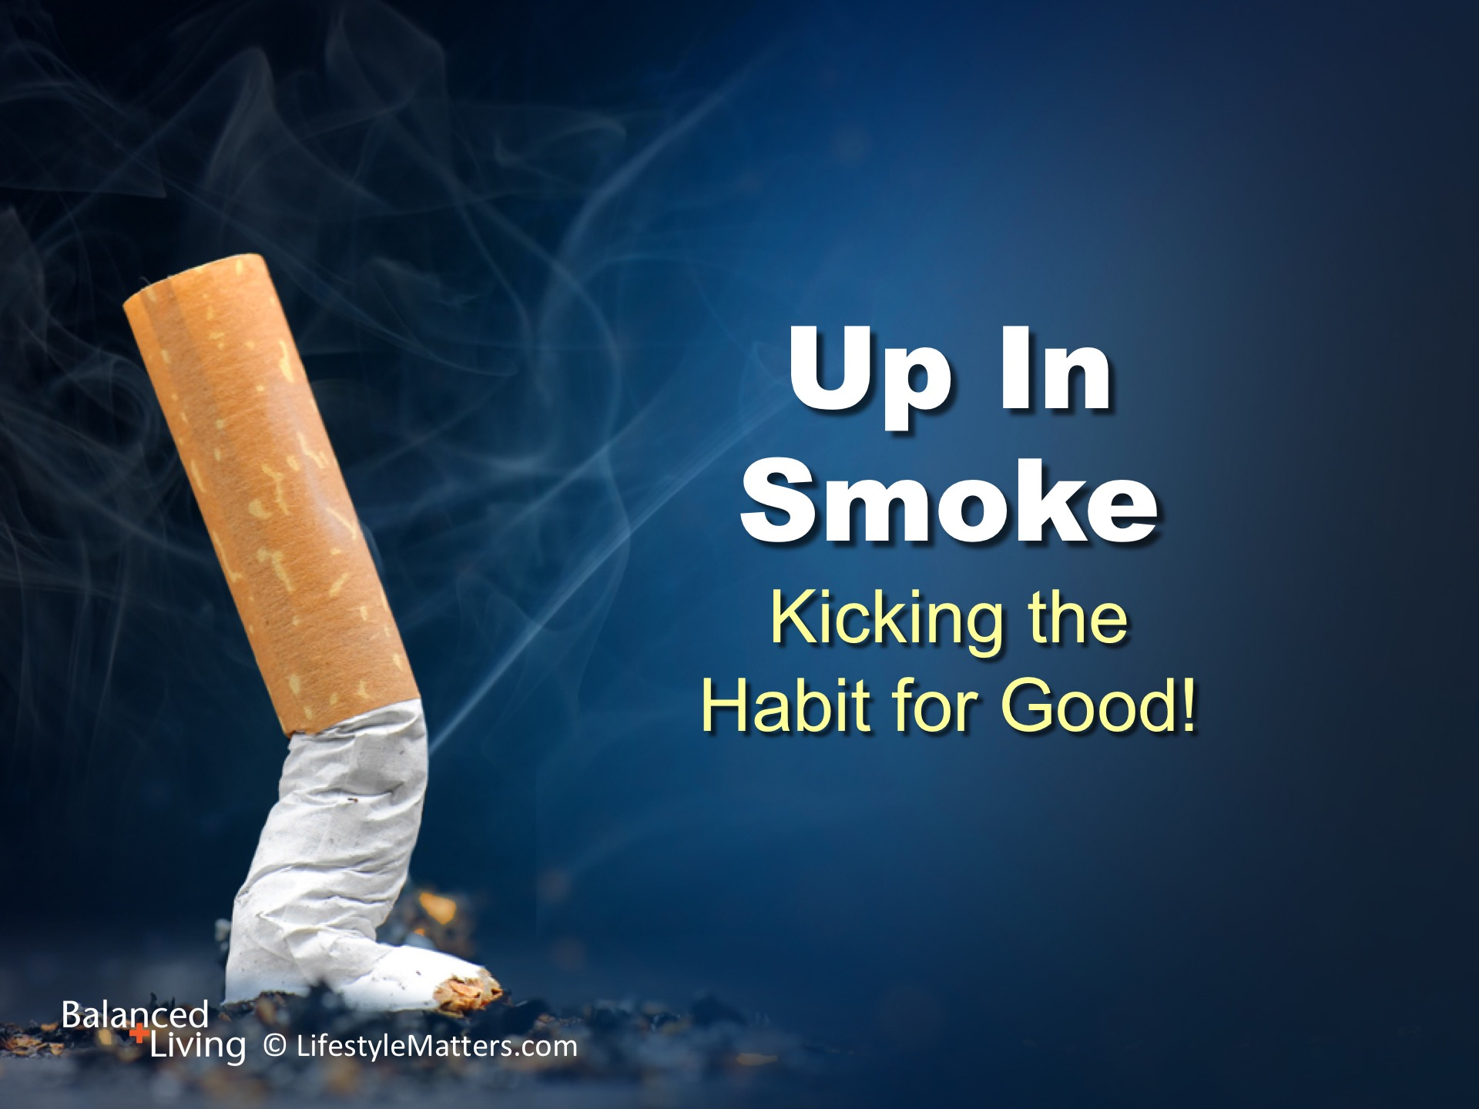
Notes:
Presenter: Please read and study the tract that accompanies this PowerPoint to prepare for this presentation.
Read slide. Are you thinking about quitting smoking, or wondering how to help someone you know who wants to quit?
Every quitter starts in the same place: “How do I stop smoking? Where do I begin?
In this presentation we will cover the basics: practical lifestyle steps; the brain/body connection; and building spiritual, mental, and emotional strength to stay free.

Slide 4
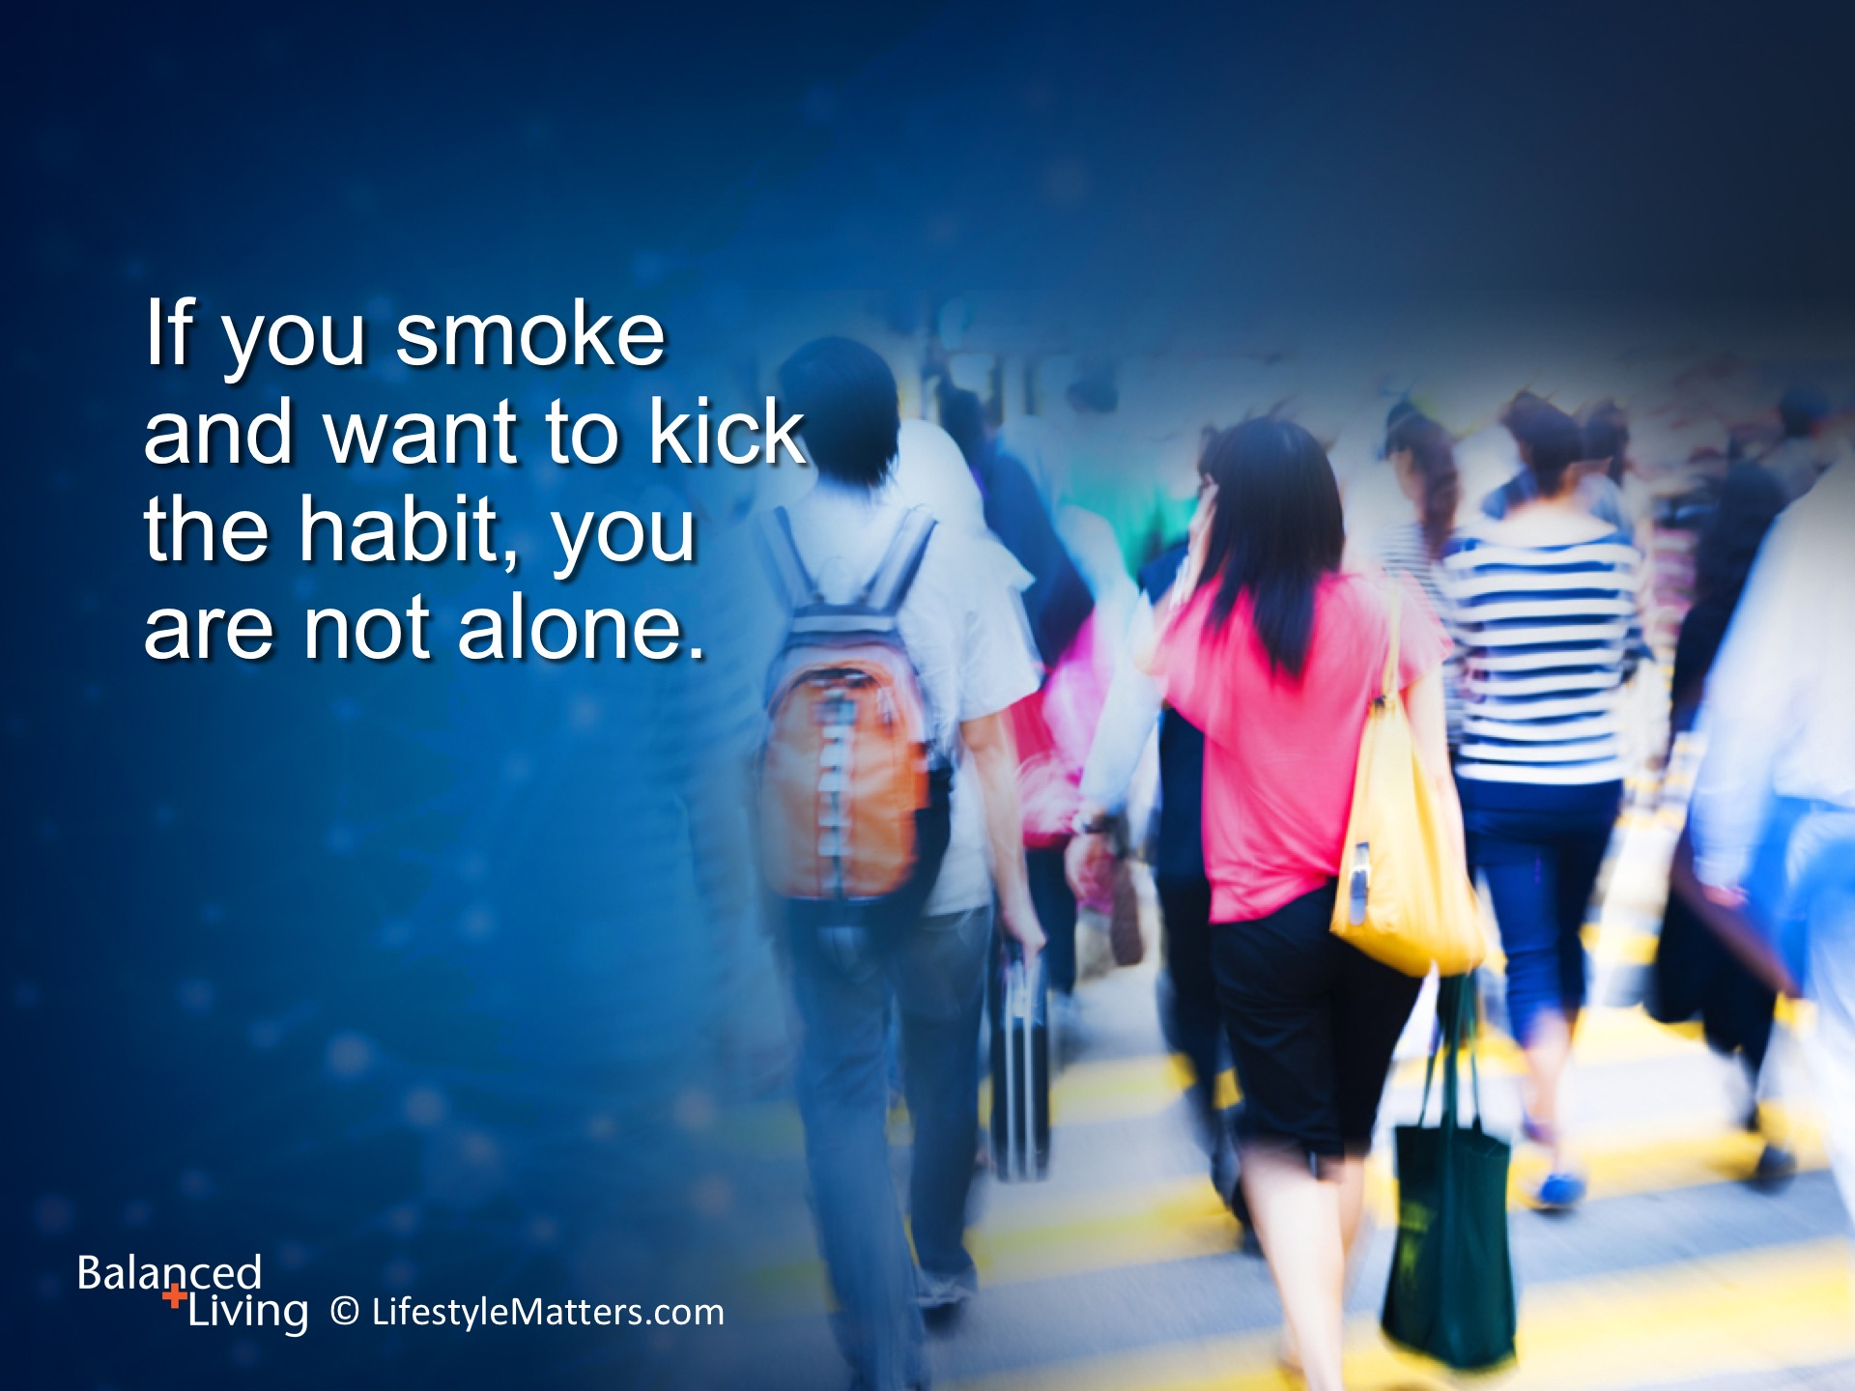
Notes:
Read slide.
What are some reasons a person might want to quit smoking? (wait for response)
It is good to quit—for better health; better quality and length of life; for your pocketbook; your influence; and your peace of mind.
(Note: A pack a day costs about $1,500 a year)
Quitting smoking is beneficial at any age and no matter how long you have smoked.

Slide 5
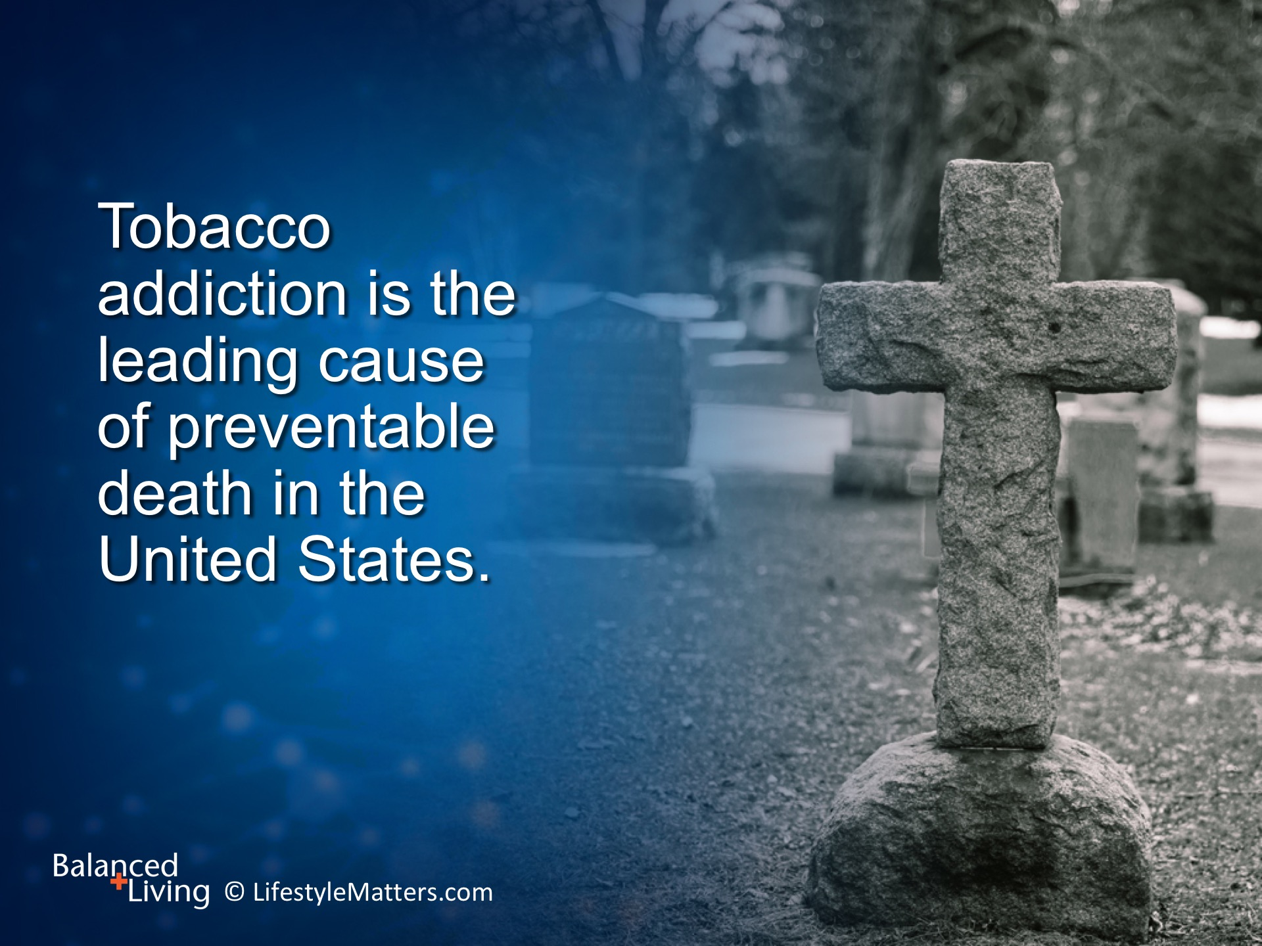
Notes:
Read slide.
Tobacco addiction kills 480,000 people each year, or about 1,300 every day.
That’s like 4 Boeing 747 airplanes crashing each day. (Boeing 747 holds 336 passengers.)
That is double the death toll for AIDS, car crashes, illegal drugs, murders, and suicides combined.
(Source: https://www.tobaccofreekids.org/facts_issues/toll_us/California)

Slide 6
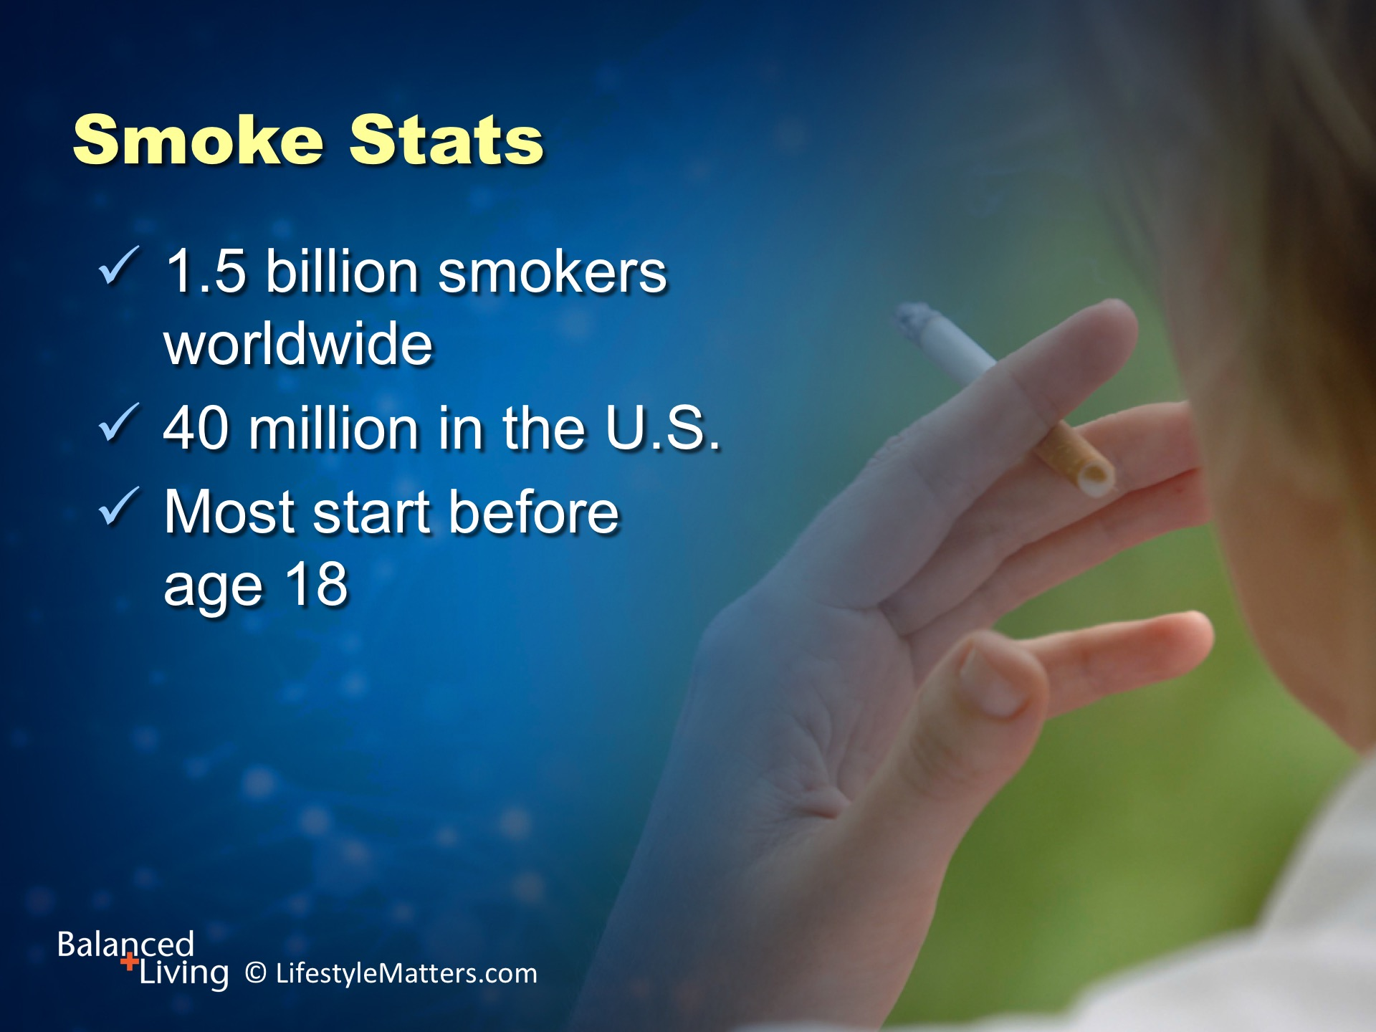
Notes:
Read slide.
In the US, 2 out of 10 adults (20%) that are 25-44 years old smoke.
These numbers do not include marijuana smokers, which are rapidly trending up in the U.S.
(https://www.cdc.gov/tobacco/data_statistics/fact_sheets/adult_data/cig_smoking/_)

Slide 7
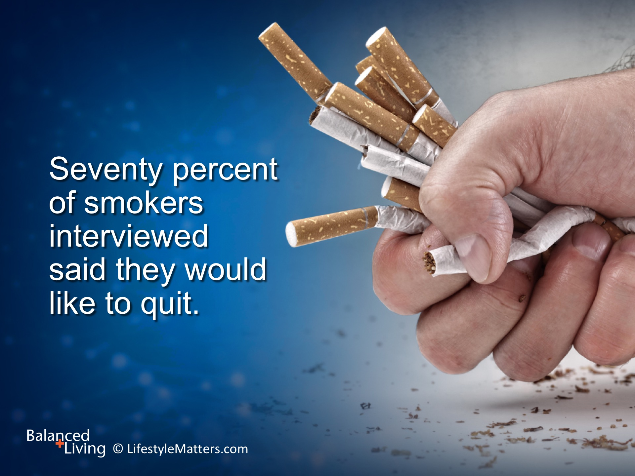
Notes:
Read slide.
Out of the 7 in 10 smokers that expressed a desire to quit, 4 in 10 made a recent attempt.
Thousands of people successfully kick the habit each year, and you can be one of them.
Taking part in a smoking cessation program dramatically increases the likelihood of long-term success.
(Source: U.S. Department of Health and Human Services survey, 2011)

Slide 8
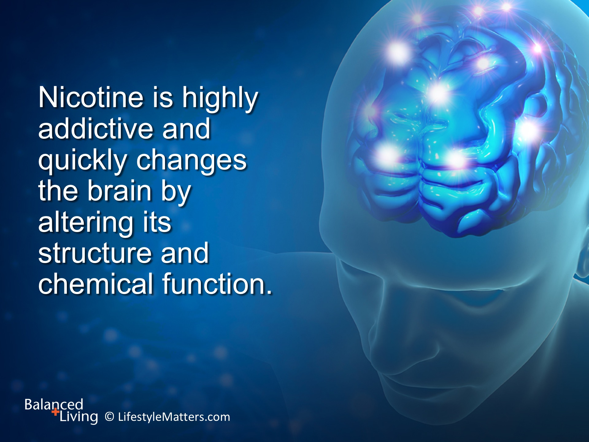
Notes:
Why can it be so hard to quit? Read slide.
The initial drug effects include elevated stress hormones and dopamine, which work together to increase energy and produce a quick “lift.”
Nicotine is highly addictive and quickly changes the brain by altering neurotransmitter function, especially dopamine.
Dopamine is linked to feelings of joy and happiness as well as learning and motivation.
When nicotine is stopped, it leaves the system within 30 hours of the last dose.
But dopamine circuitry is altered due to addiction, so normal activities don’t kindle the same pleasant feelings.
Because brain chemistry takes time to return to normal, relapse can occur.

Slide 9
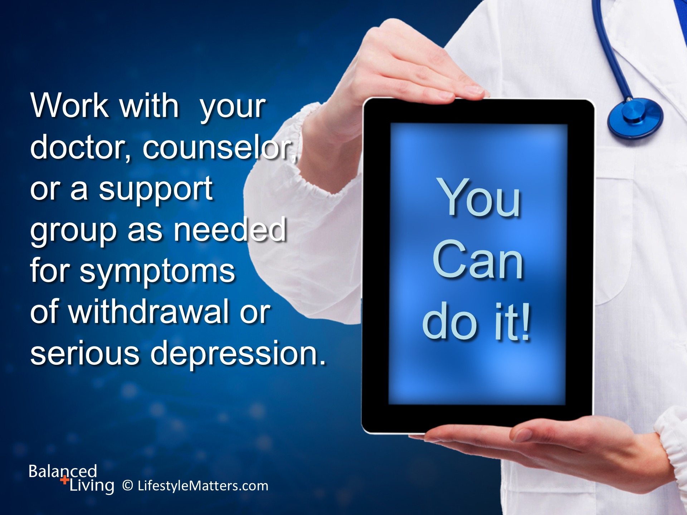
Notes:
Read slide.

Slide 10
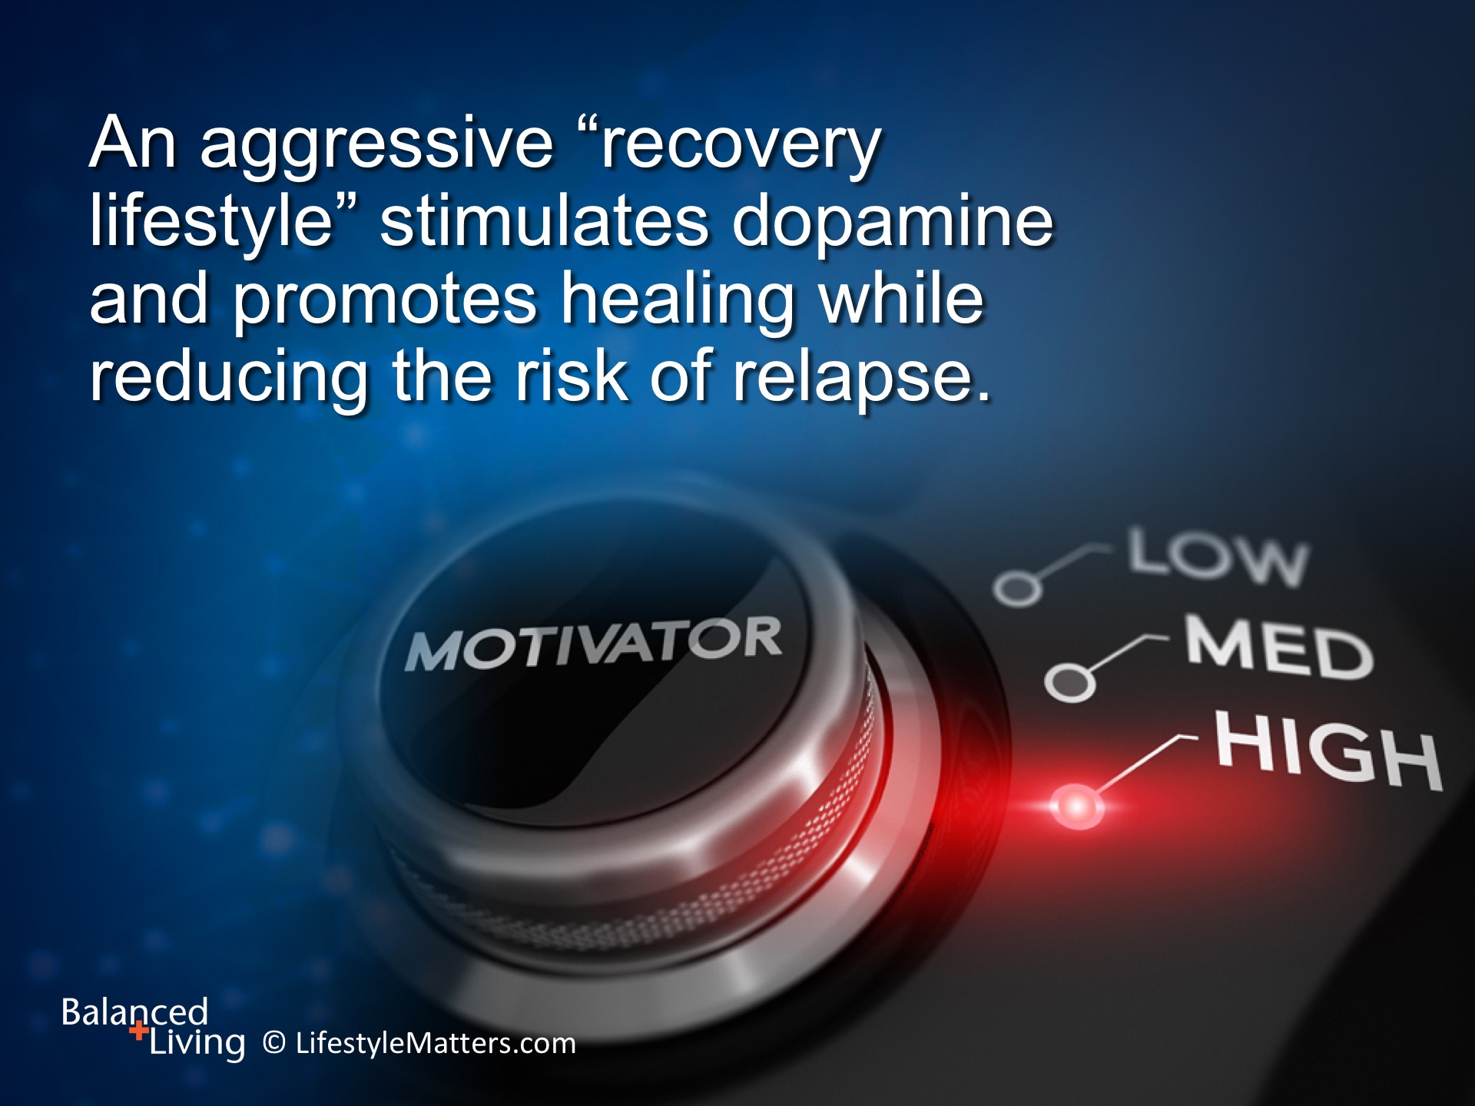
Notes:
The good news is that: Read slide.
Addictions roots are physical, genetic, environmental, emotional, and spiritual.
God knows all about the tangled roots of addiction.
He knows your story and what lies at the root of your addiction. He is personally acquainted with your history, needs, and longings.
Psalm 139:3 says: “You keep watch over my steps…and have knowledge of all my ways.”
A strong spiritual experience with God will give you power in overcoming addiction.

Slide 11
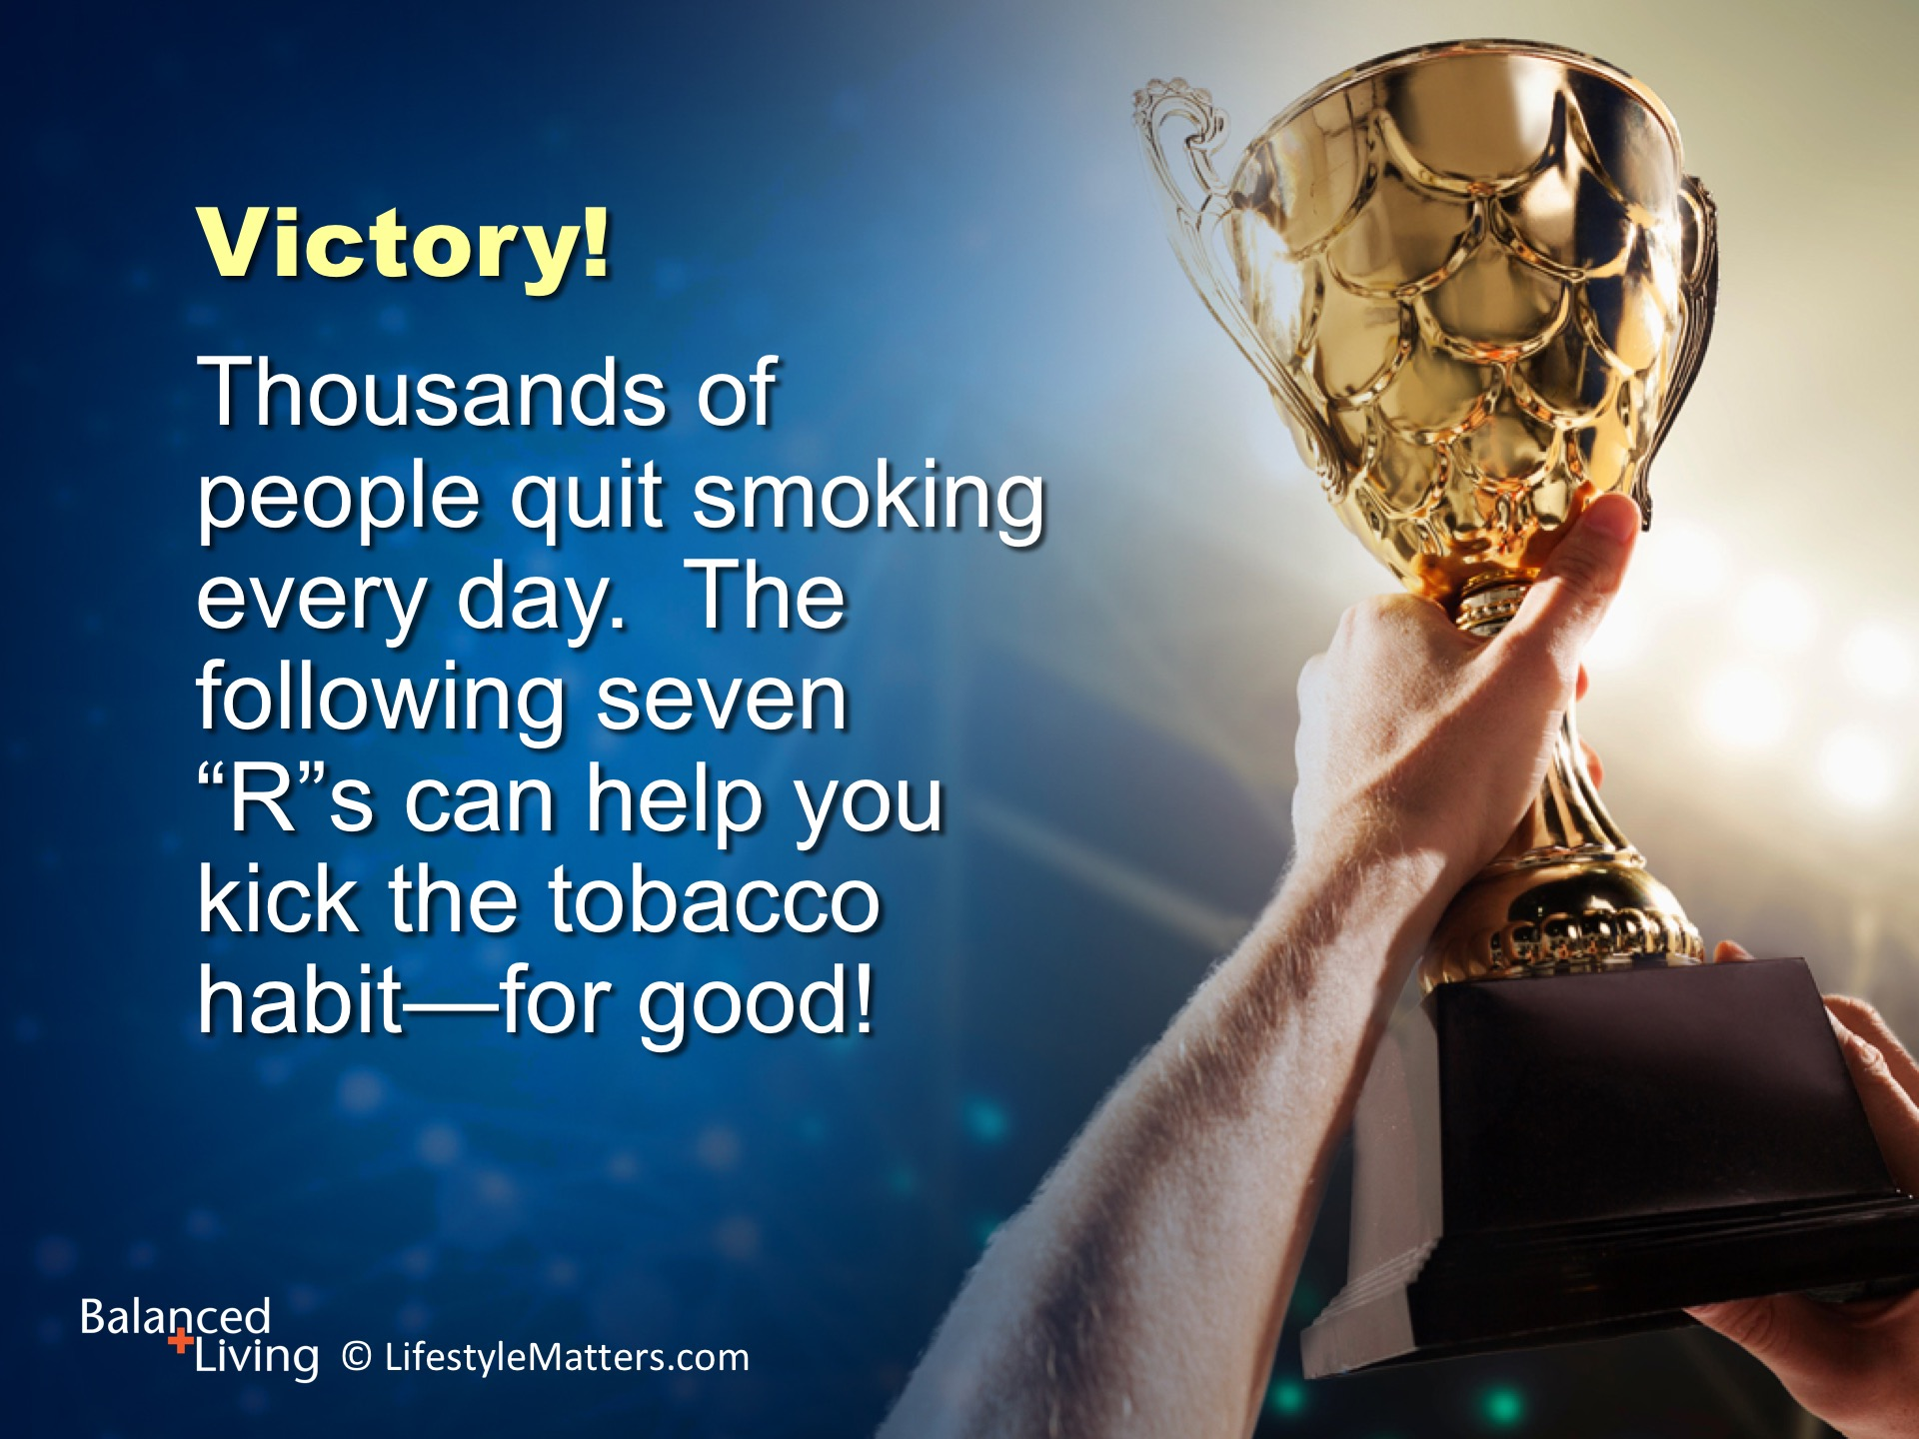
Notes:
Read slide.
God made our brains—what we learn, we can unlearn. The brain can and does recover!
God knows what needs healing. He wants you live free on the inside, in your mind—and free from nicotine and all addictions.
Overcoming an addiction is not just about “stopping.” It’s about “adding.” And that’s what the 7 “R”s are about.
Let’s take a closer look: (Next slide)

Slide 12
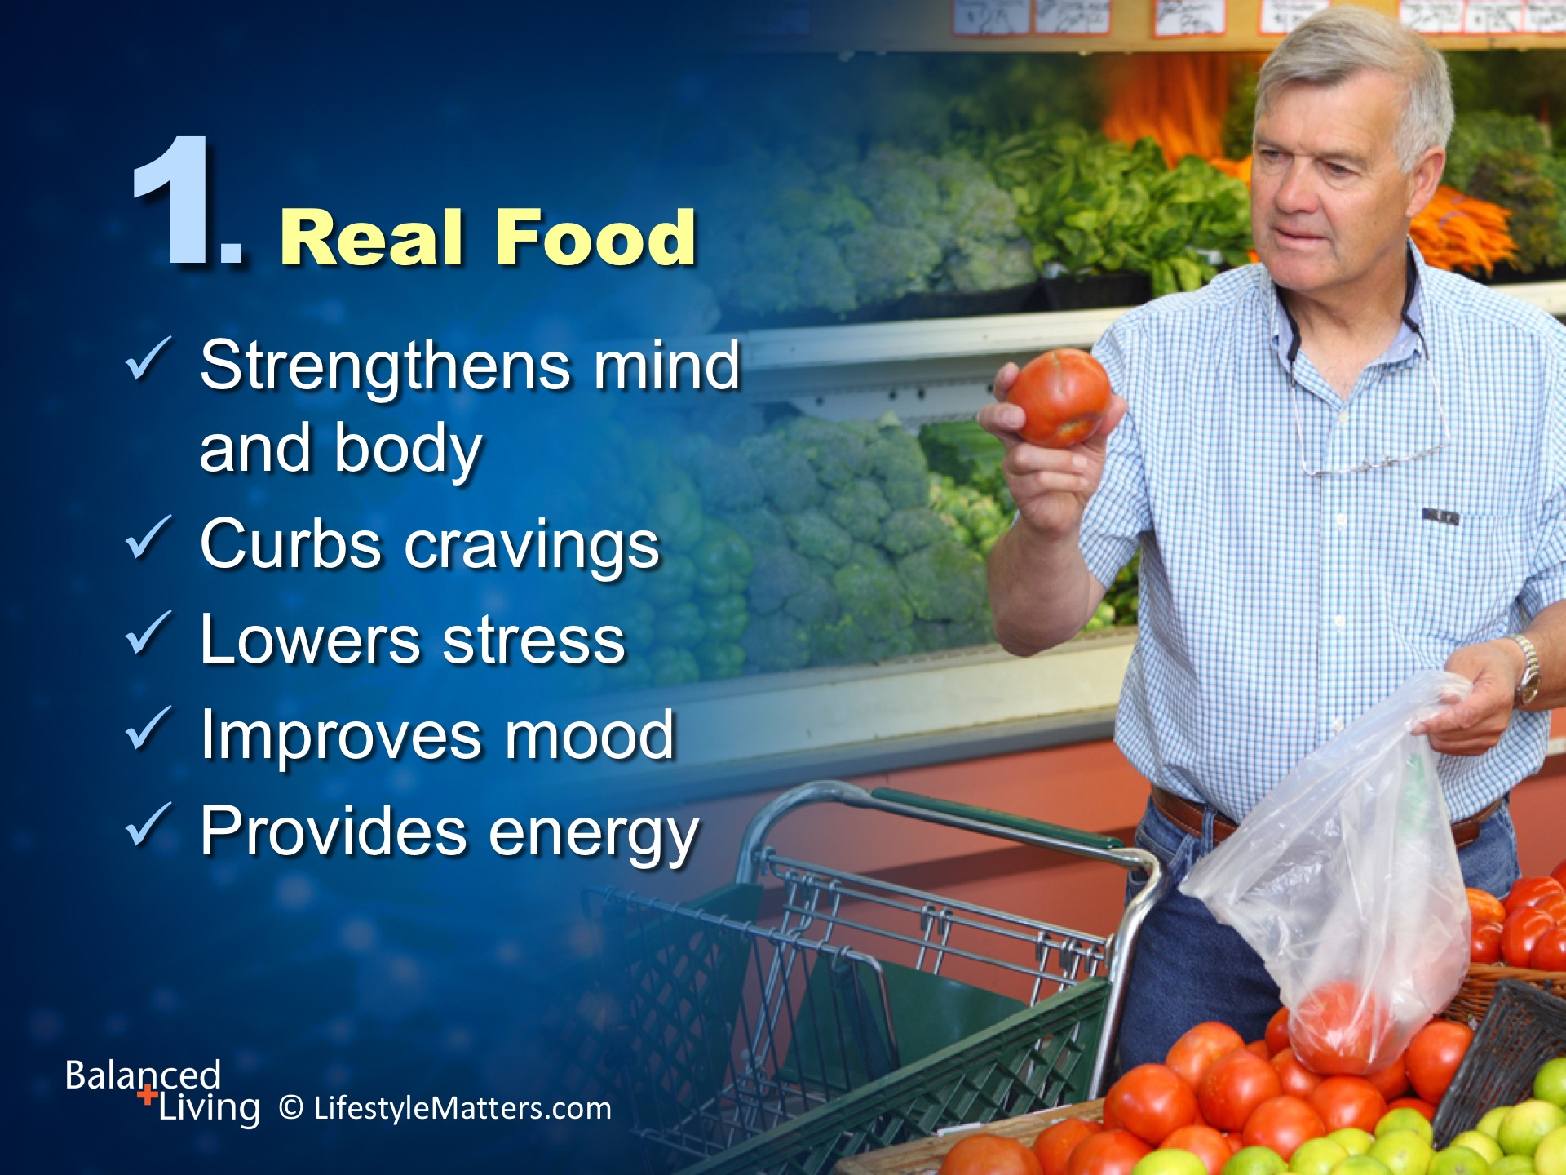
Notes:
Nourishing food strengthens both the body and the brain. Read slide.
Plant foods are rich in antioxidants and nutrients that repair cellular damage and improve circulation.
What would be some benefits of better blood, oxygen, and nutrient circulation in the brain? (Wait for response)
(Note: More energy, better problem-solving and learning, better mood, less anxiety and depression, more creative processes activated, which are a source of pleasure)

Slide 13
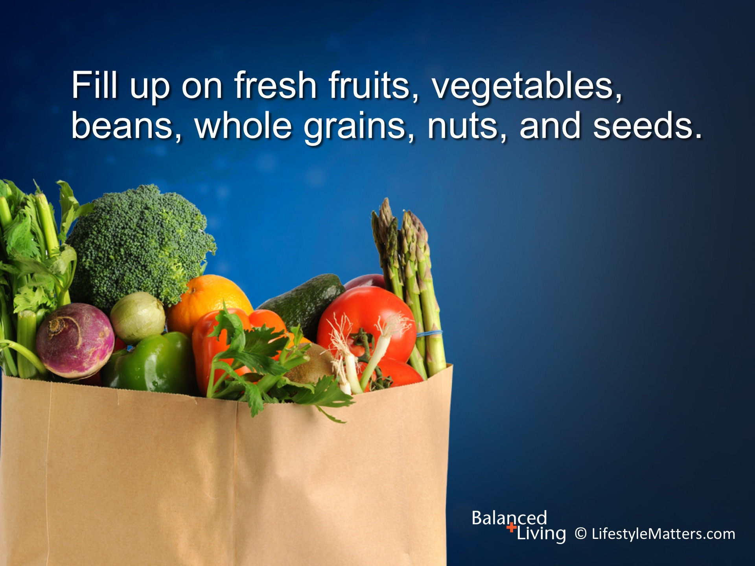
Notes:
Read slide.
These foods lower stress, cut cravings for sugar and stimulants (tobacco and caffeine are stimulants), and improve mental function and mood.
Better brain health means better mental processing for solving problems and keeping stress under control!
What are some ways to add more of these foods to breakfast? Midday meal? Third, lighter meal? (Wait for response)

Slide 14
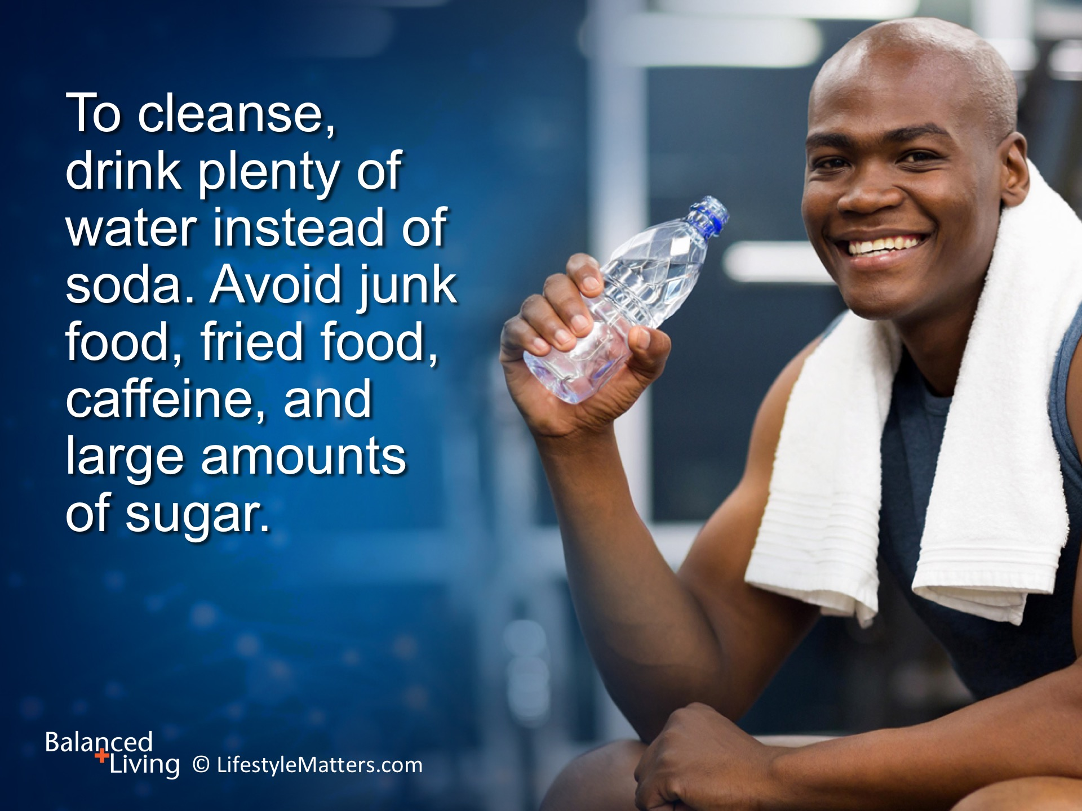
Notes:
Read slide.
Often nicotine craving is triggered by other substances such as alcohol and caffeine.
Nicotine, alcohol, and caffeine are called the “bad habit trio” because they reinforce each other.
Avoiding caffeine and alcohol will give greater success in helping to reduce cravings.
High fiber meals supply energy and calm and help break the “terrible trio” of addiction.
Delicious, filling, energy-producing high fiber foods help reduce snacking and control weight.
When you eat better, you will feel better and have the energy to make better choices.

Slide 15
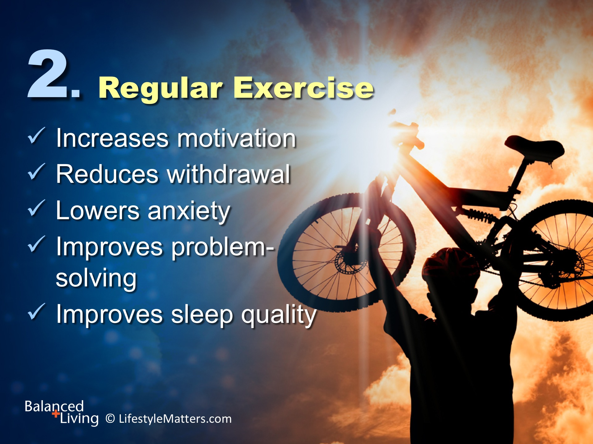
Notes:
Exercise reduces the desire to smoke, and much more: Read slide.
Exercise increases dopamine and other chemicals in the brain linked to feeling good, increasing motivation, and prompting better choices.
Exercise lowers stress, depression, and anxiety; it improves mood, well-being, and mental processing; it also increases learning power.
Exercise reduces withdrawal symptoms and the desire to smoke.
Exercise improves recovery and reduces the risk of gaining weight.
Take a brisk ten minute walk after each meal to give you energy and help curb tobacco cravings.
(Sources: Ratey J. User¹s Guide to the Brain (New York, NY: Vintage Books, 2002).
Effect of a short bout of exercise on tobacco withdrawal symptoms and desire to smoke. Ussher M, et al. Outcomes Management 2001:157(4)66-72.
Perceived stress, quitting smoking, and smoking relapse. Cohen S, Lichtenstein E. Health Psychol 1990:9(4)466-78.
Ratey J. User¹s Guide to the Brain; Effect of a short bout of exercise on tobacco withdrawal symptoms and desire to smoke. Ussher M, et al. Outcomes Management 2001:157(4)66-72.)

Slide 16
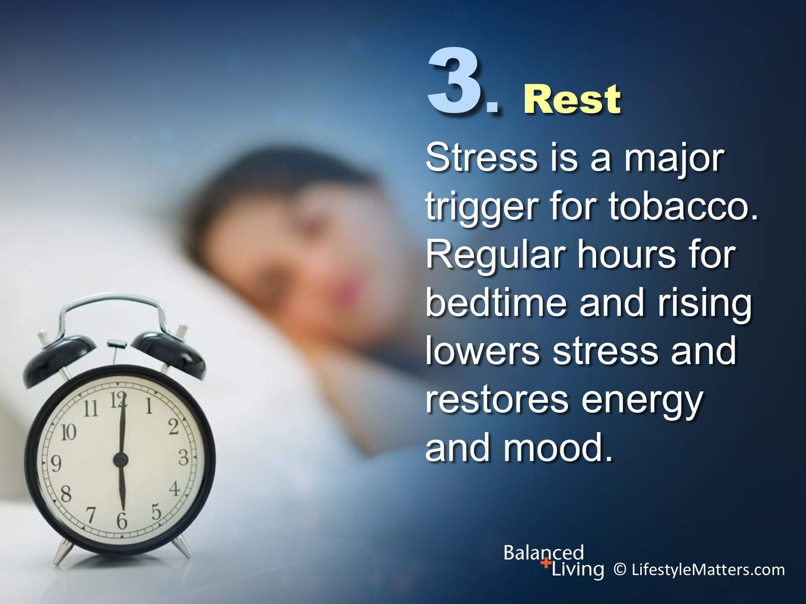
Notes:
Read slide.
Regular sleep restores the brain, reinforces memory, and hits the “reset” button for each new day you face.
Taking time for mental and physical rest is a major weapon against relapse.
Enjoy calming activities in the evening —not “numbing activities” like hours in front of the screen which increase stress, tension, and fatigue.
What are some positive “calming” activities? (Wait for a response)
(ie. Walk your dog; visit a neighbor; garden; woodworking; creative hobby such as painting or sketching)
Deep breathing or stretching exercises can calm the body and mind in the middle of a stressful day.

Slide 17
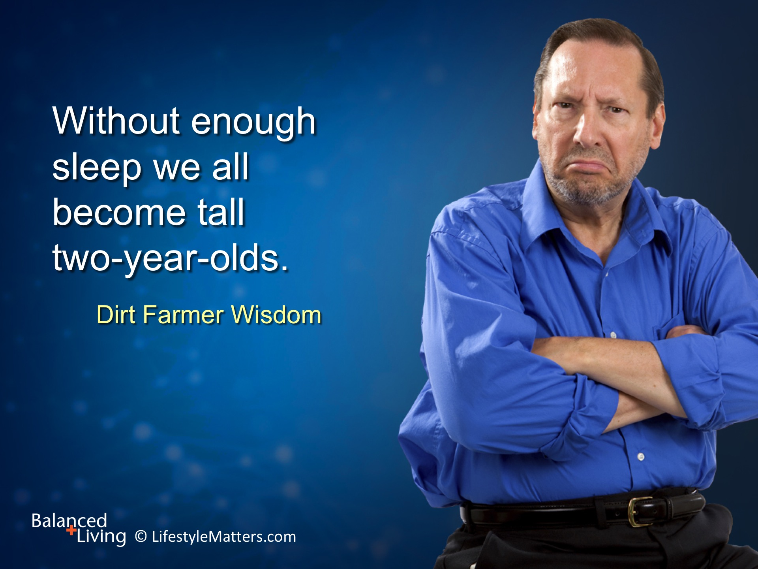
Notes:
Read slide.
HALT!
Take care to avoid getting overly Hungry, Angry or Anxious, Lonely, or Tired!

Slide 18
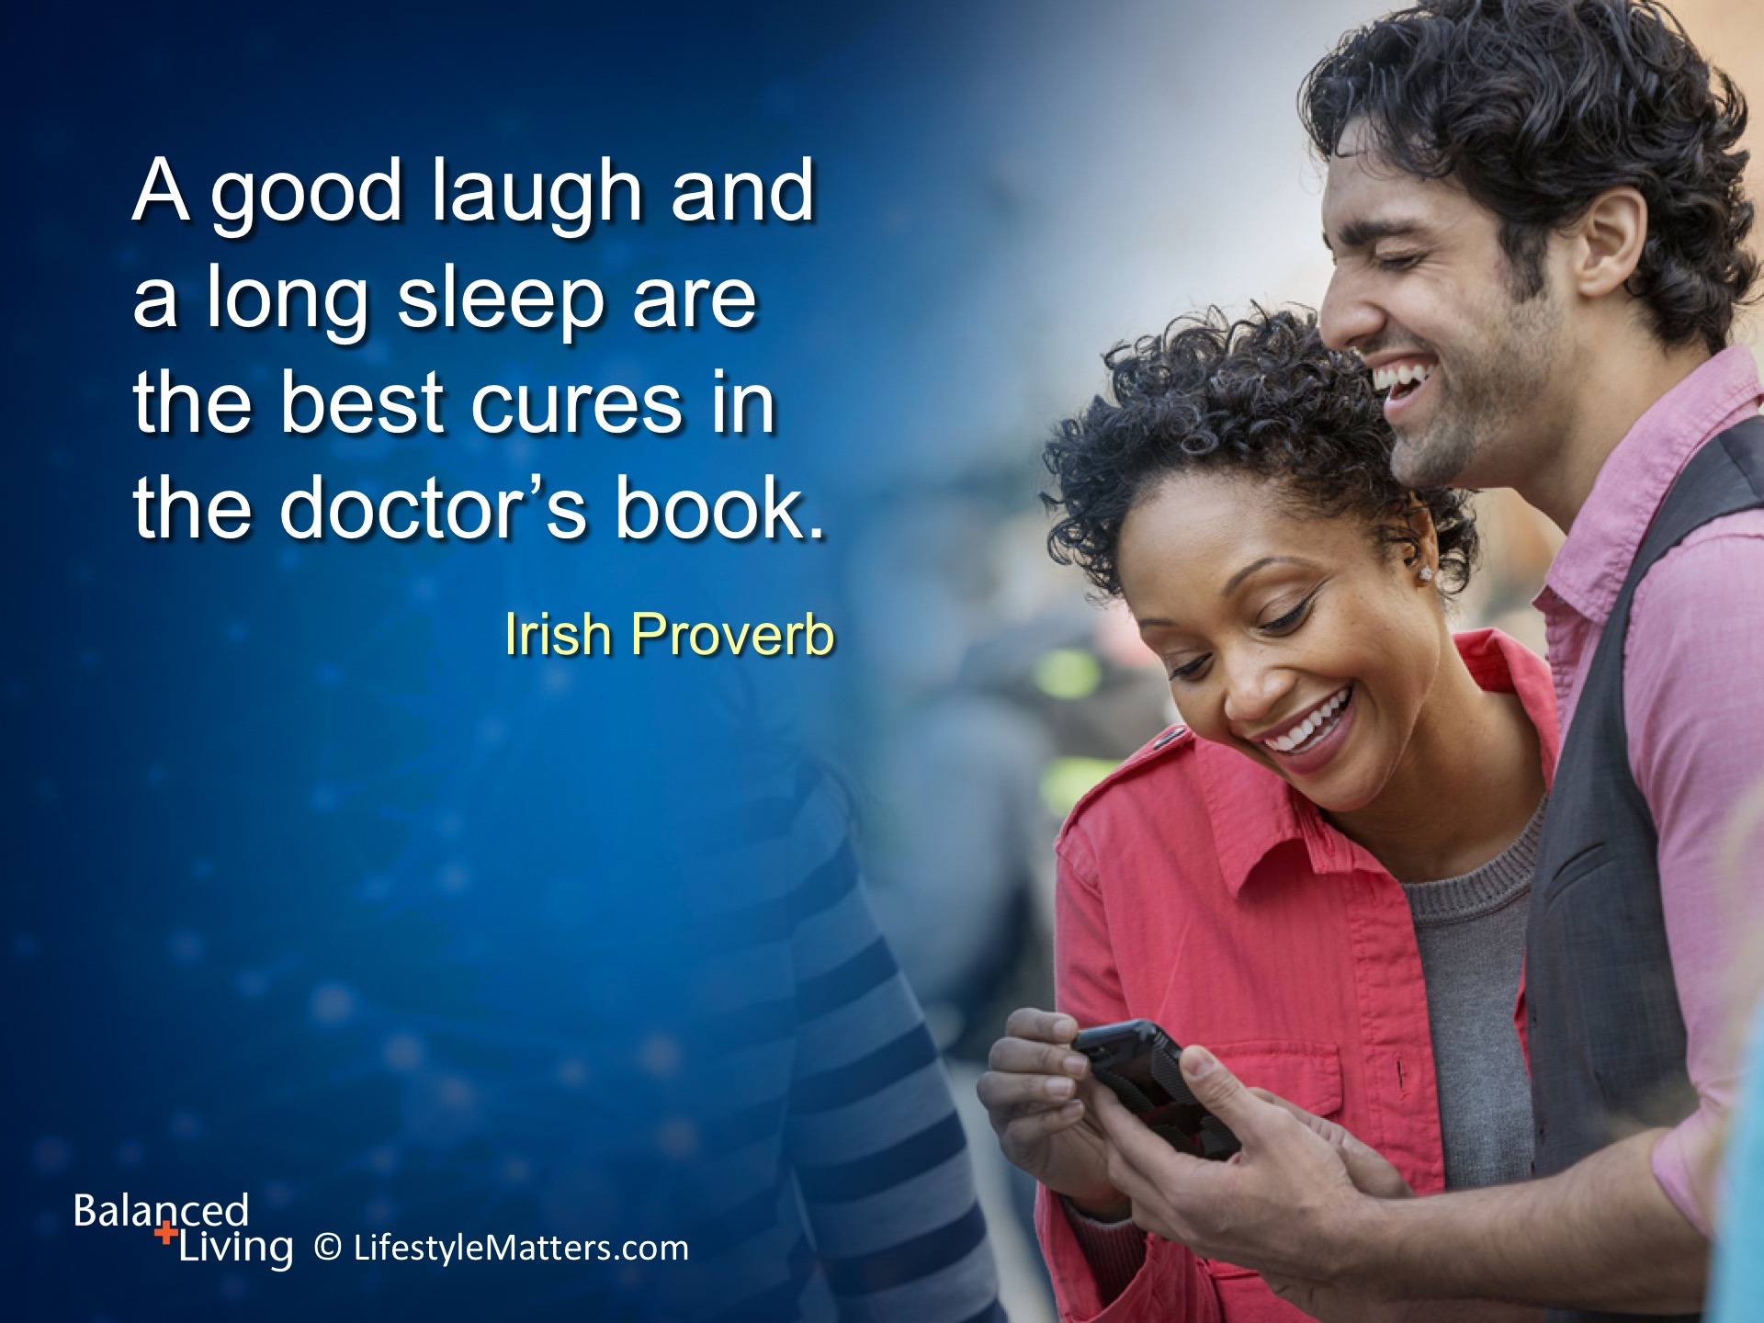
Notes:
Read slide.
A cheerful outlook, good sleep, and trust in God are powerful weapons against chronic negativity, discouragement, helplessness, and pessimism.

Slide 19
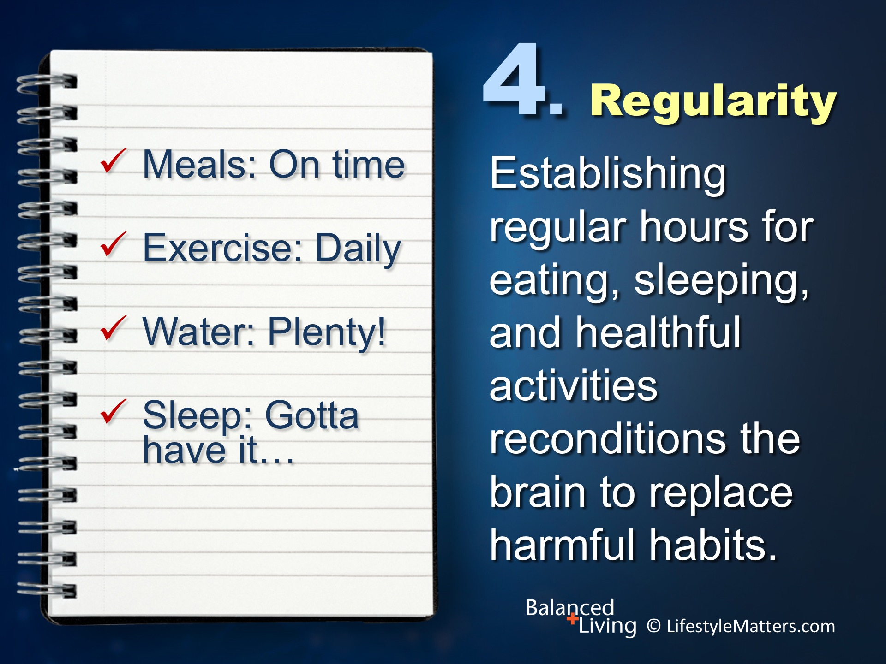
Notes:
Read slide.
We have seen the importance of regularity.
We can get overbooked, overbusy, and about to snap!
“Good” can be the enemy of “best.” Too much busy activity can crowd out the important priorities such as healthy meals, rest, face-to-face friendships, and exercise.
What area of your life needs more regularity?
What will be your first step in establishing more regularity in your life? (Wait for response)

Slide 20
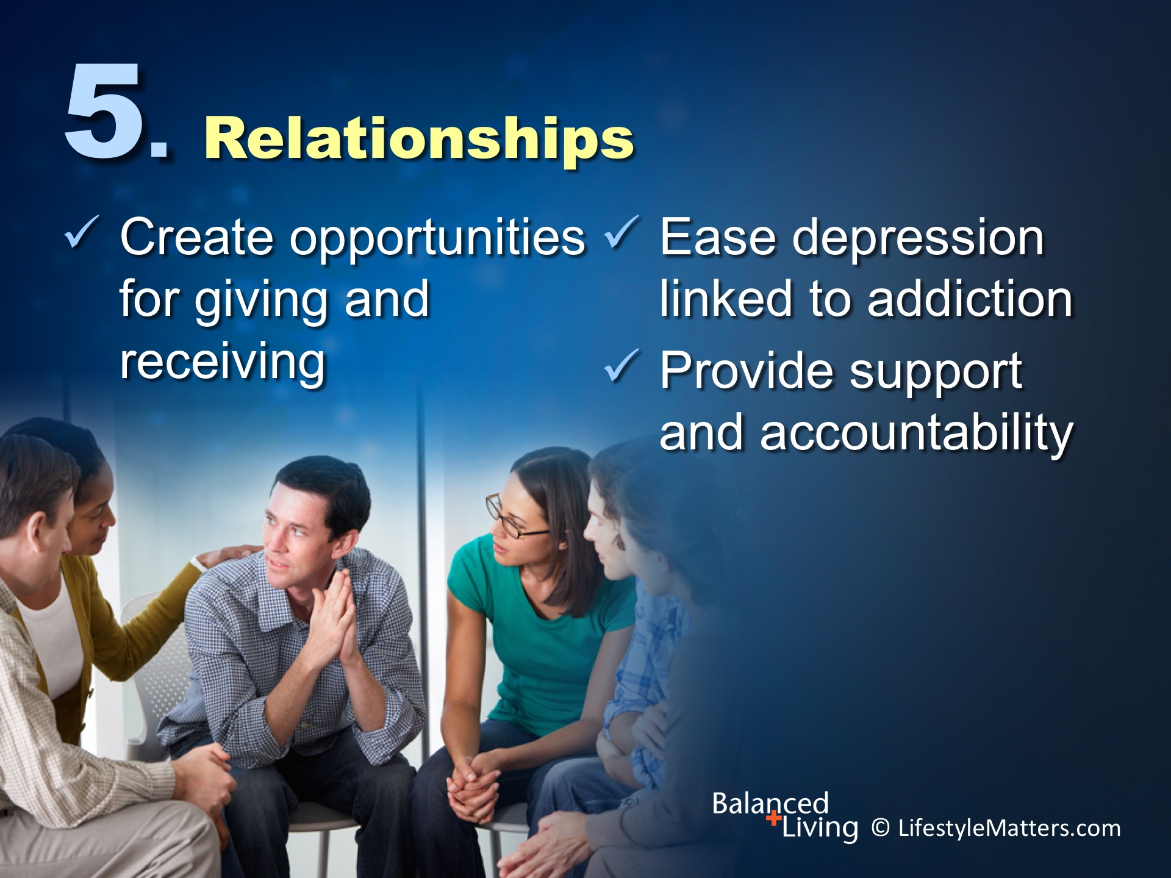
Notes:
We are wired for relationships.
You are created in His image, a relational being.
Addictions create a false relationship with the addiction that robs from true relationships.
Building healthy relationships helps: Read slide.
(Note: See 2 Corinthians 13:14. ASV. “The grace of the Lord Jesus Christ, and the love of God, and the communion of the Holy Spirit, be with you all.”)

Slide 21
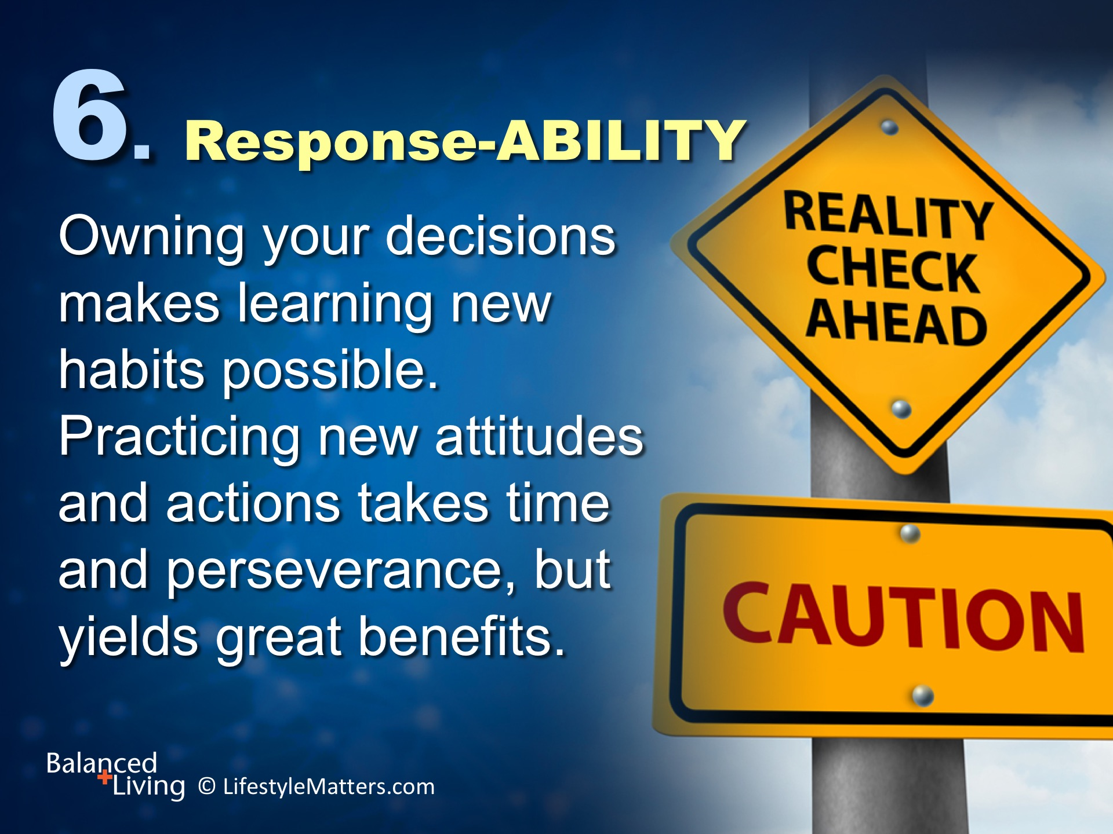
Notes:
Read slide.
God will give you the power to change. He is reaching out to you by His Spirit, through His Word, and through those who love and care for you.
Practicing new thinking, new choices, and new habits is your decision—and it’s a daily one for all of us!

Slide 22
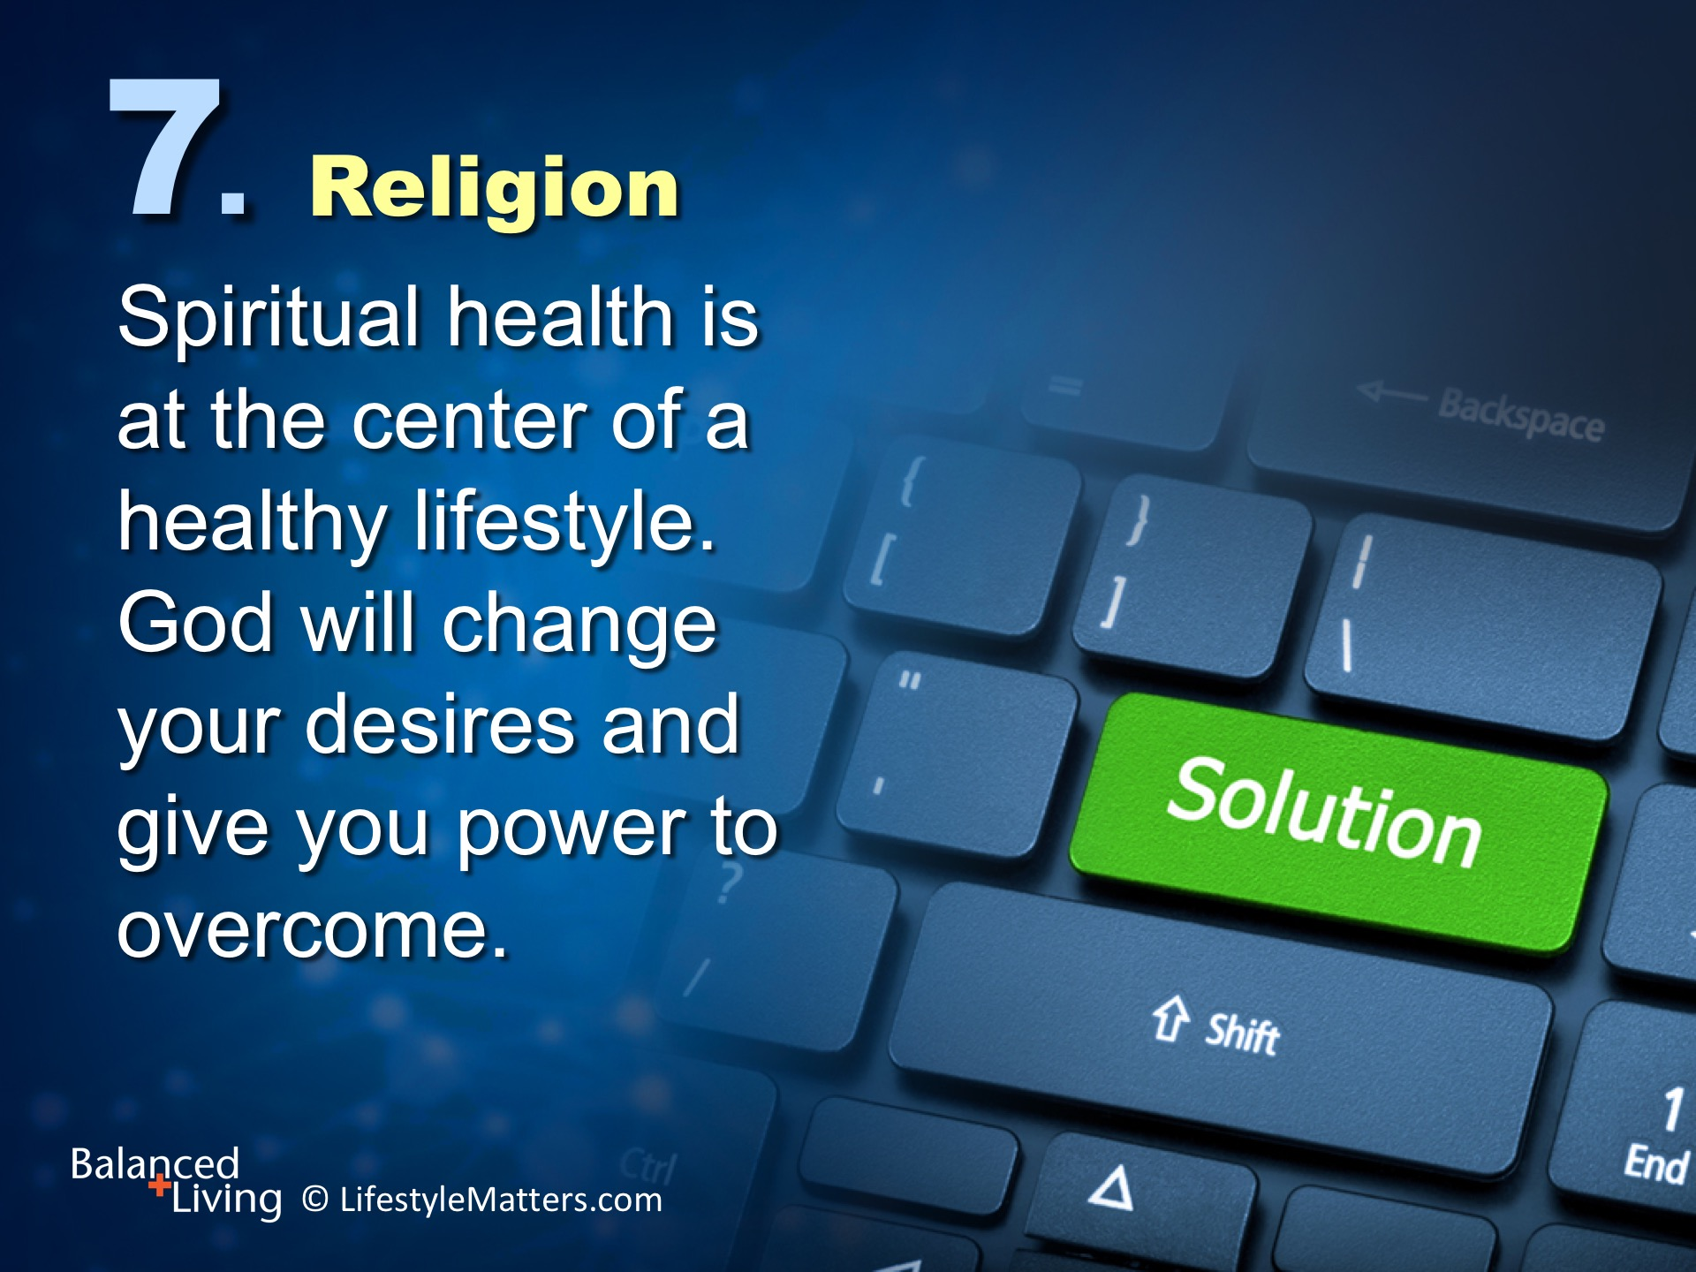
Notes:
Read slide.
Would you like power and wisdom for life’s journey?
Would you like to gain strength and even joy when facing challenges instead of being crushed by life’s pressures?
That is the kind of deep strength and inner freedom God wants to build in you and me.

Slide 23
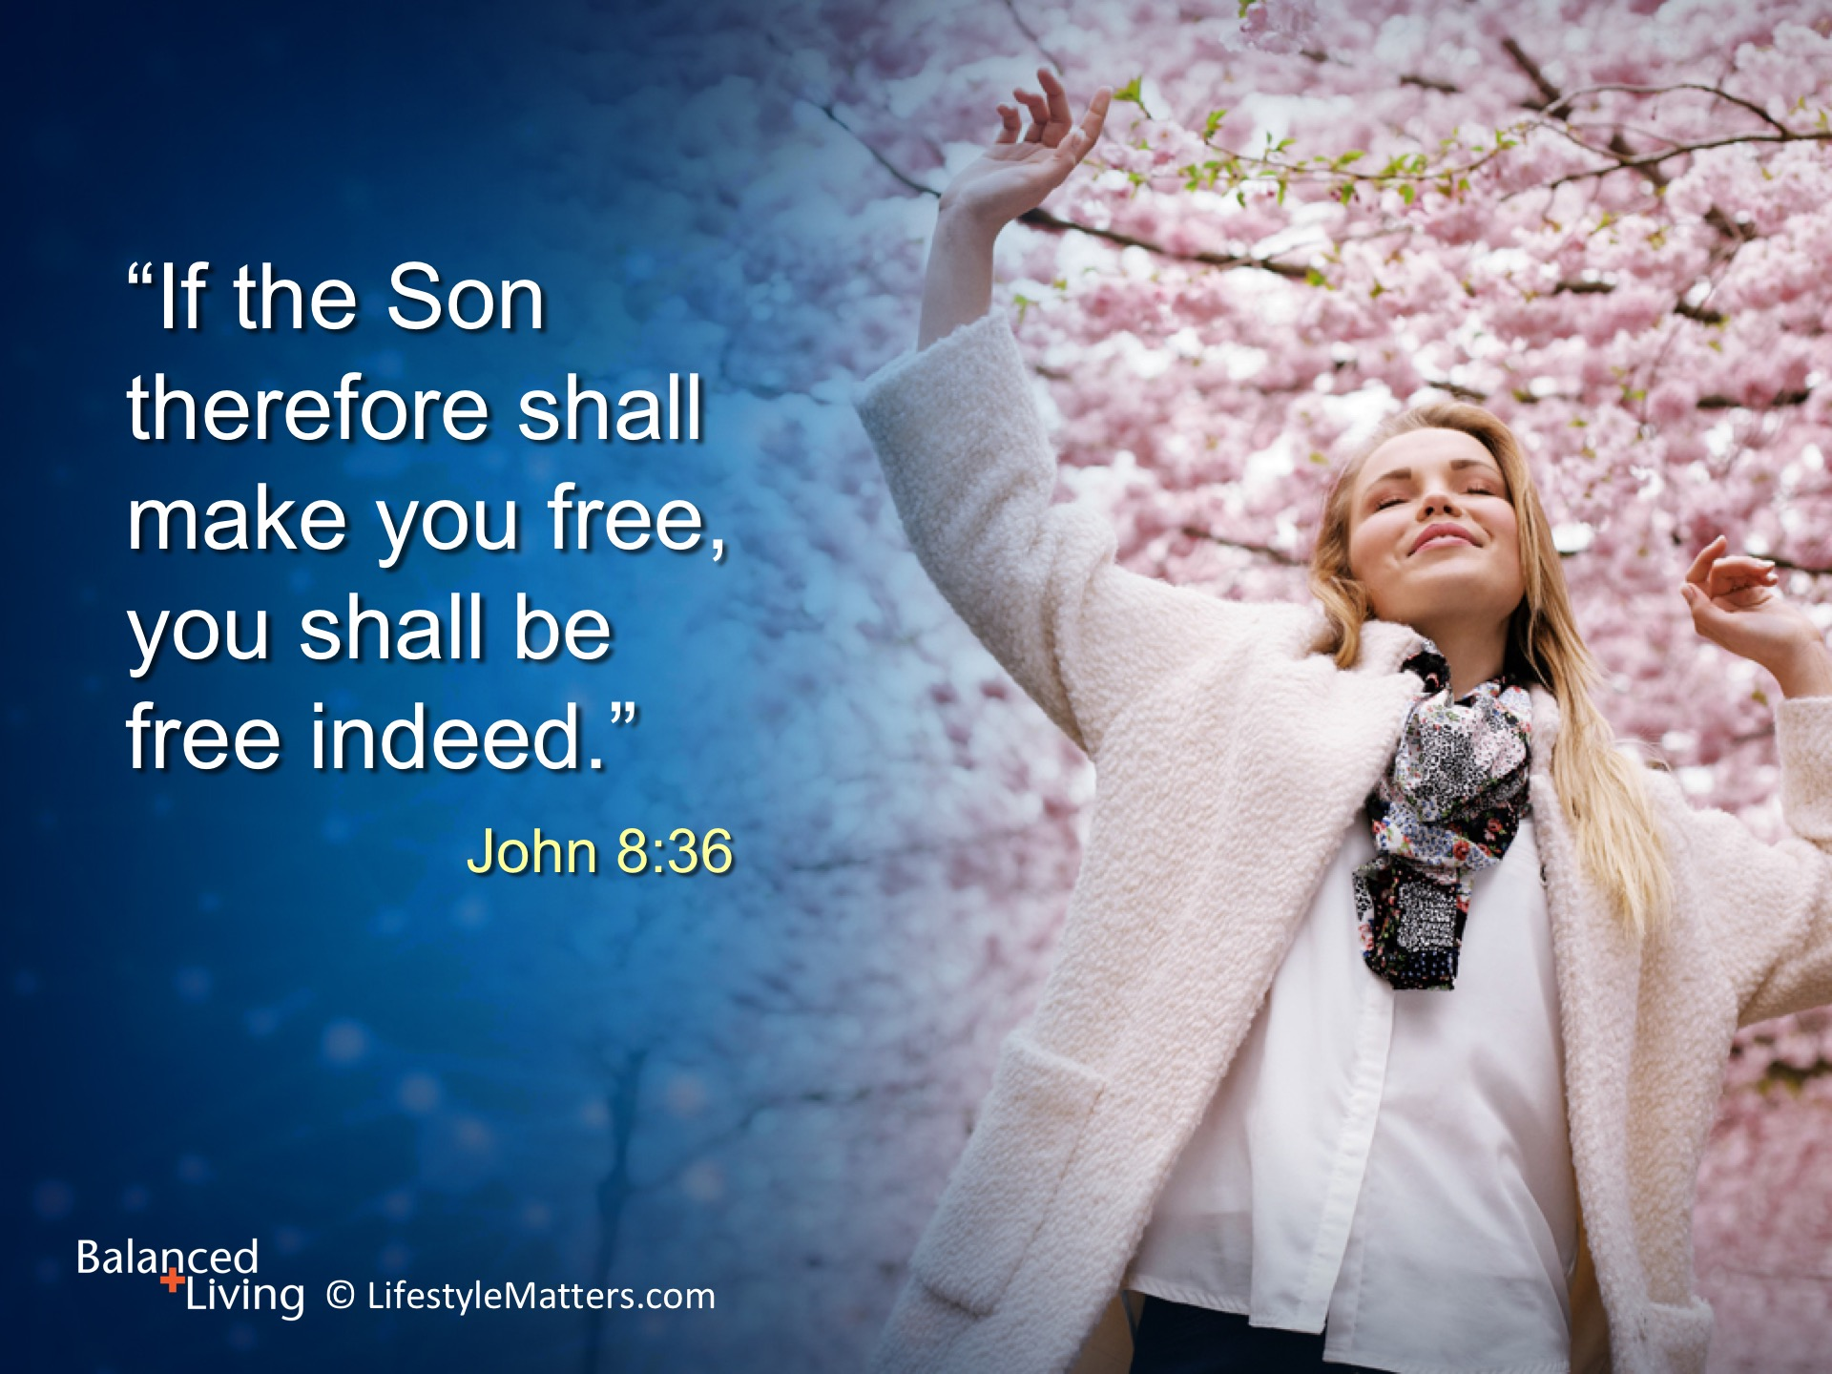
Notes:
Read slide.
Free. Free on the inside.
You were designed for joy, strength and freedom.
Free from depression, bitterness, anger, and addictions.
Free to learn, forgive, grow, and gain power over your life.
Do you want that freedom? (Wait for response)
That freedom can be yours by making the choice each day to allow God to work in your life one day at a time.

Slide 24
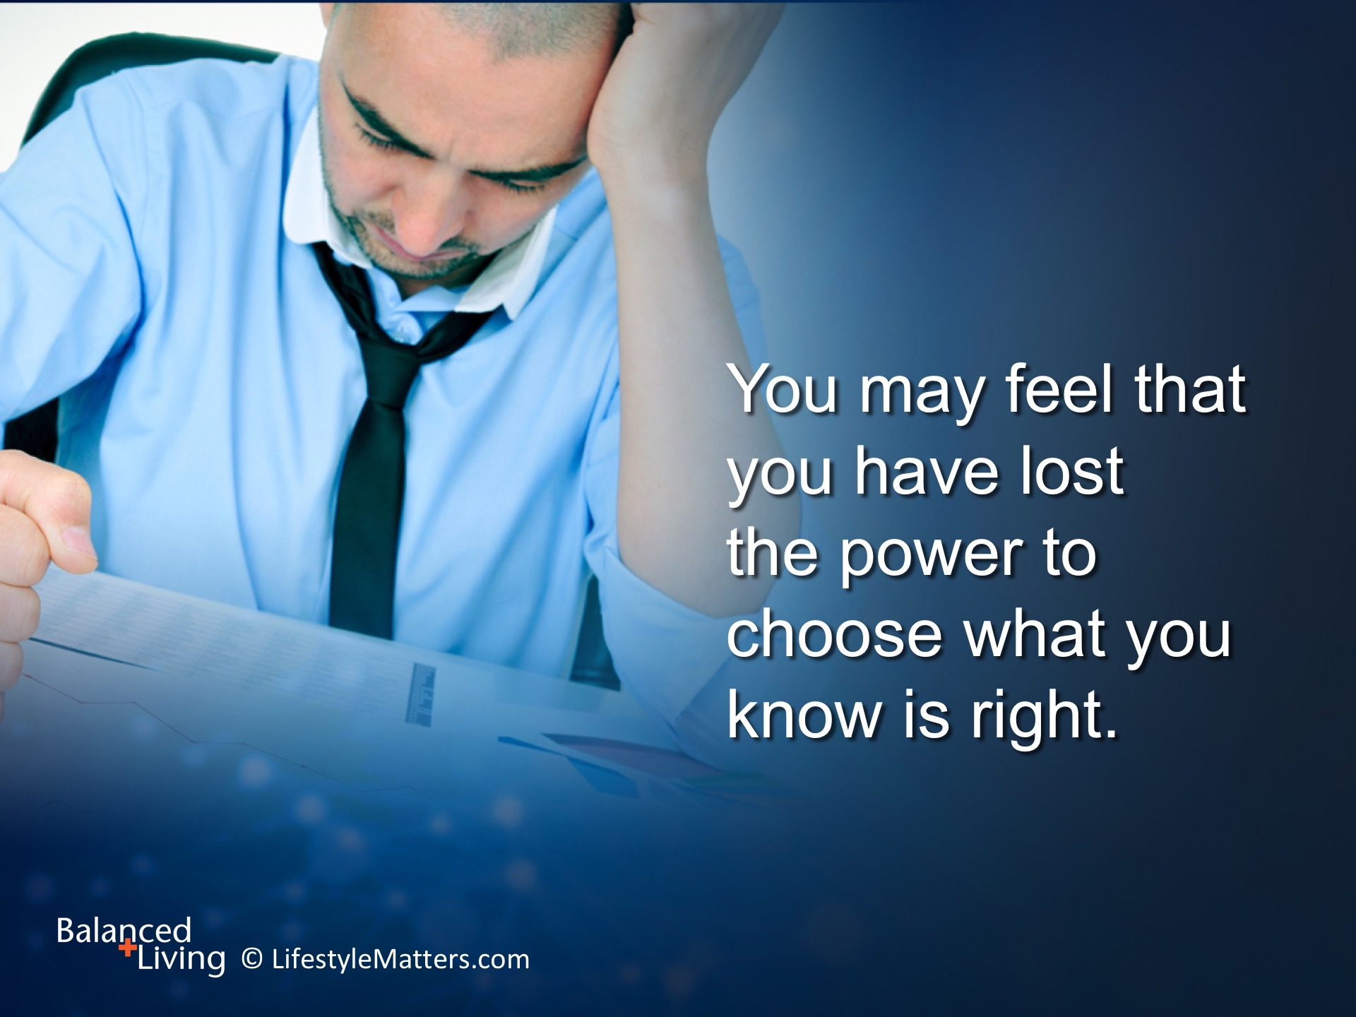
Notes:
Read slide.
We all know what this feels like.
We have all been there and are still in the process of moving toward greater freedom from sin.

Slide 25
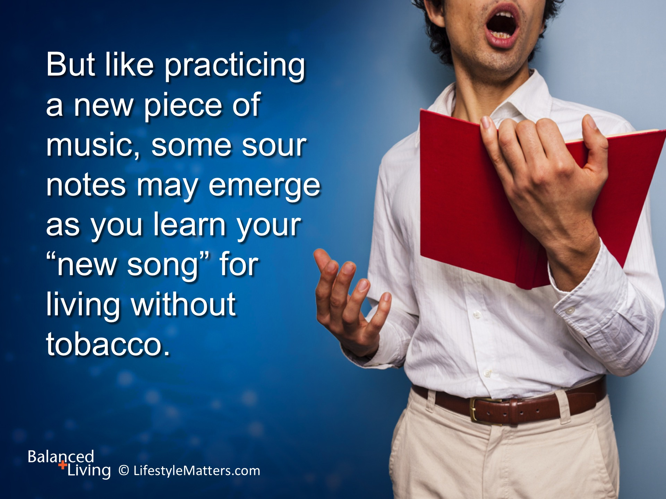
Notes:
Read slide.
Relapse can be part of the learning process.
When you slip and fall, you can get up again with even more strength and power.
God is with you and will be by your side each step of the day.
Each successful experience strengthens success. Focus on the successes that you achieve each day.

Slide 26
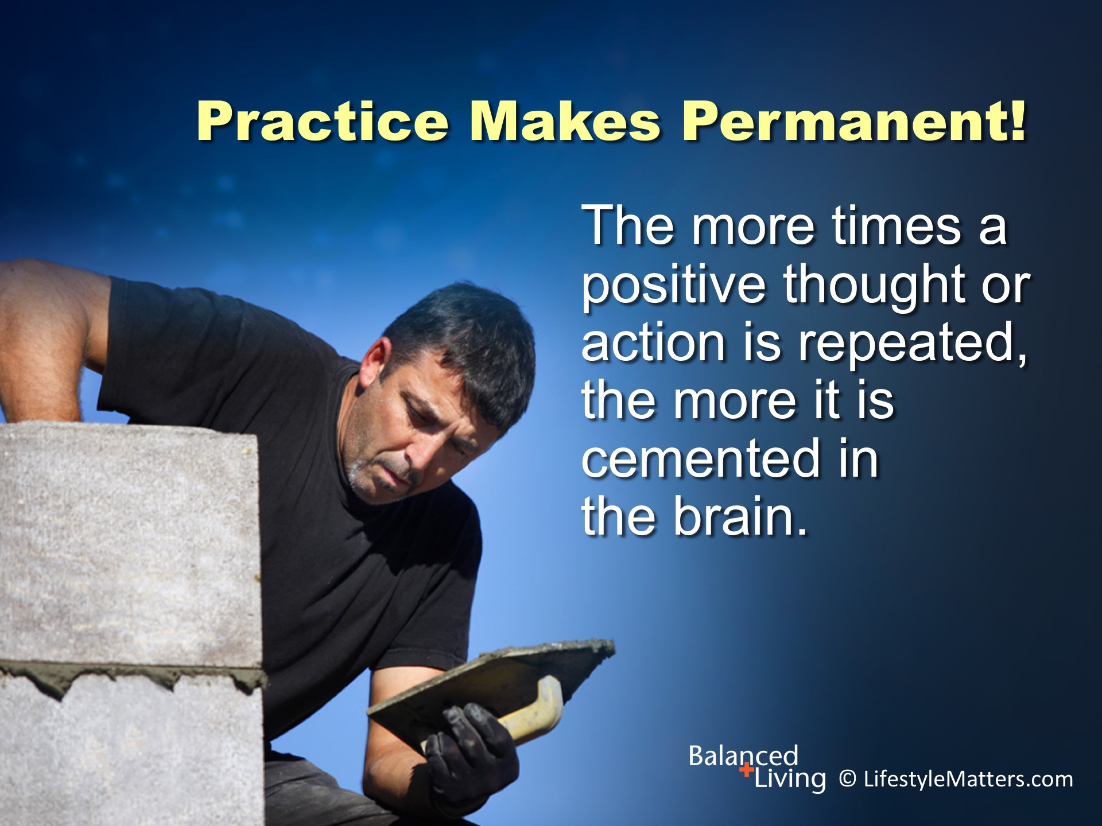
Notes:
Read slide.
When forming new habits, the good news is that “practice makes permanent”!
It gets easier and more automatic to make healthy choices.

Slide 27
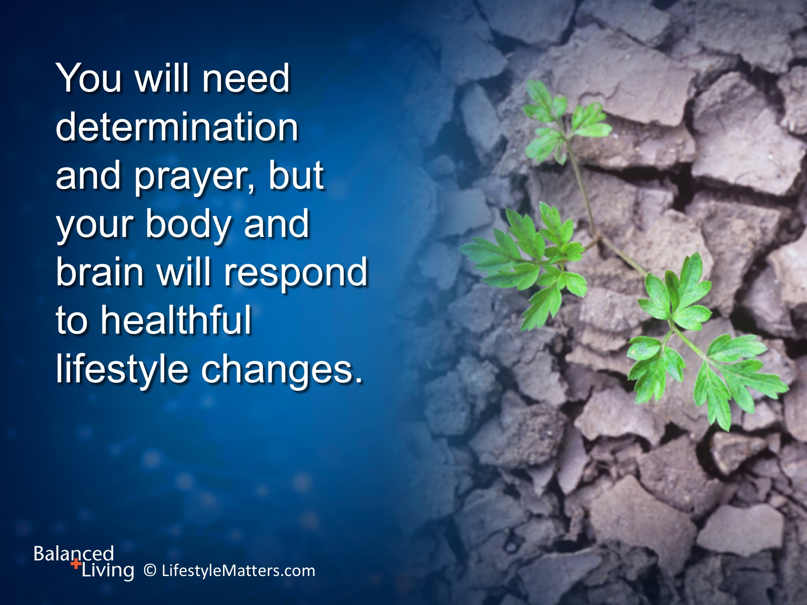
Notes:
Read slide.
God will renew your mind and help you through patient perseverance carve new brain maps of victory to replace old maps of defeat.
He designed you for renewal, recovery, and restoration.

Slide 28
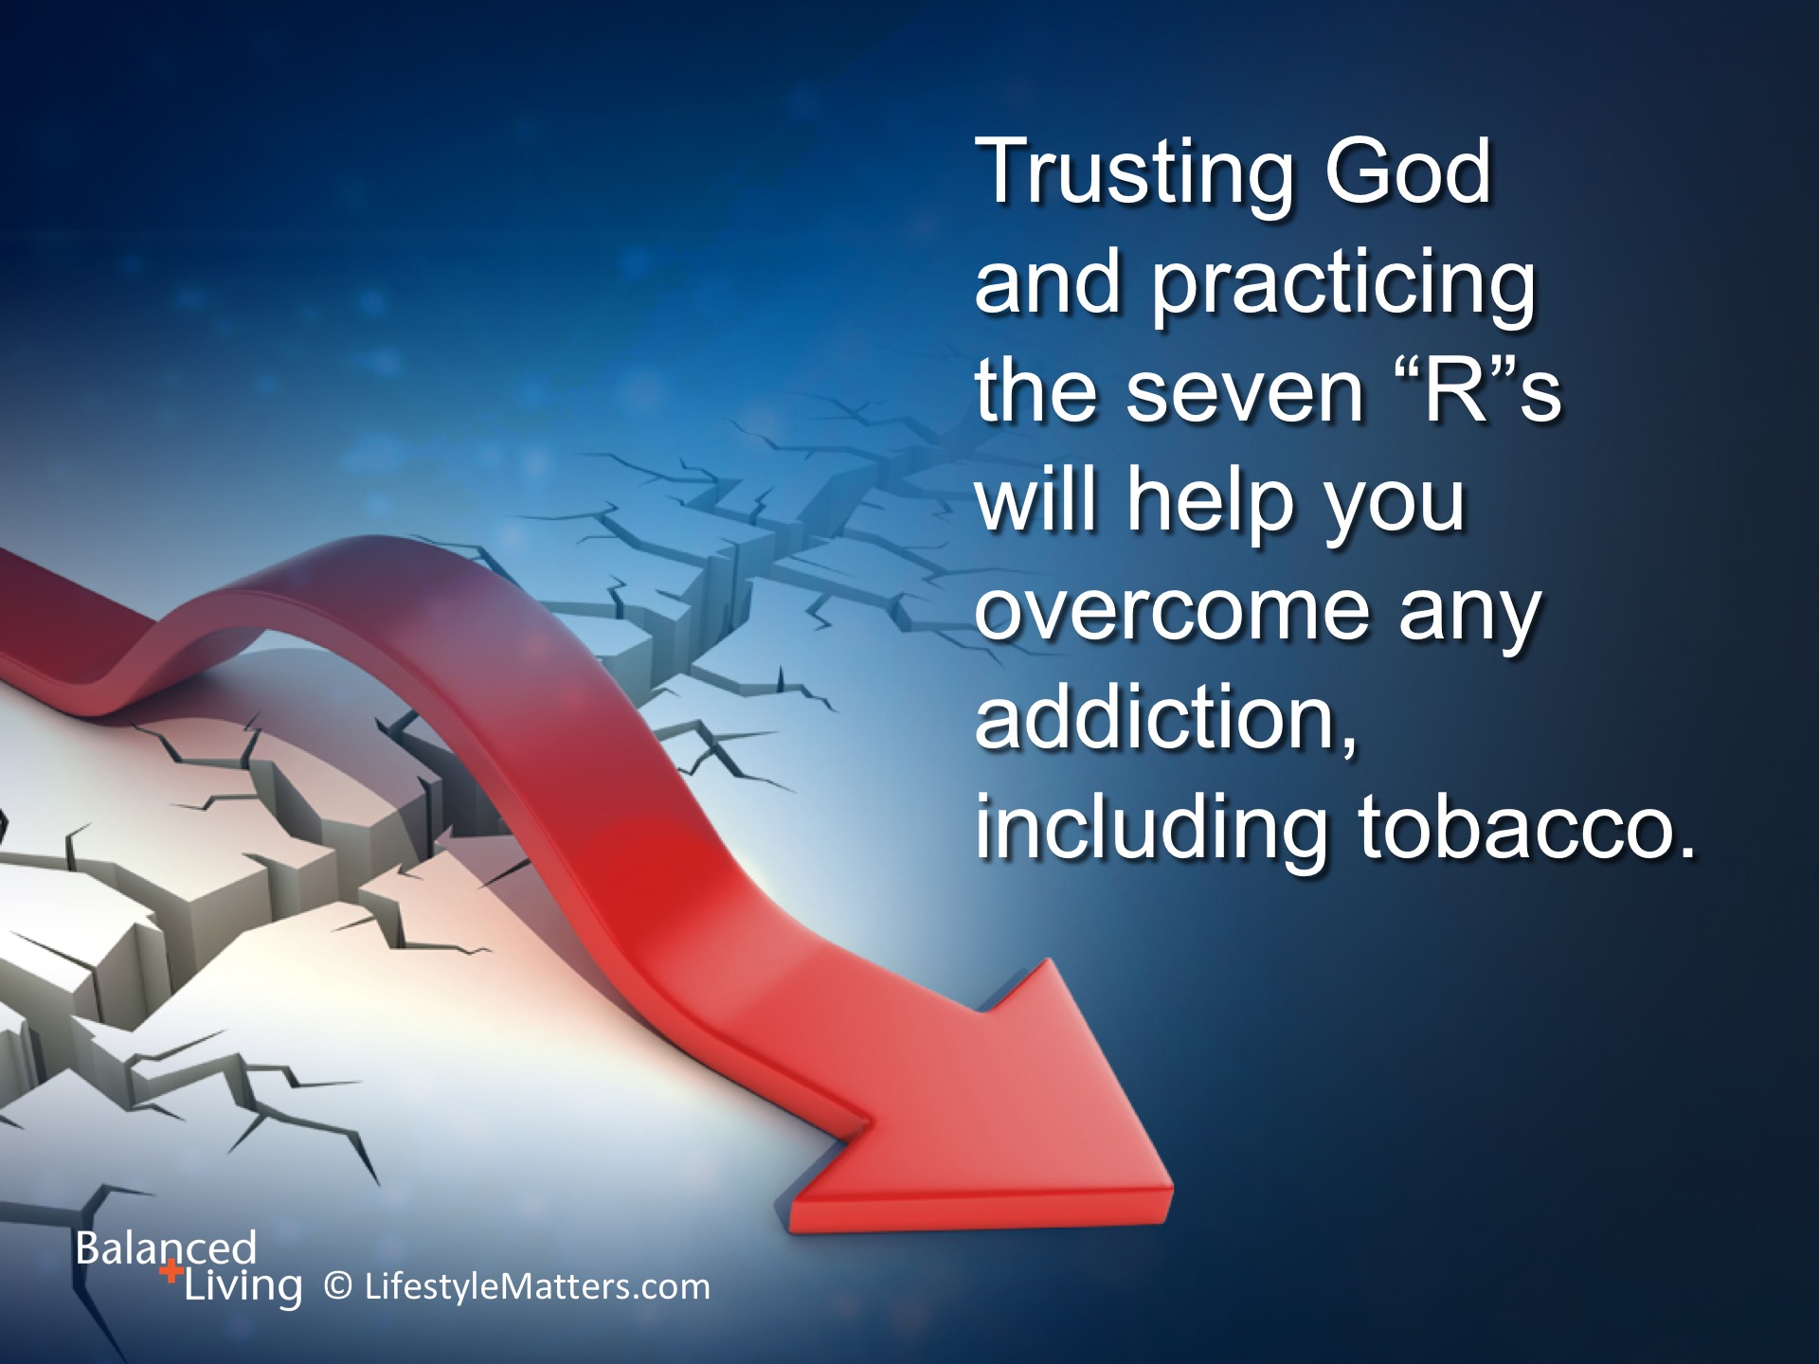
Notes:
Read slide.
Overcoming addictions is not just about stopping—its about filling.

Slide 29
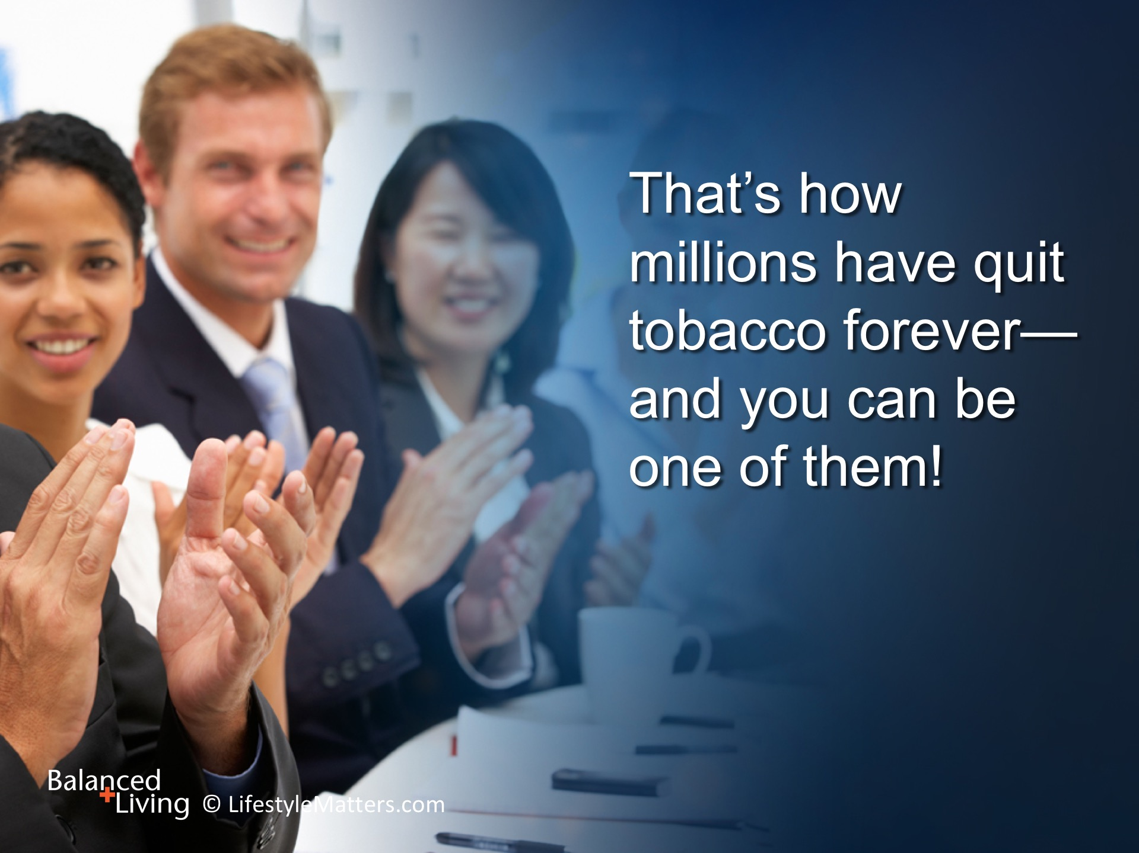
Notes:
God will fill you with new thoughts and desires, a deeper capacity to give and receive love, and new habits that will bring you to new and exciting places in life!
Read slide.

Slide 30

Notes:
Read slide.
God knows how to deliver you out of temptation.
Would you like that deliverance?
He will help you persevere, quit for good, and build a new life—a life without the chains of addiction.
If this is your desire, please stand to your feet. (Wait for response)

