Slide 1


Images © Alamy
www.alamy.com
Images used in powerpoint presentation are part of the presentation and not to be used out of context of the presentation, may not be used as stand-alone images unless to promote the presentation/event, and may not be resold in singular form or as part of an image library. Images are © Alamy and presentation templates and content therein are © MISDA, any other usage requires written permission from both parties.

Slide 2
Scripture quotations used in Balanced Living PowerPoints are taken from Bibles in the Public Domain which have no USA copyright restrictions. We have indicated which version each quotation is taken from as follows:
KJV - King James Version
BBE - Bible in Basic English
WEB - World English Bible
DBY - Darby's Translation
Any scriptures not otherwise noted are the author's paraphrase of one of these versions.

Slide 3
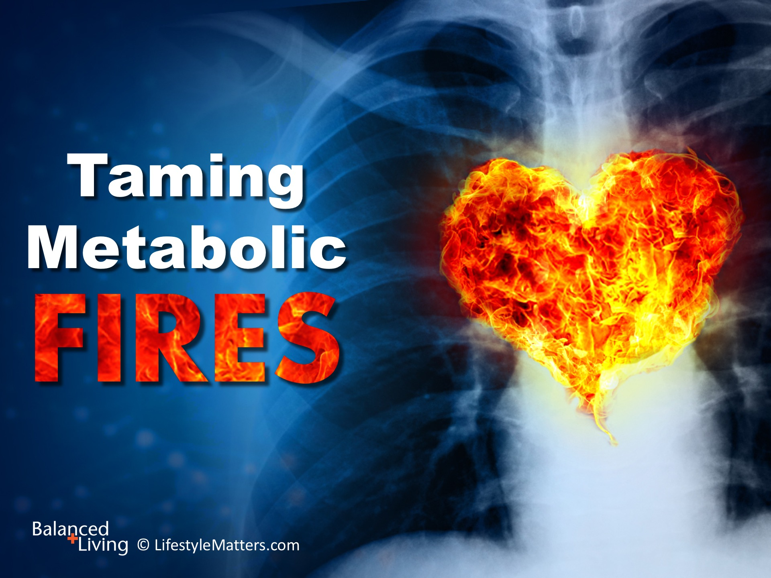
Notes:
Presenter: Please read and study the tract that accompanies this PowerPoint to prepare for this presentation.
Read slide.
How many of you know someone whose life has been altered or even shortened by heart disease? You may be experiencing challenges yourself.
For many, the first symptom of heart trouble is the last—too many fall victim to a sudden, unexpected, fatal heart attack.

Slide 4
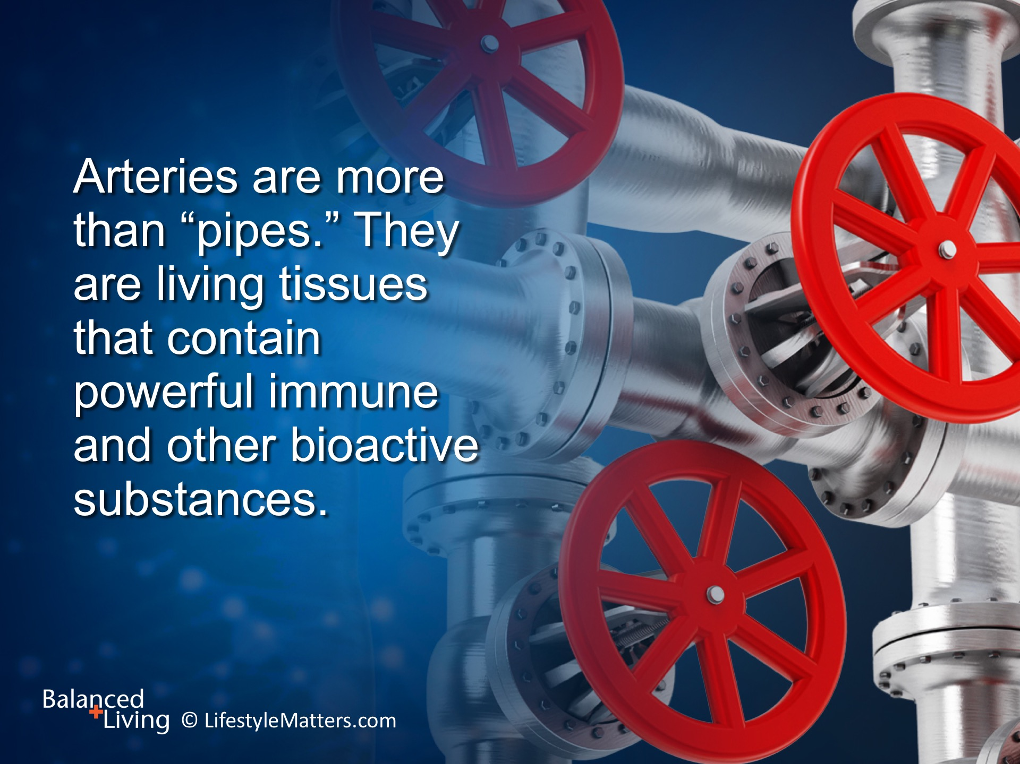
Notes:
Read slide.
Chronic inflammation underlies heart disease and is often caused or exacerbated by lifestyle factors such as diet, poor sleep quality, inactivity, and stress.

Slide 5
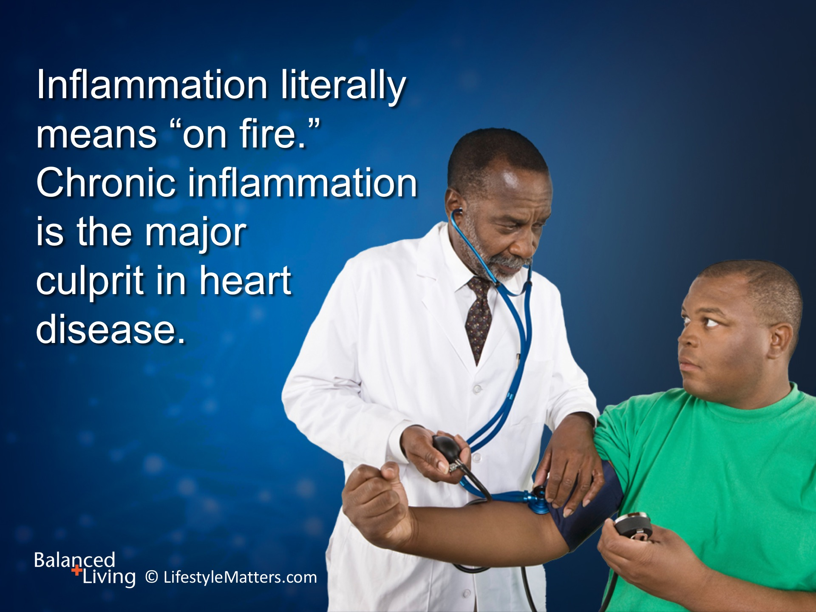
Notes:
Read slide.

Slide 6
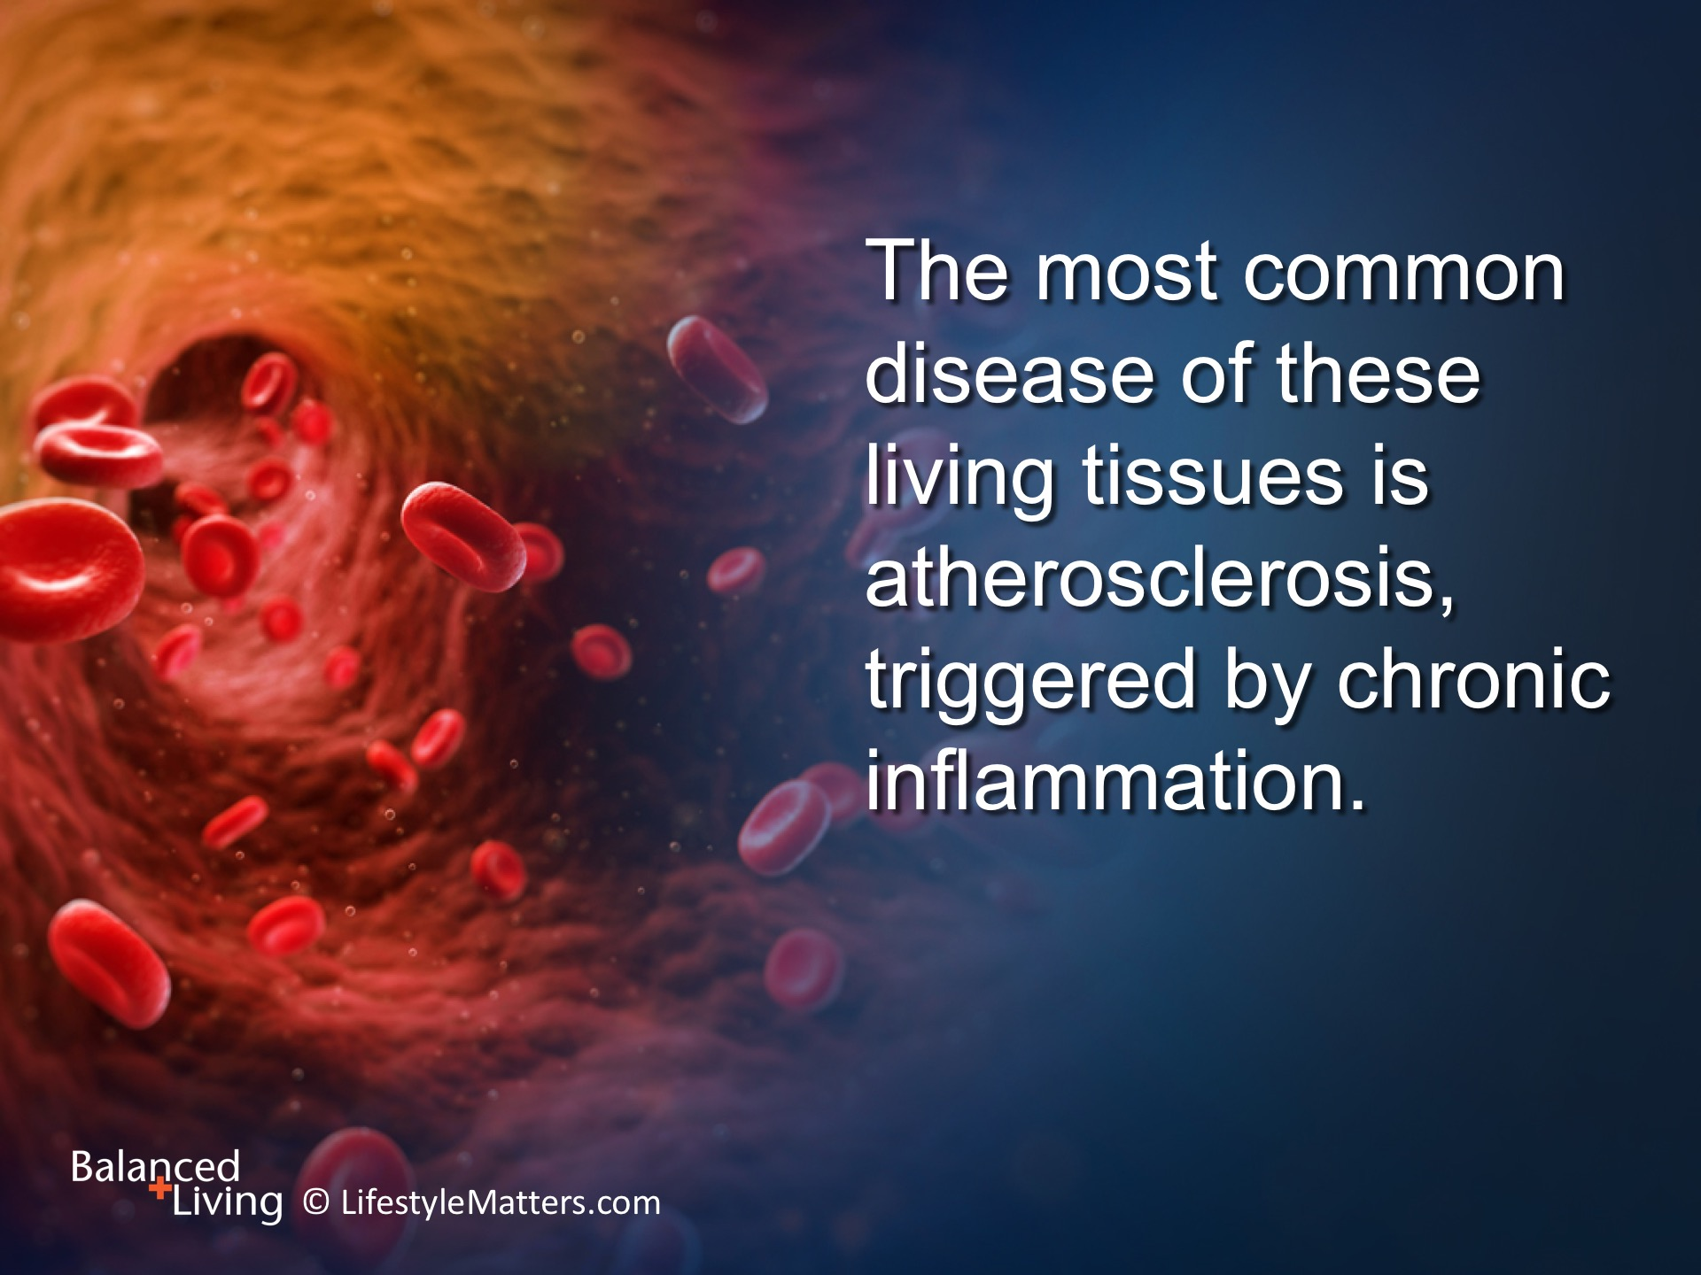
Notes:
Read slide.
Fats (such as cholesterol) can move from the blood supply into the lining of the blood vessels.

Slide 7
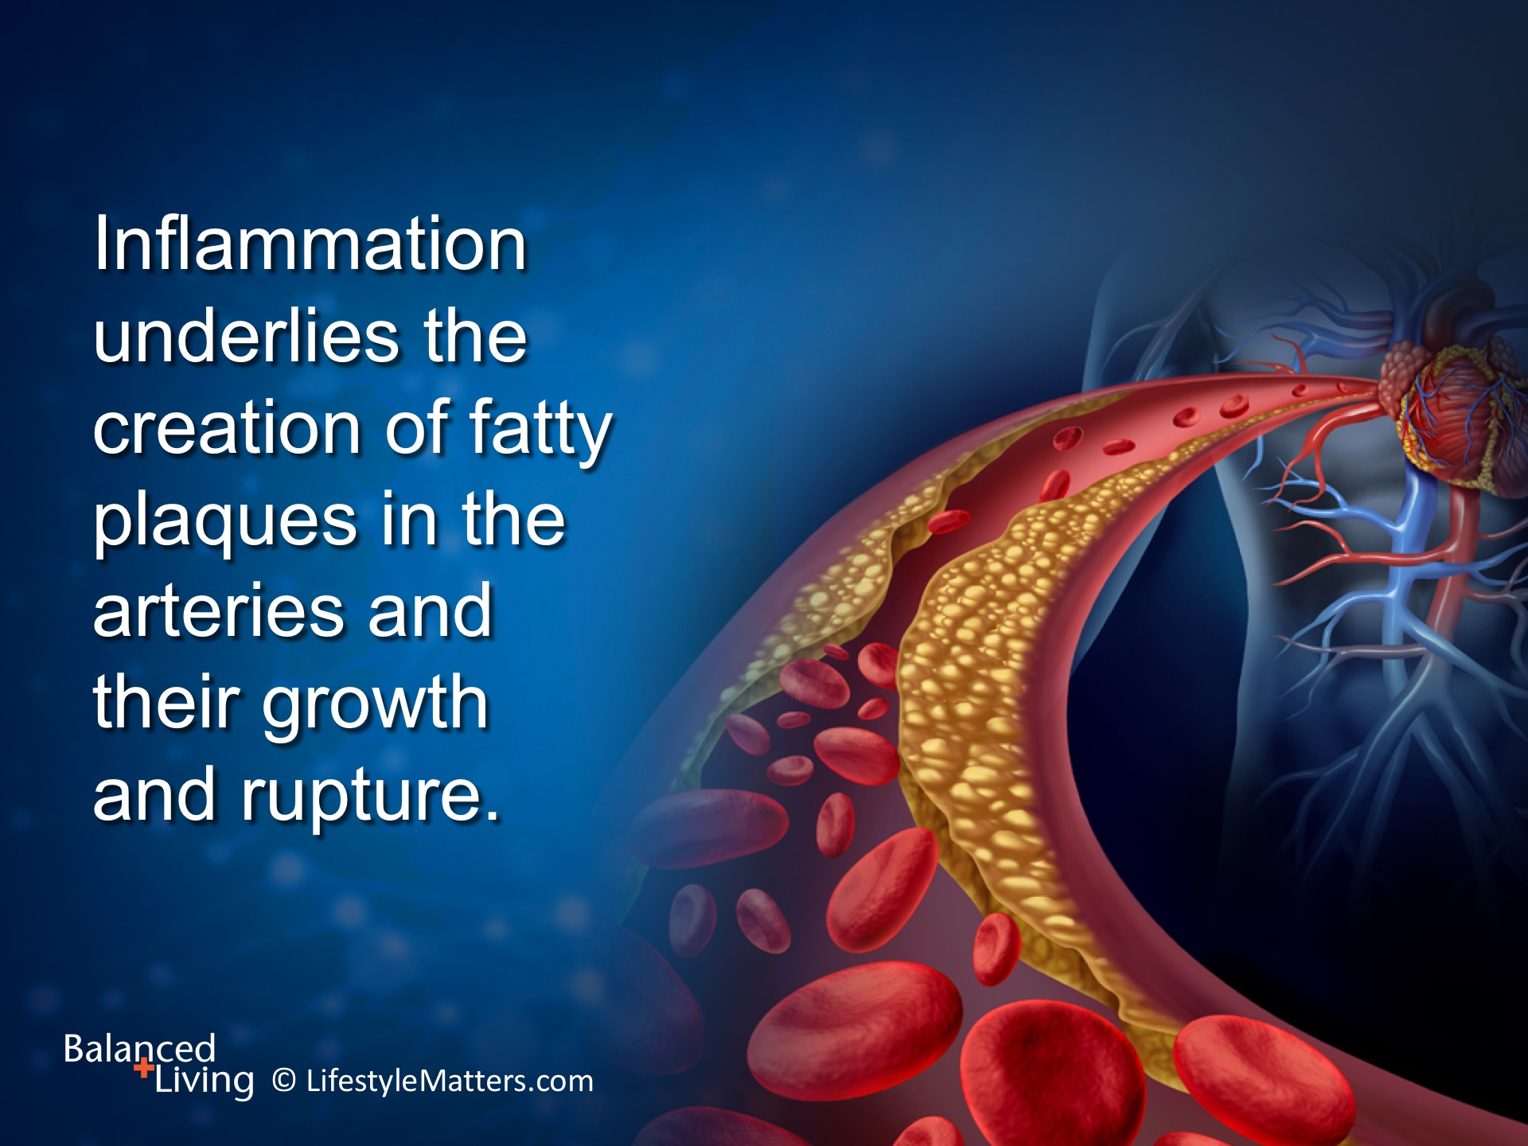
Notes:
Read slide.
When plaque breaks off or ruptures, a deadly clot can cut off blood supply and cause a heart attack or stroke.

Slide 8
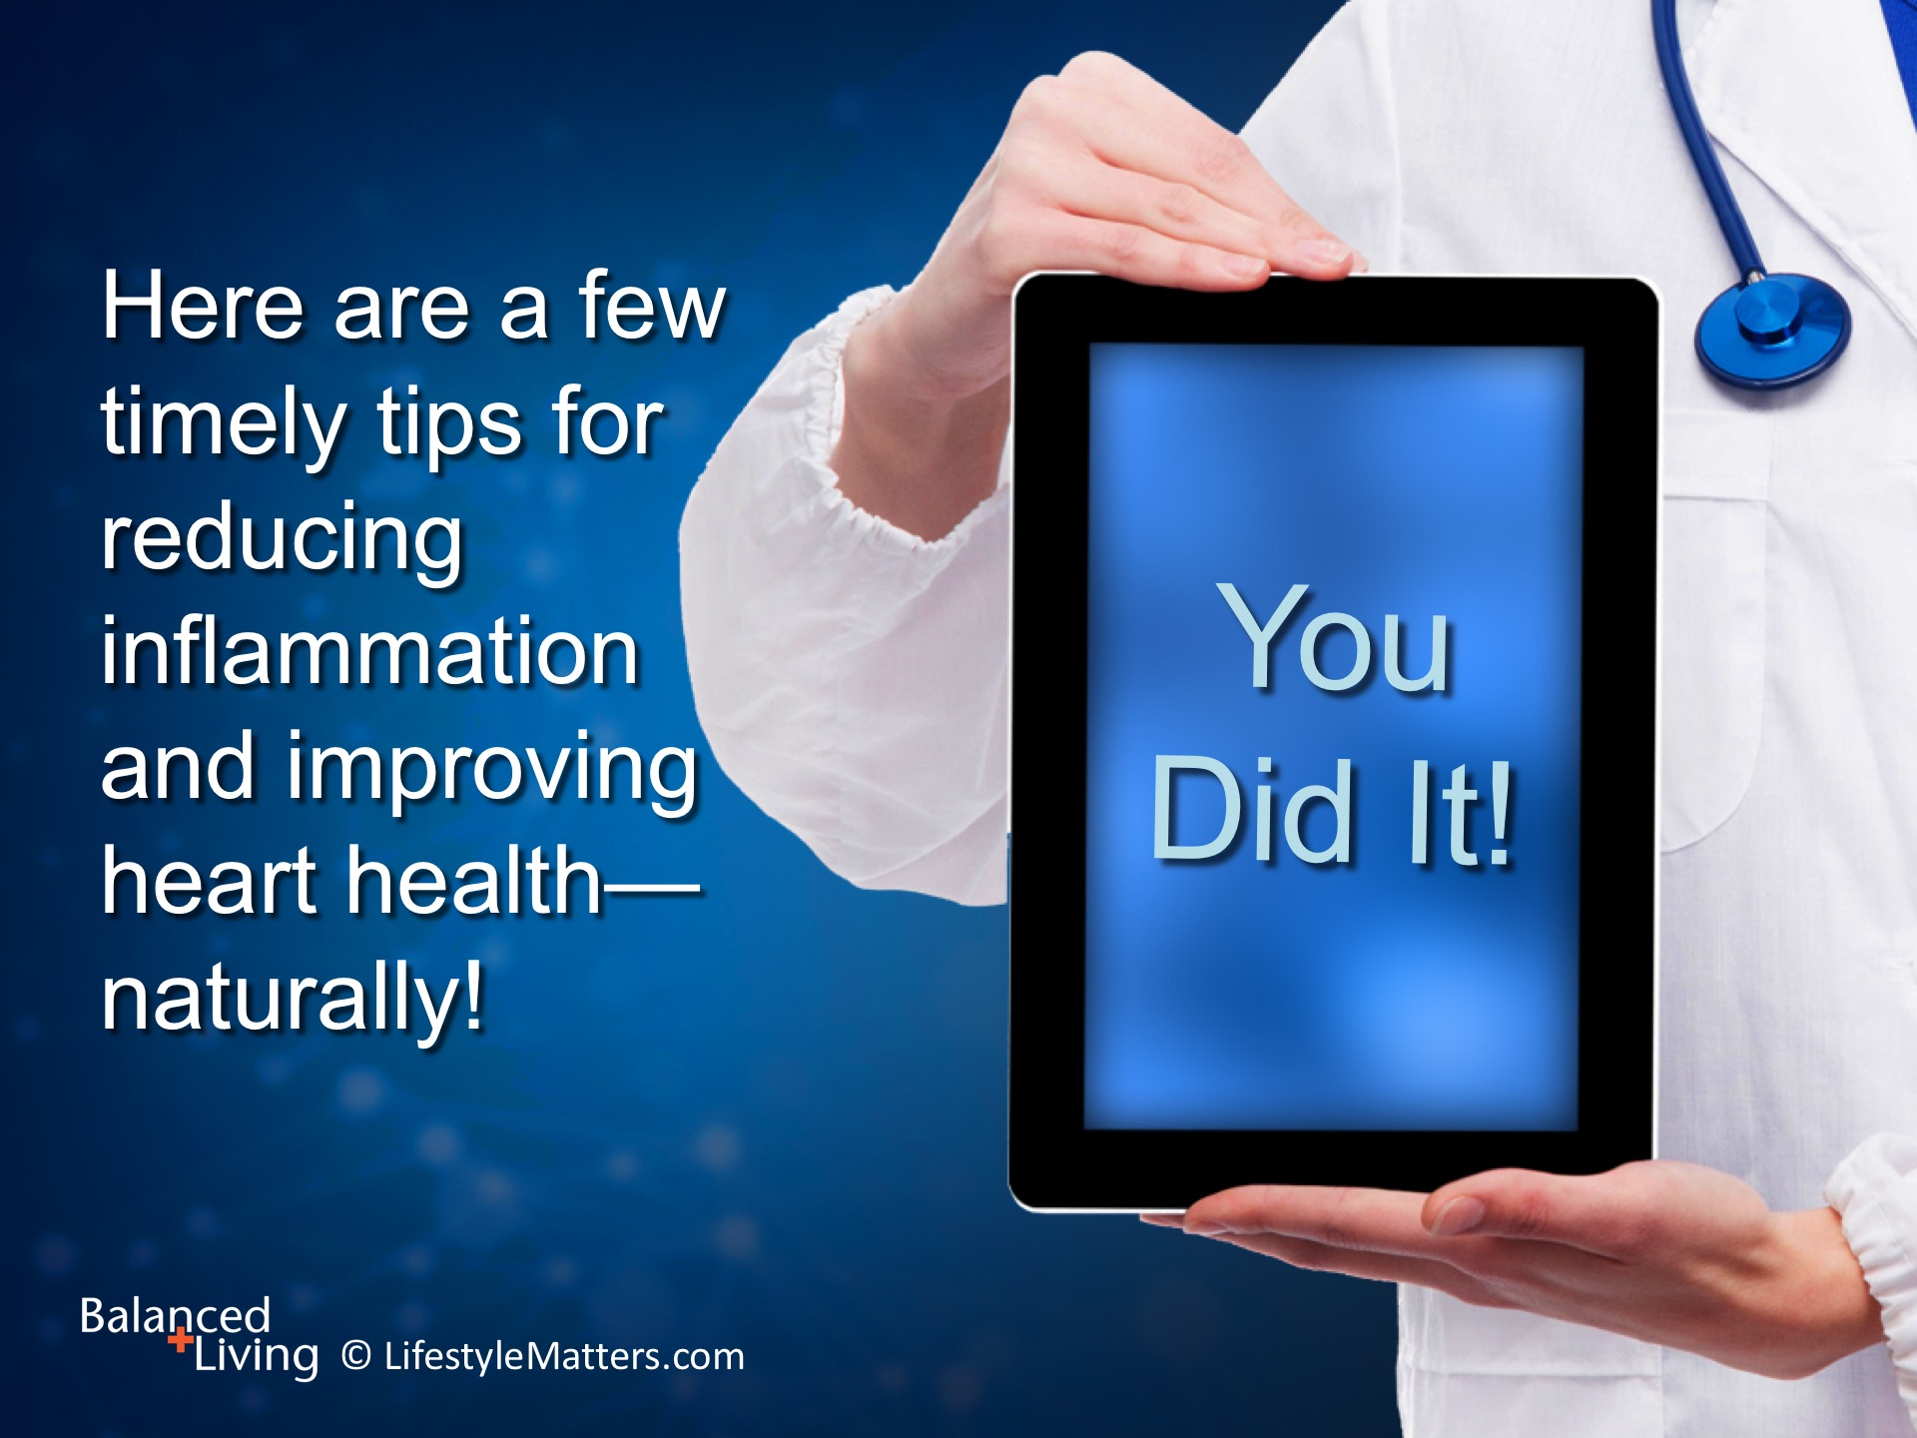
Notes:
Read slide.

Slide 9
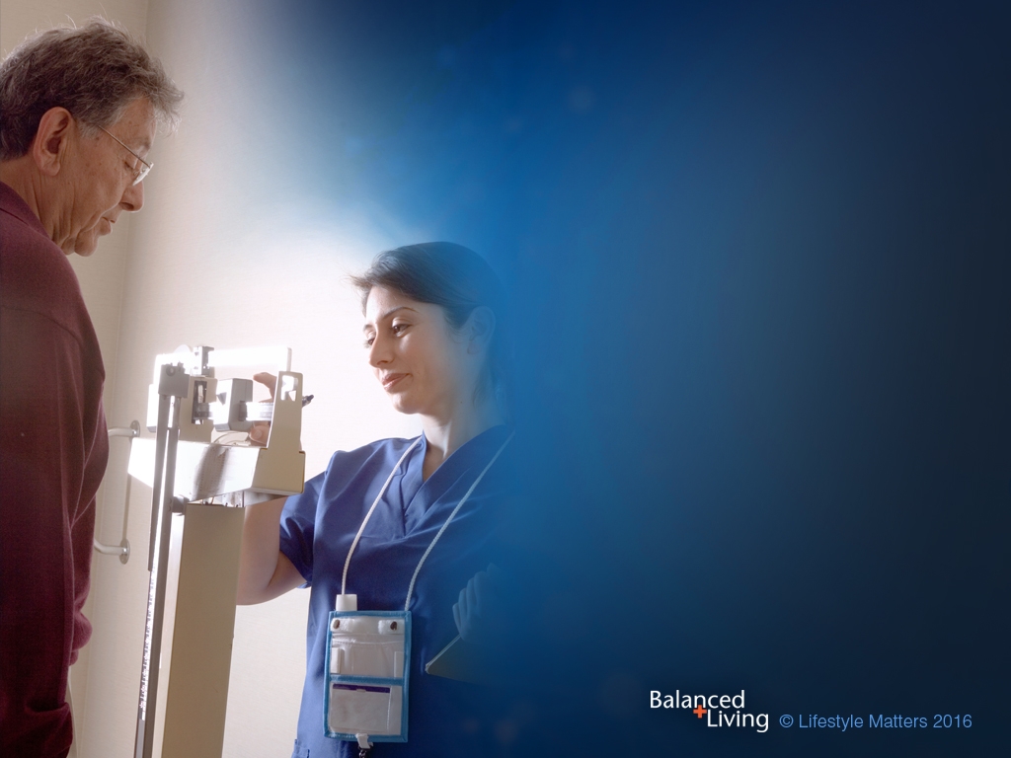
Always work with your health care provider when implementing diet and exercise programs. They will be able to help you adjust medications and exercise safely.

Slide 10
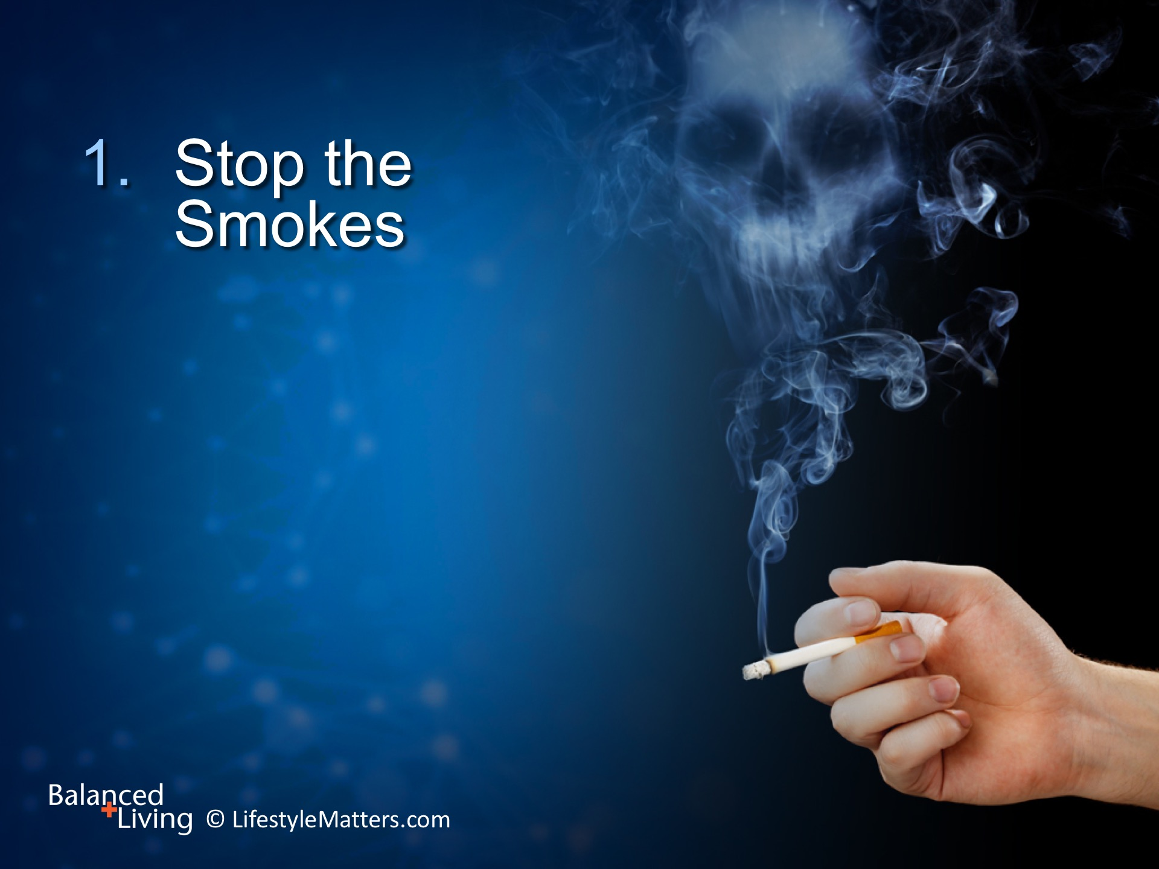
Notes:
Read slide.
Smoking is the number 1 risk factor for heart disease, partly because it robs your heart of oxygen and floods the blood vessels with toxins.
Quitting dramatically reduces your risk of a heart attack and helps you breathe as well as feel better.

Slide 11
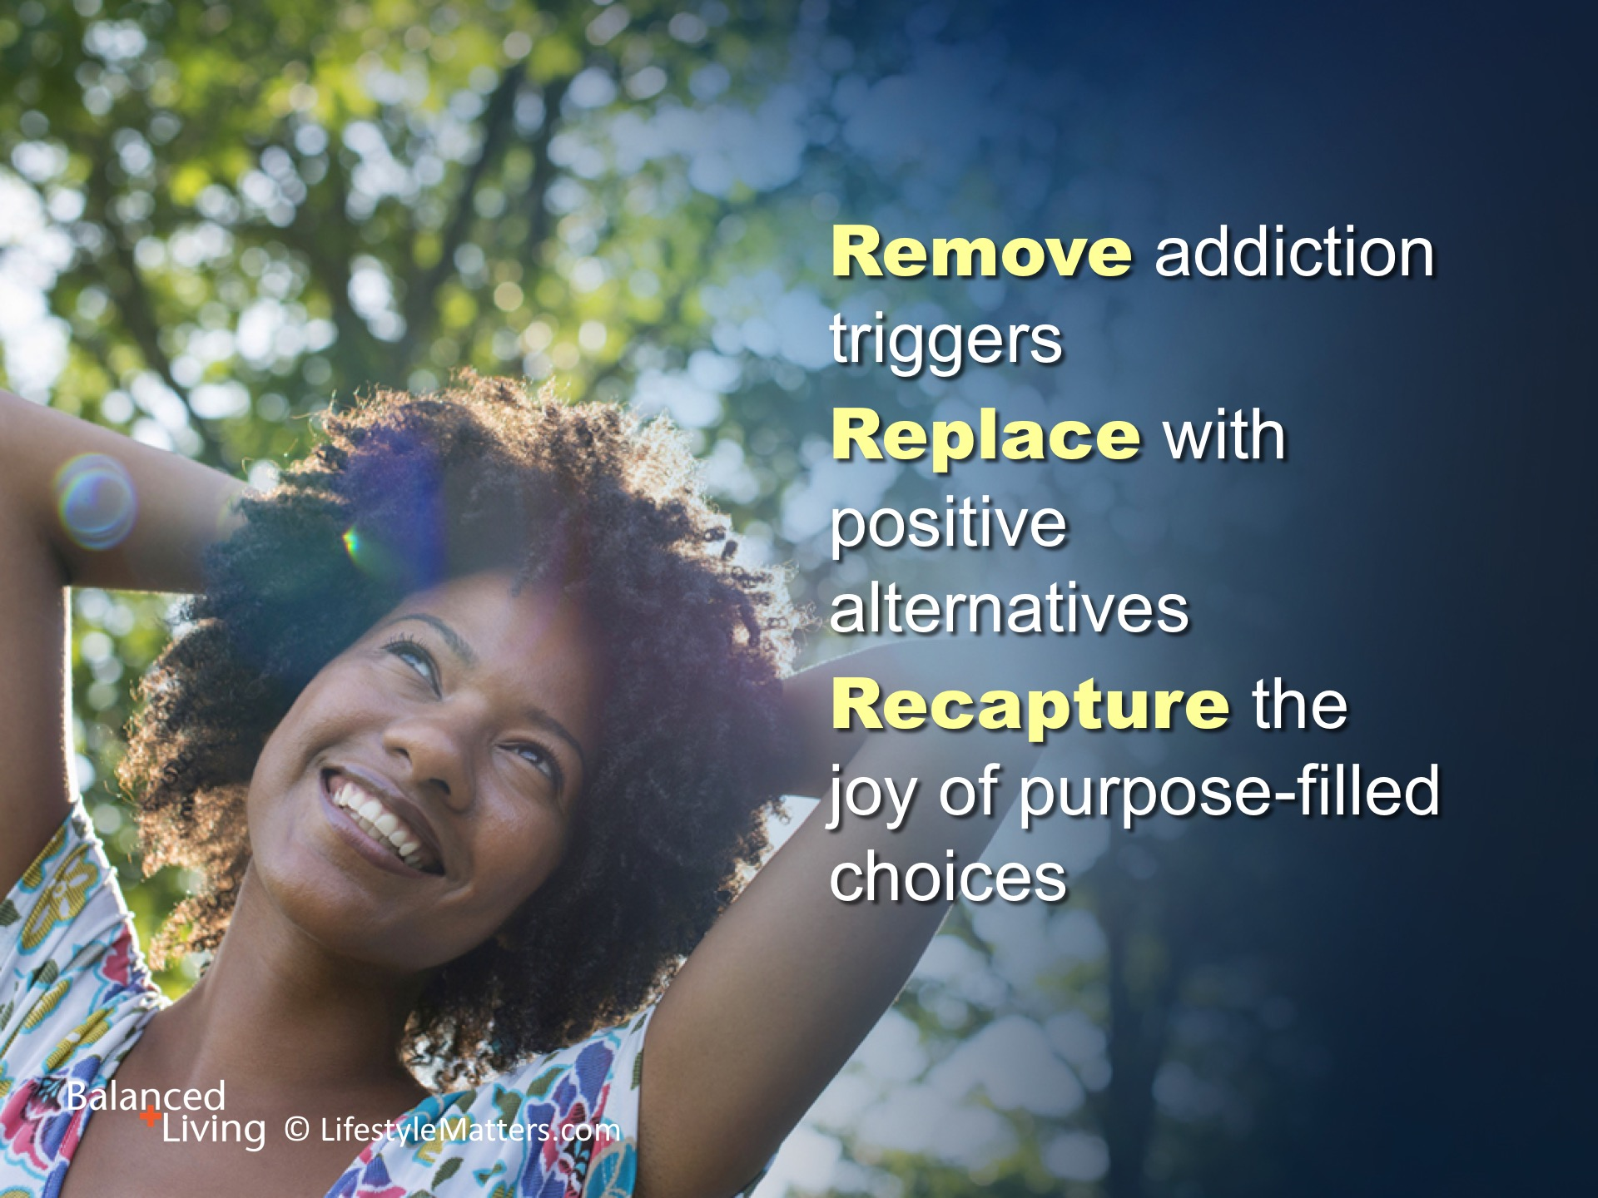
Notes:
You’ve heard of the 3 “R”s for learning in school (reading, writing, and arithmetic).
There are 3 “R”s that work well in breaking bad habits as well.
Read slide.

Slide 12
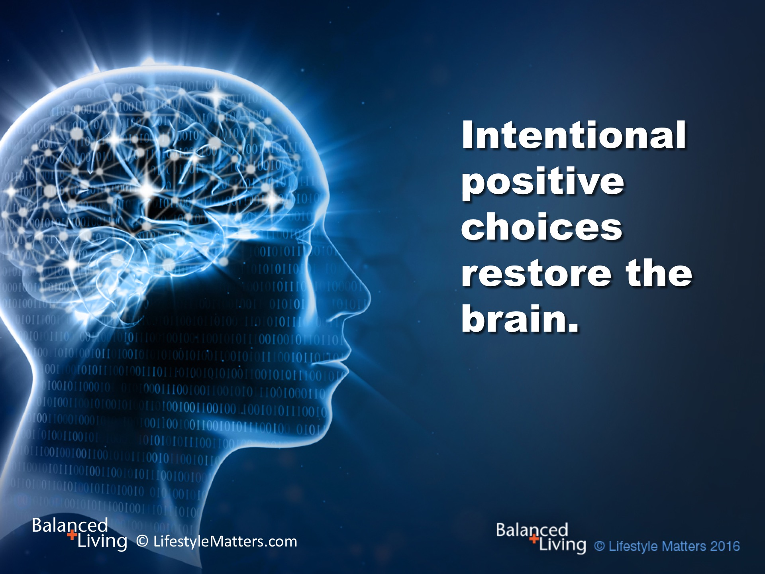
Notes:
Read slide.
You’ve heard the saying, “Practice makes perfect.” Well, practice also makes permanent!
What we learn, we learn by doing. God has designed your brain to continually reshape itself according to what it learns.
He promises His power to accomplish in you a determination to break free from destructive habits.

Slide 13
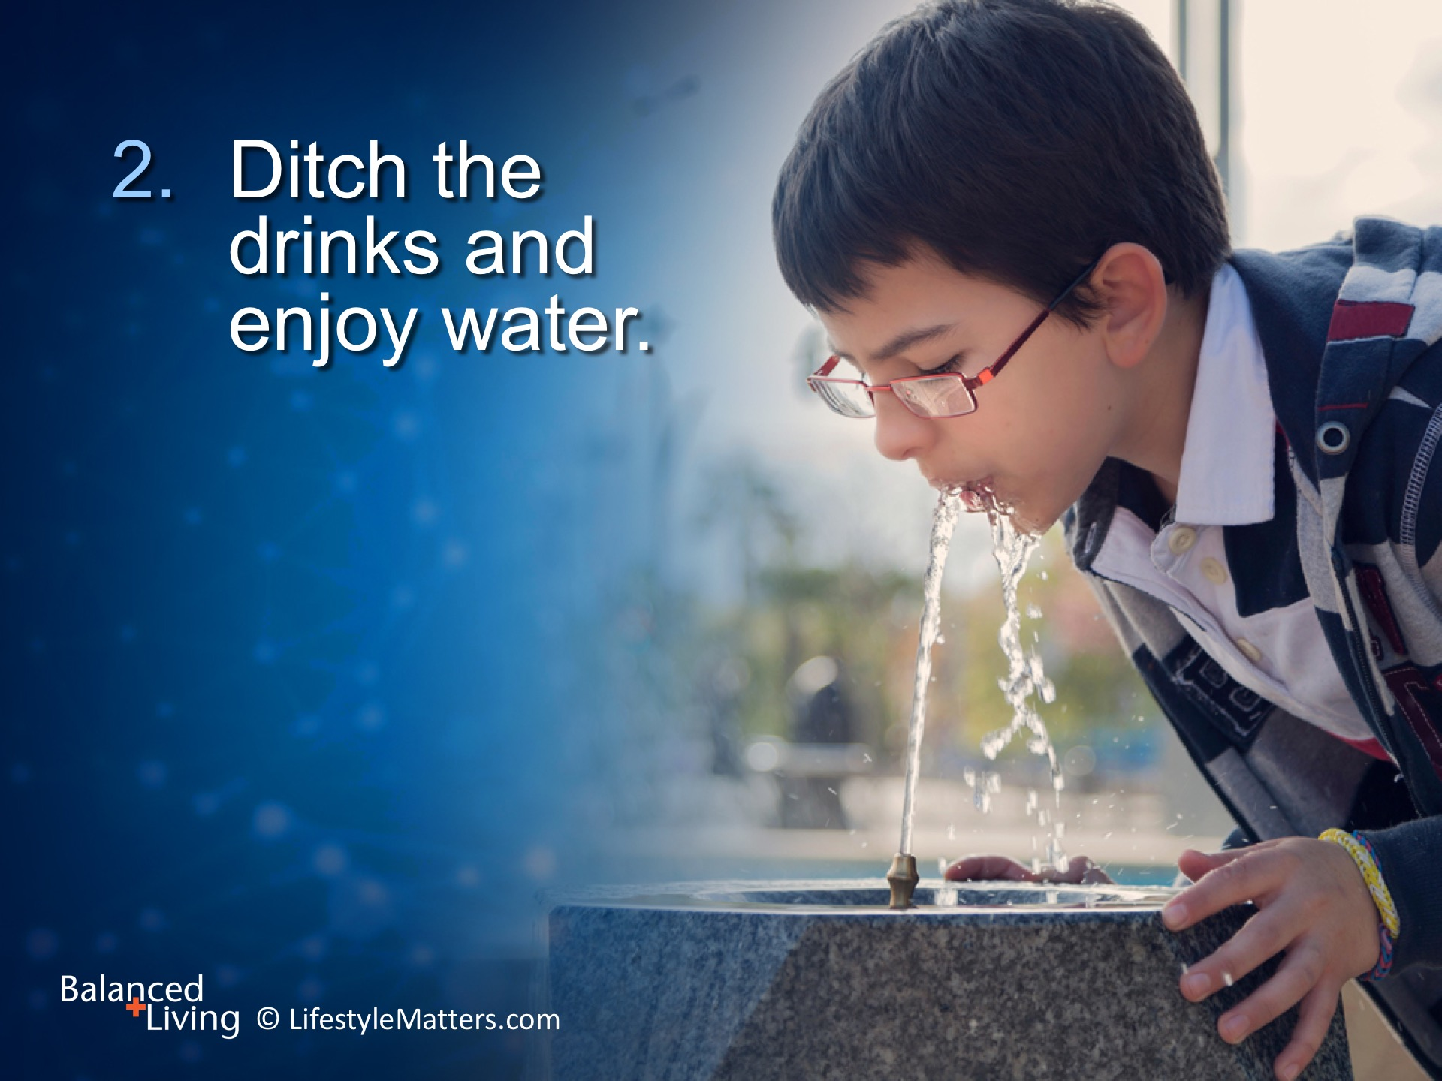
Notes:
Read slide.
Sugary drinks fuel belly fat, which stokes the fires of inflammation linked not only with heart disease, but also diabetes, obesity, and certain cancers.
This is because the fat carried around our bellies is metabolically active, producing chemicals that heighten inflammation throughout the body.
In fact, the top source of added sugar in the United States population is sweetened drinks. (EFNEP, 2005)

Slide 14
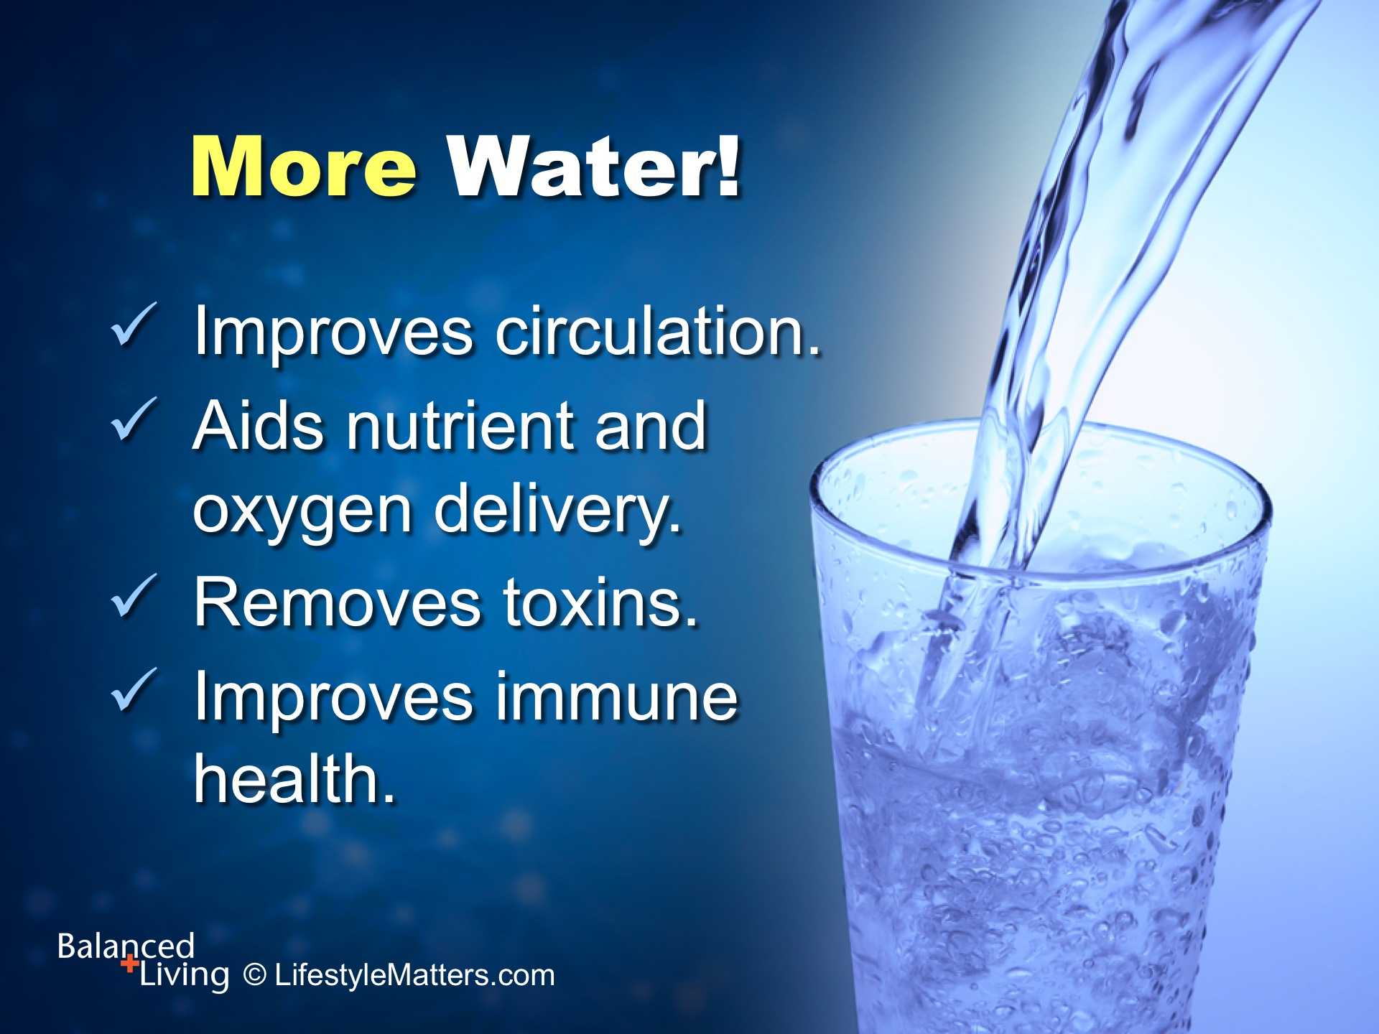
Notes:
Drinking plenty of water, at least 8 glasses a day between meals, keeps the blood moving freely and cuts cravings and false hunger signals.
Read slide.
If you have a hard time with plain water, why not spruce it up with:
Fresh lemon or lime juice
A few mint leaves
A dash of juice
Herbal tea

Slide 15
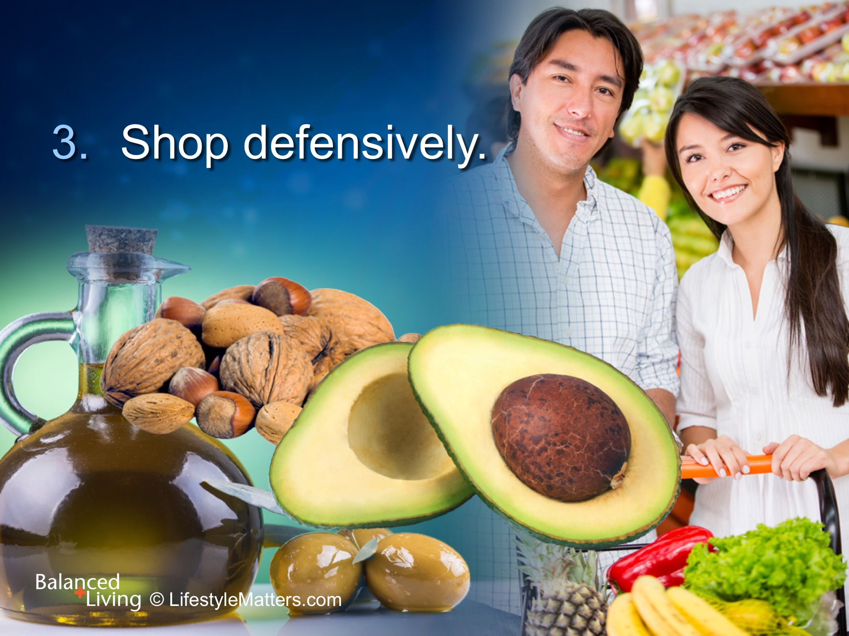
Notes:
Read slide.
High fat animal products such as red meat, butter, and hard cheese fan the flames of inflammation, including high blood pressure—but switching to plant foods and healthy plant fats like olives, olive oil, and avocados dampen inflammation and help lower blood pressure.
Enjoy healthy omega-3 fats by adding walnuts or ground flax seed. Can you think of some ways to add these healthy fats? (wait for response)

Slide 16
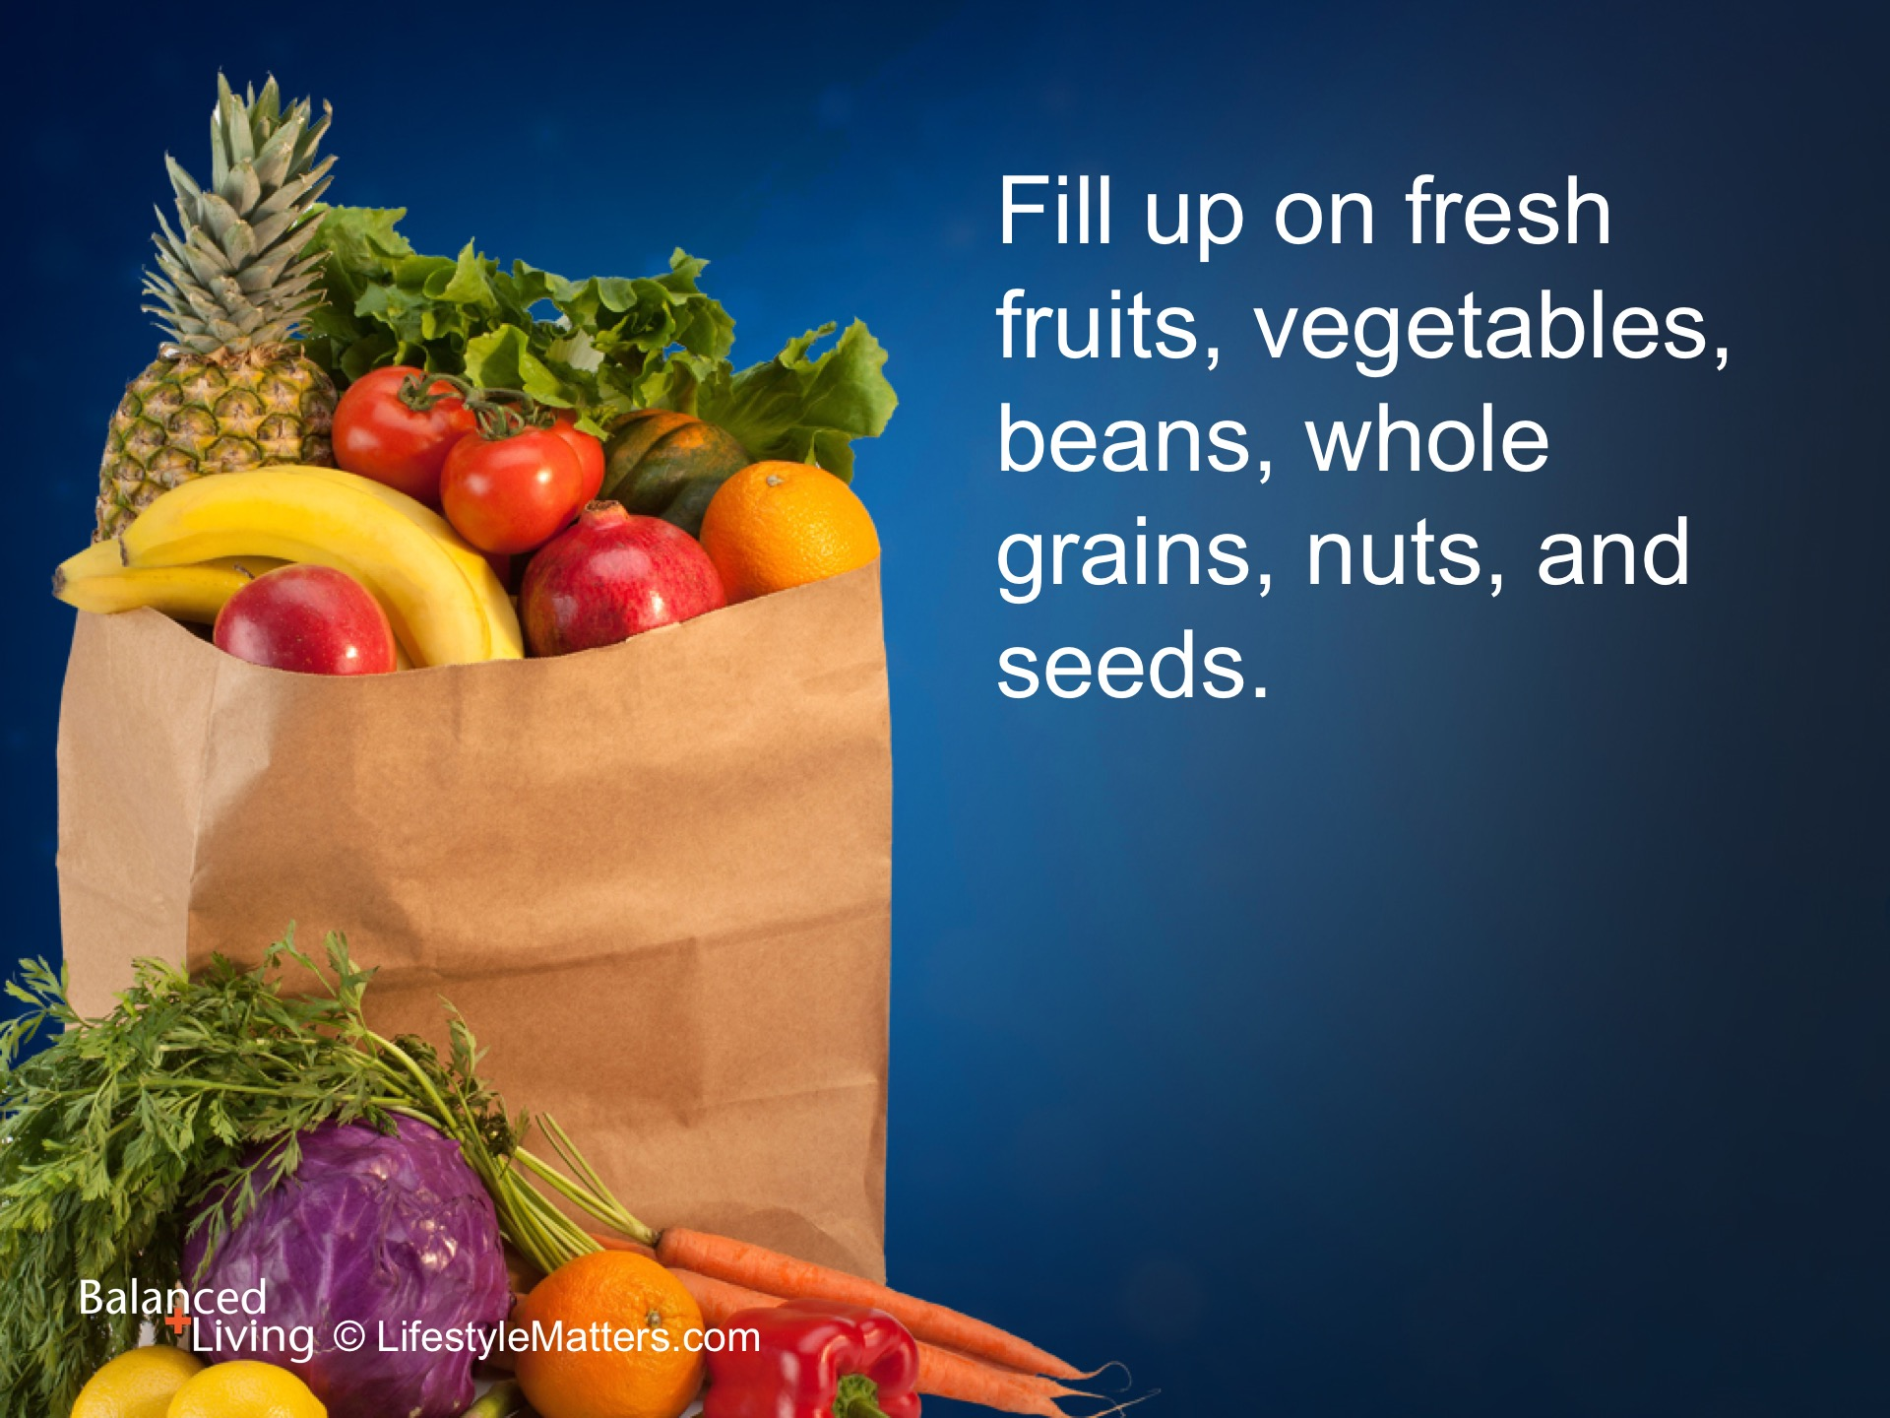
Notes:
Read slide.
Focus your shopping in the produce department—the “Department of Defense” when it comes to disease prevention.
“Plant power” foods are colorful, full of flavor, nutrition, and fiber, but low in calories.
Fruits, vegetables, beans, and whole grains contain powerful compounds called antioxidants that “sweep up” dead cells, remove waste, and lower inflammation.
Can you think of some easy ways to build a better breakfast? Lunch? Dinner? (wait for responses)

Slide 17
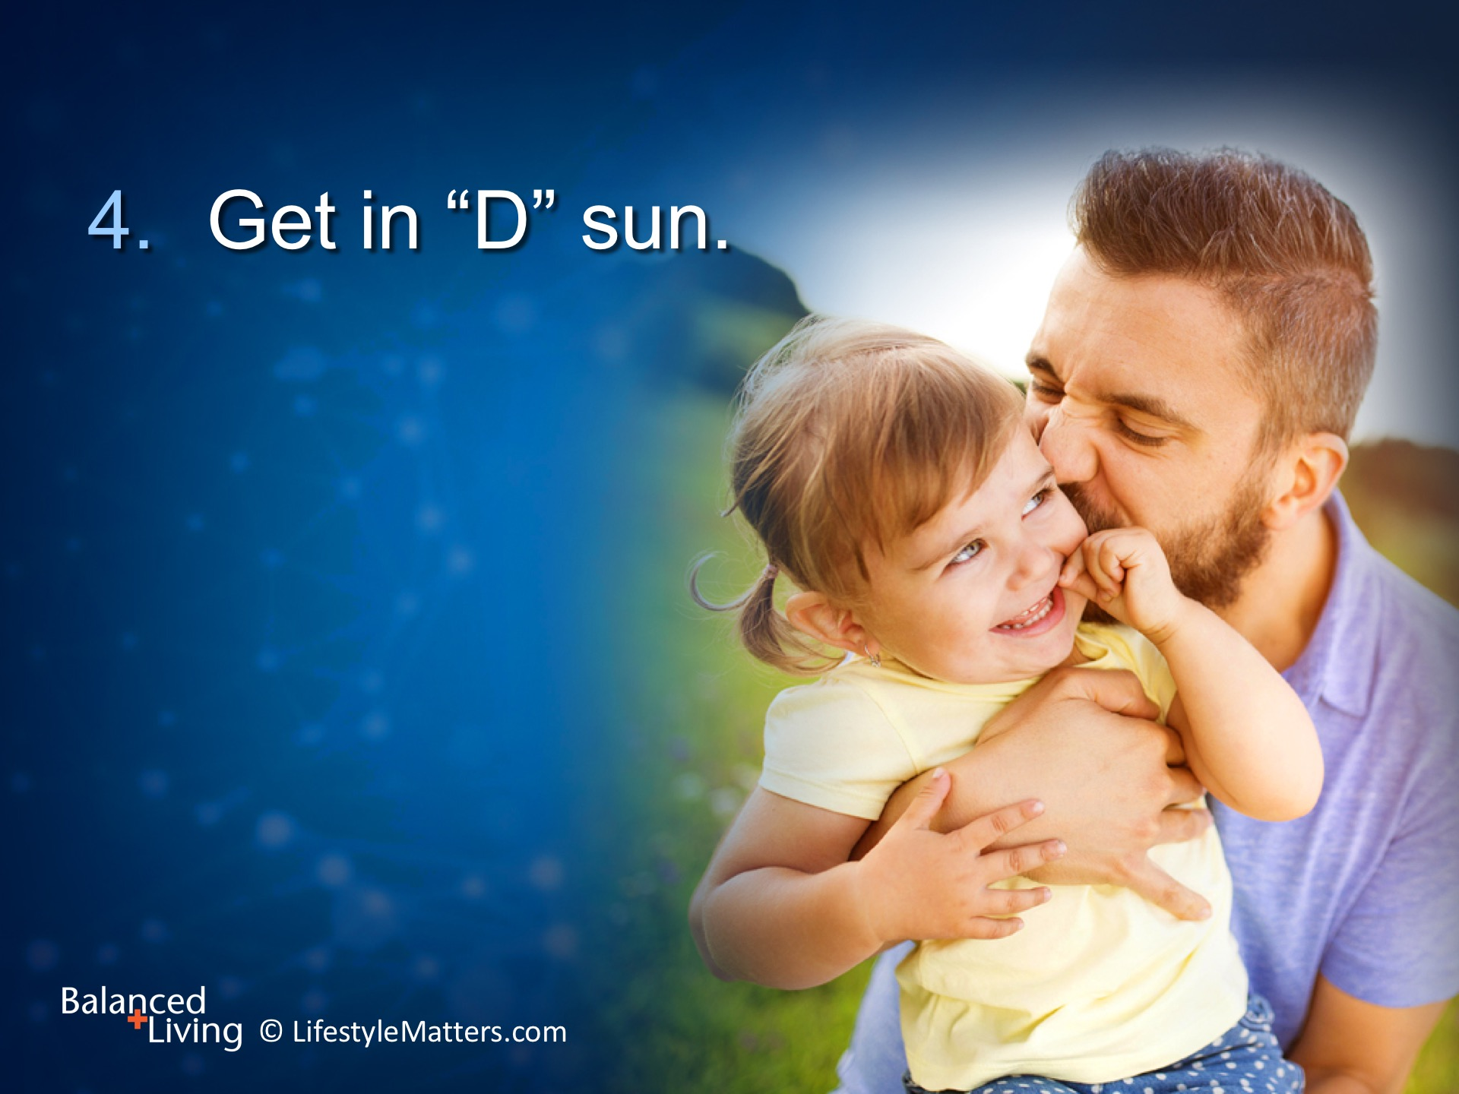
Notes:
Read slide.
Vitamin D is called the “sunshine vitamin.” Low levels of this important vitamin are linked with heart disease.
Enjoy outdoor time in the sun and use sun protection that is appropriate for you.
Be sure and have your vitamin D levels checked when you visit the doctor. Many people are deficient and need to supplement.

Slide 18
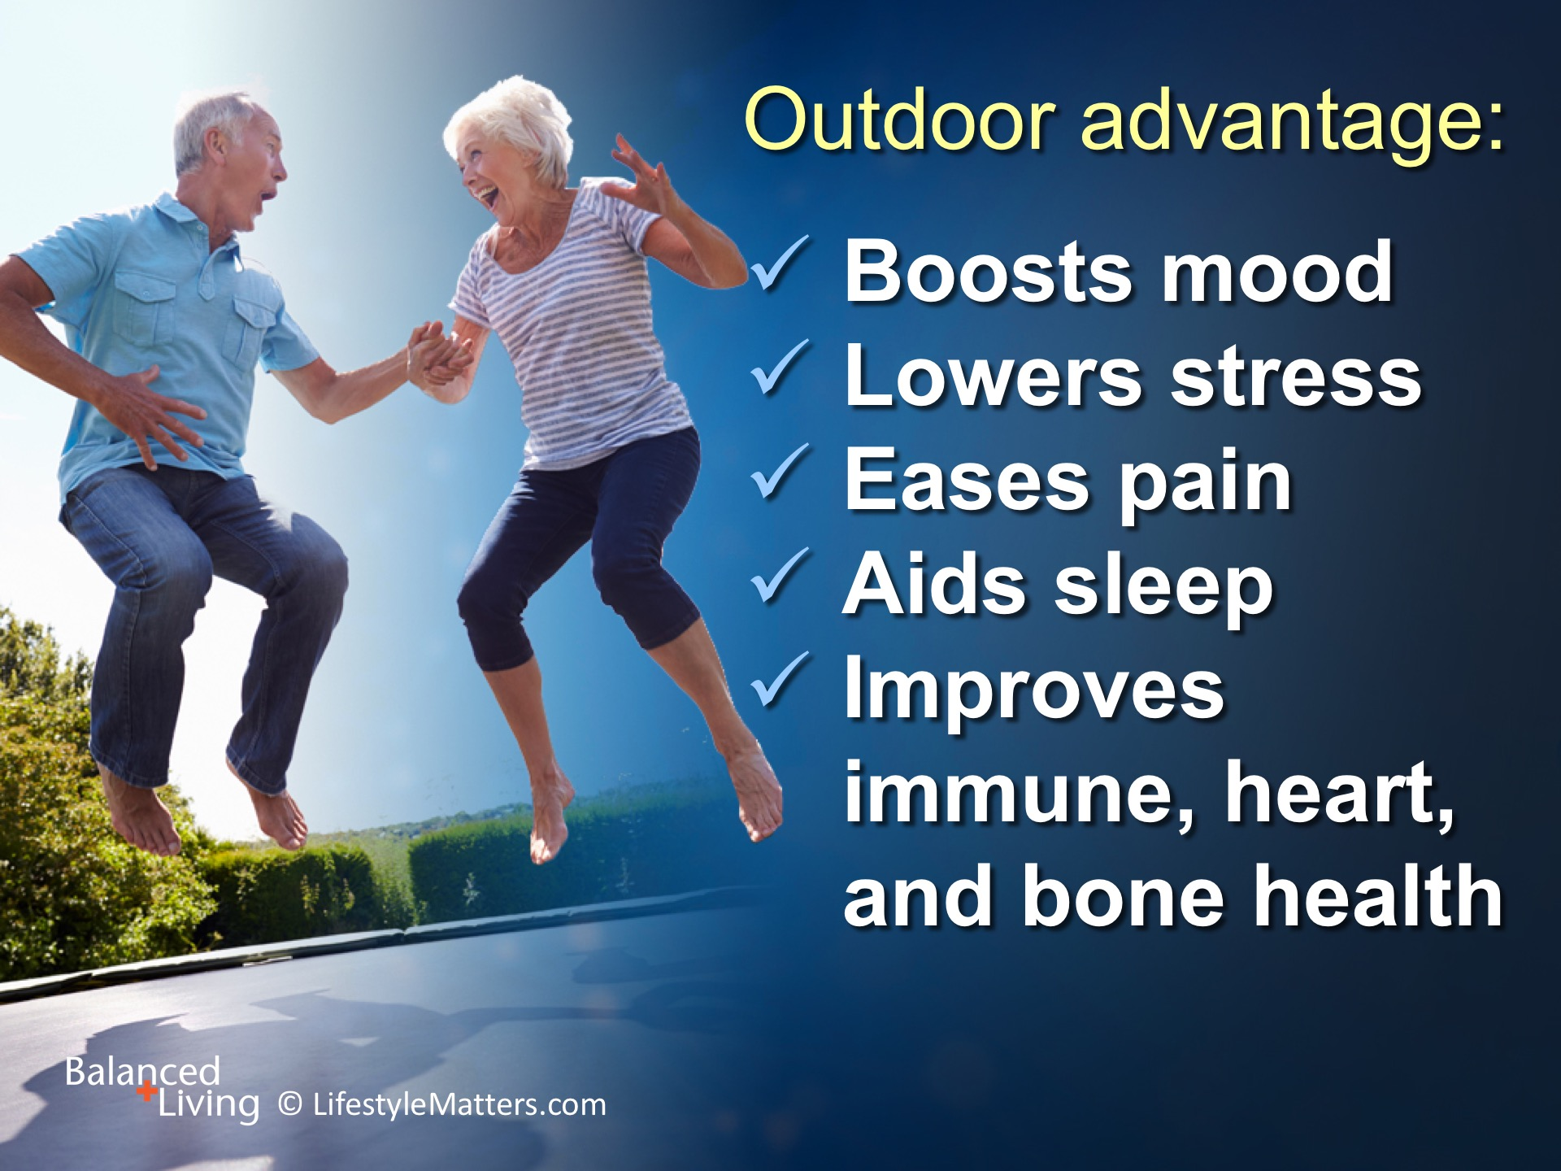
Notes:
Getting outdoors in the sun not only improves vitamin D levels. It also: Read slide:
http://www.healthline.com/health/depression/benefits-sunlight#1
Lambert, G., Reid, C., Kaye, D., Jennings, G., & Esler, M. (2002). Effect of sunlight and season on serotonin turnover in the brain. The Lancet, 360(9348), 1840-1842.
Spina, C., Tangpricha, V., Uskokovic, M., Adorinic, L., Maehr, H., & Holick, M. (2006). Vitamin D and Cancer. International Journal of Cancer Research and Treatment, 26(4A), 2515-2524.
Walch, J., Rabin, B., Day, R., Williams, J., Choi, K., & Kang, J. (2005). The Effect of Sunlight on Postoperative Analgesic Medication Use: A Prospective Study of Patients Undergoing Spinal Surgery. Psychosomatic Medicine, 67(1), 156-163.

Slide 19
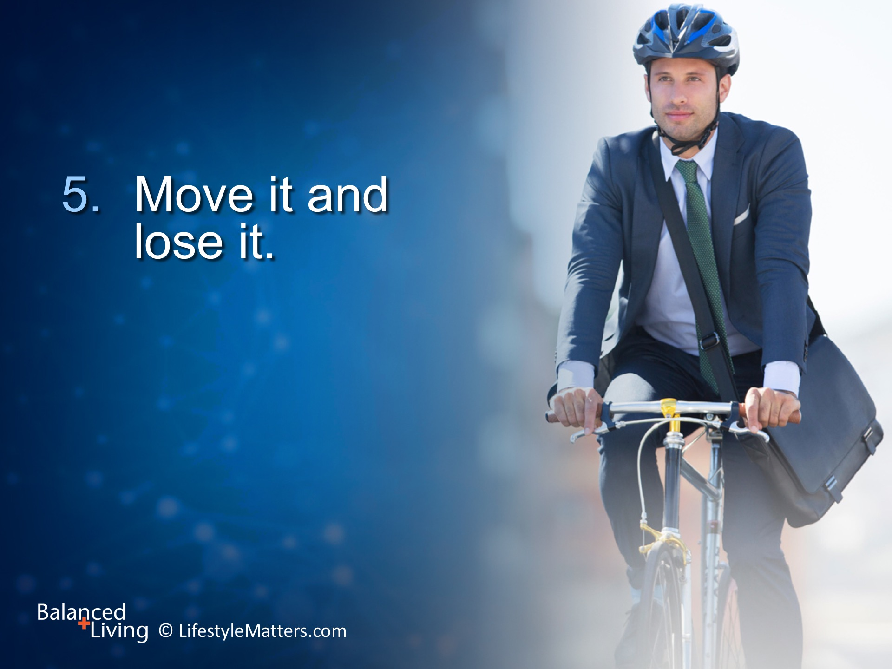
Notes:
Read slide.
Lack of physical exercise is the number 2 risk factor for heart disease.
Daily exercise is linked to lower cholesterol levels, improved blood pressure, plus better blood sugar and weight control.

Slide 20
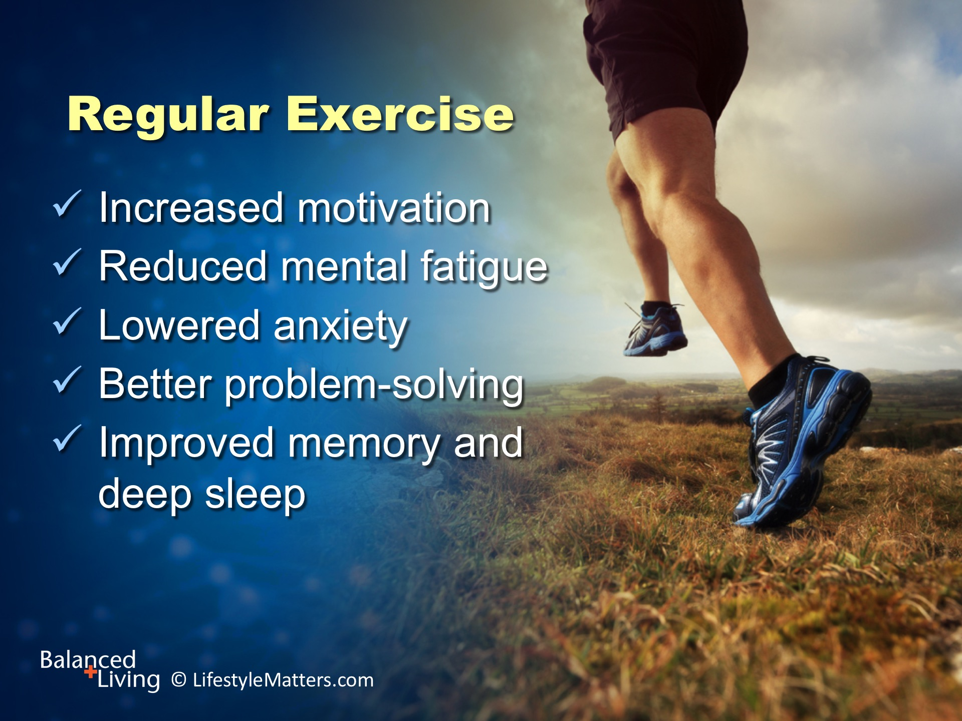
Notes:
But better labs are just the beginning of a daily exercise program, whether indoors or outside!
Powerful mood-elevating benefits include:
Read slide.

Slide 21

Notes:
Read slide.
Guard your bedtime. It’s healing time.

Slide 22
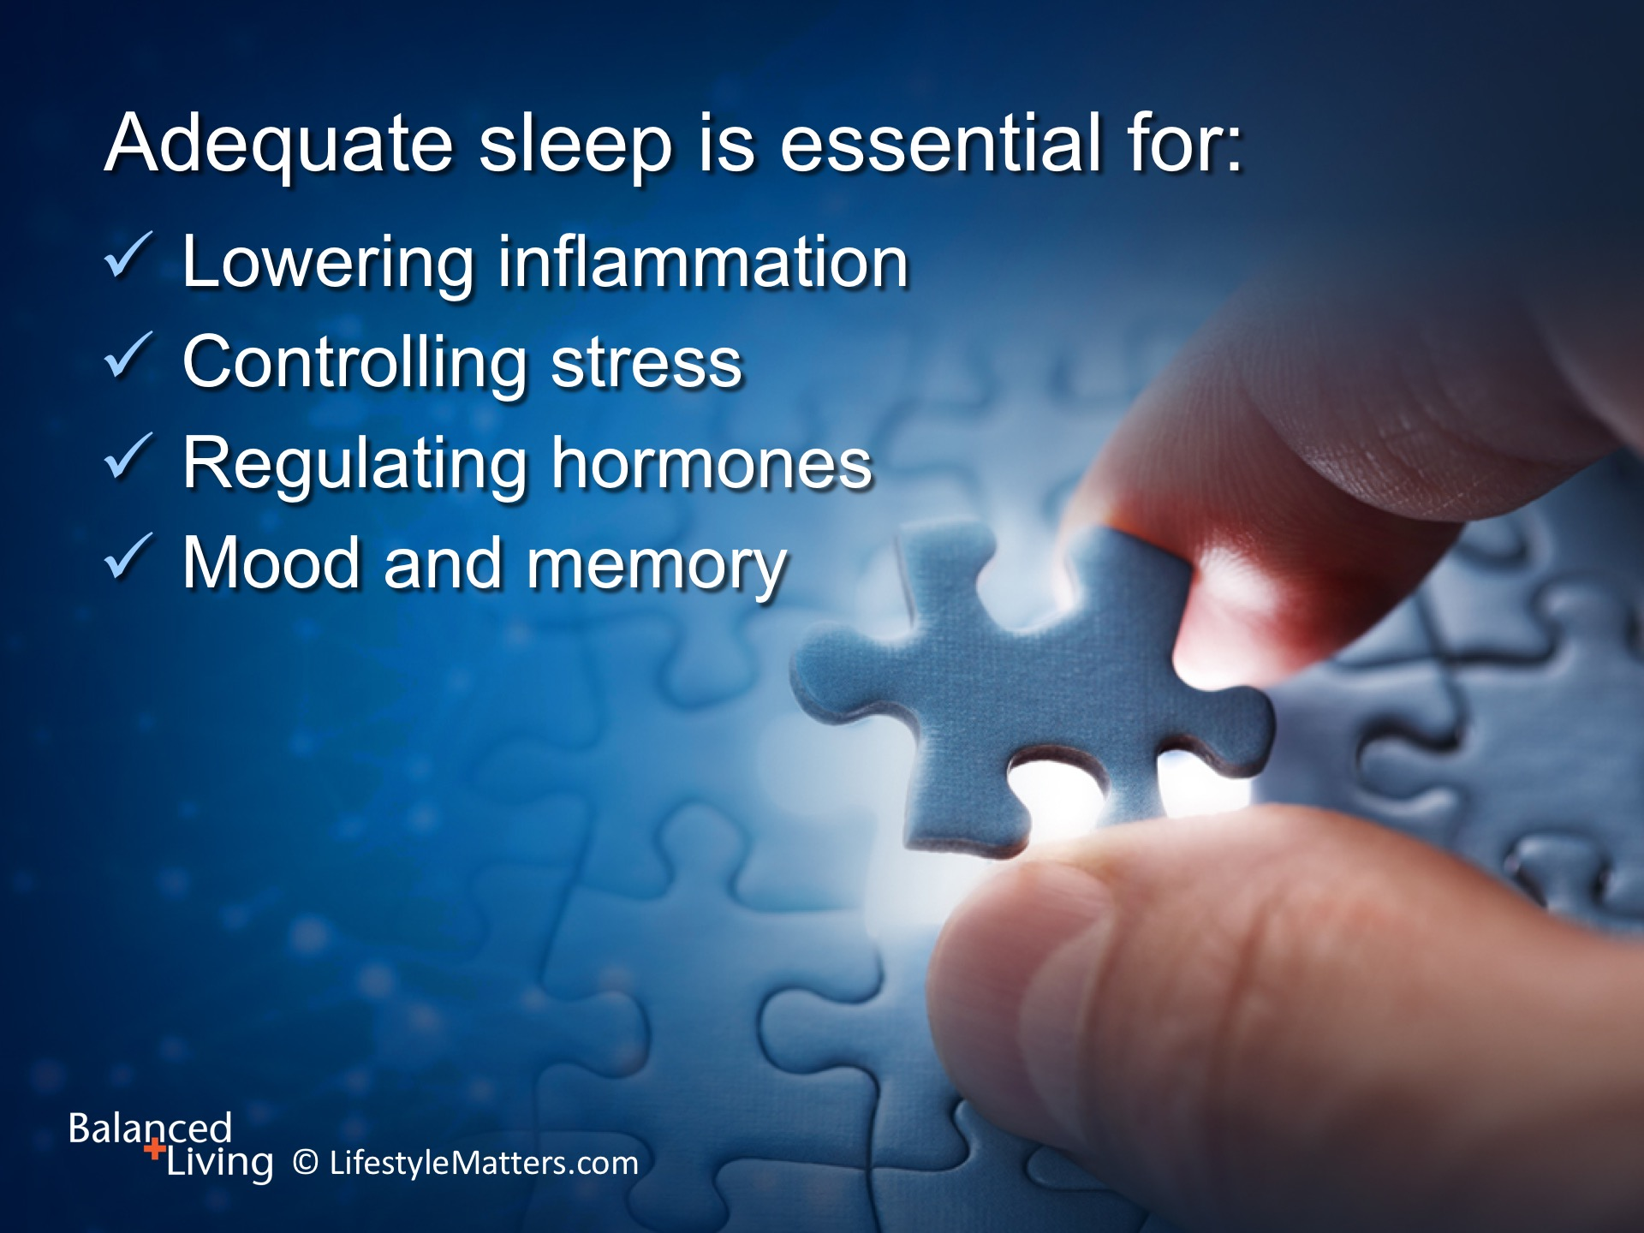
Notes:
Read slide.
Develop a “sleep routine” at night to signal your brain and body that it’s time to wind down.
It may be a favorite book, bathrobe, or bathtub.
Tone down the intensity of evening activities, and leave meals and media alone several hours before bedtime.

Slide 23
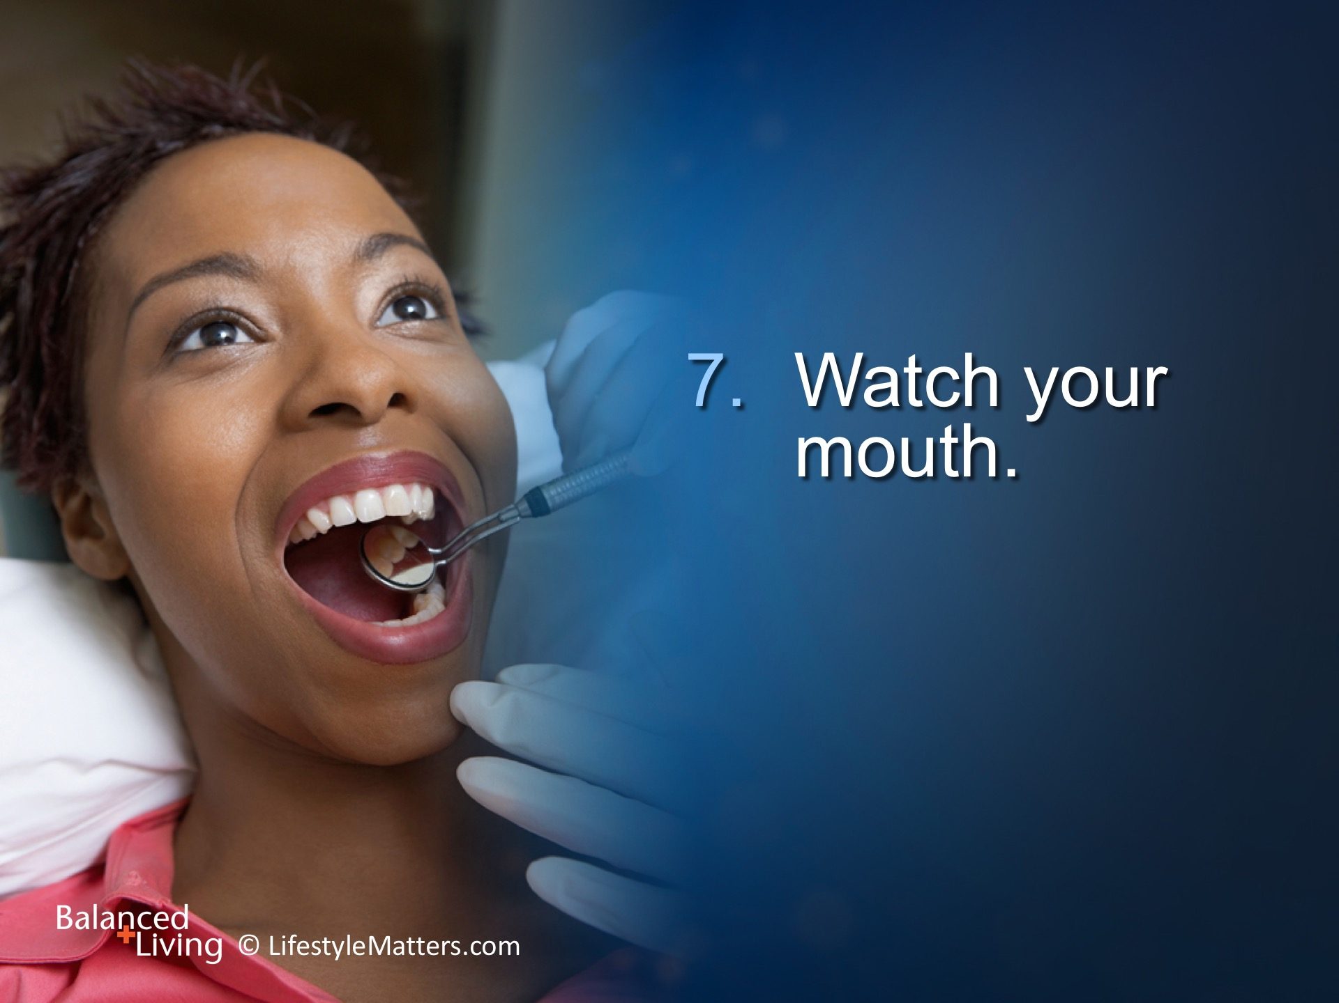
Notes:
Read slide.
When it comes to your mouth, inflammation is a two-way street.

Slide 24
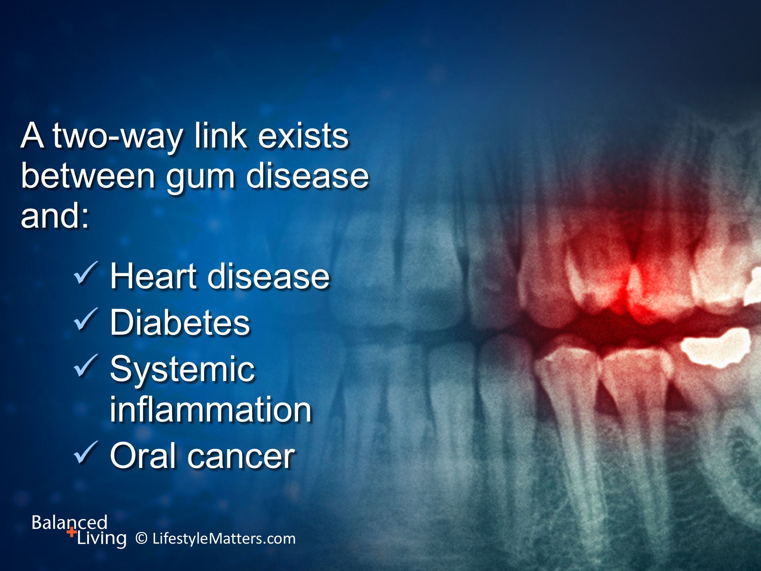
Notes:
Read slide.
Gum diseases can contribute to heart disease and diabetes. And heart disease and diabetes can fuel gum disease.
1. Healthy gums for a healthier heart
Gum disease from extended bacterial exposure can lead to cardiovascular disease as it may increase the inflammation level throughout the body. Your dentist or hygienist should ask you about your heart health and family history of heart disease and conversely, cardiologists should examine your oral health. A problem in one area may signal trouble in the other.
2. There's a two-way link between gum disease and diabetes
While it’s known that people with diabetes are more prone to gum disease, surprising new studies suggest that serious gum disease may actually contribute to diabetes. Because periodontal disease is an infection, bacteria produce toxins that affect the carbohydrate metabolism in individual cells. This two-way link is a wake-up call to take care of your teeth, especially since the incidence of diabetes is rising.

Slide 25

Notes:
Read slide.
Scientists have found a compelling link between stress and inflammation.
Although we can’t always control the things that come into our lives, we can learn better ways to cope.
One way to reduce anxiety is to focus on solutions rather than problems!
Then time to unwind by spending time with friends and family, and getting out in nature.
Turn the care of those things you can’t control over to God, who loves you and has a plan.

Slide 26

Notes:
Read slide.
Attitude is outlook.
A good attitude will get you good “altitude” when it comes to achieving forward movement in life.

Slide 27
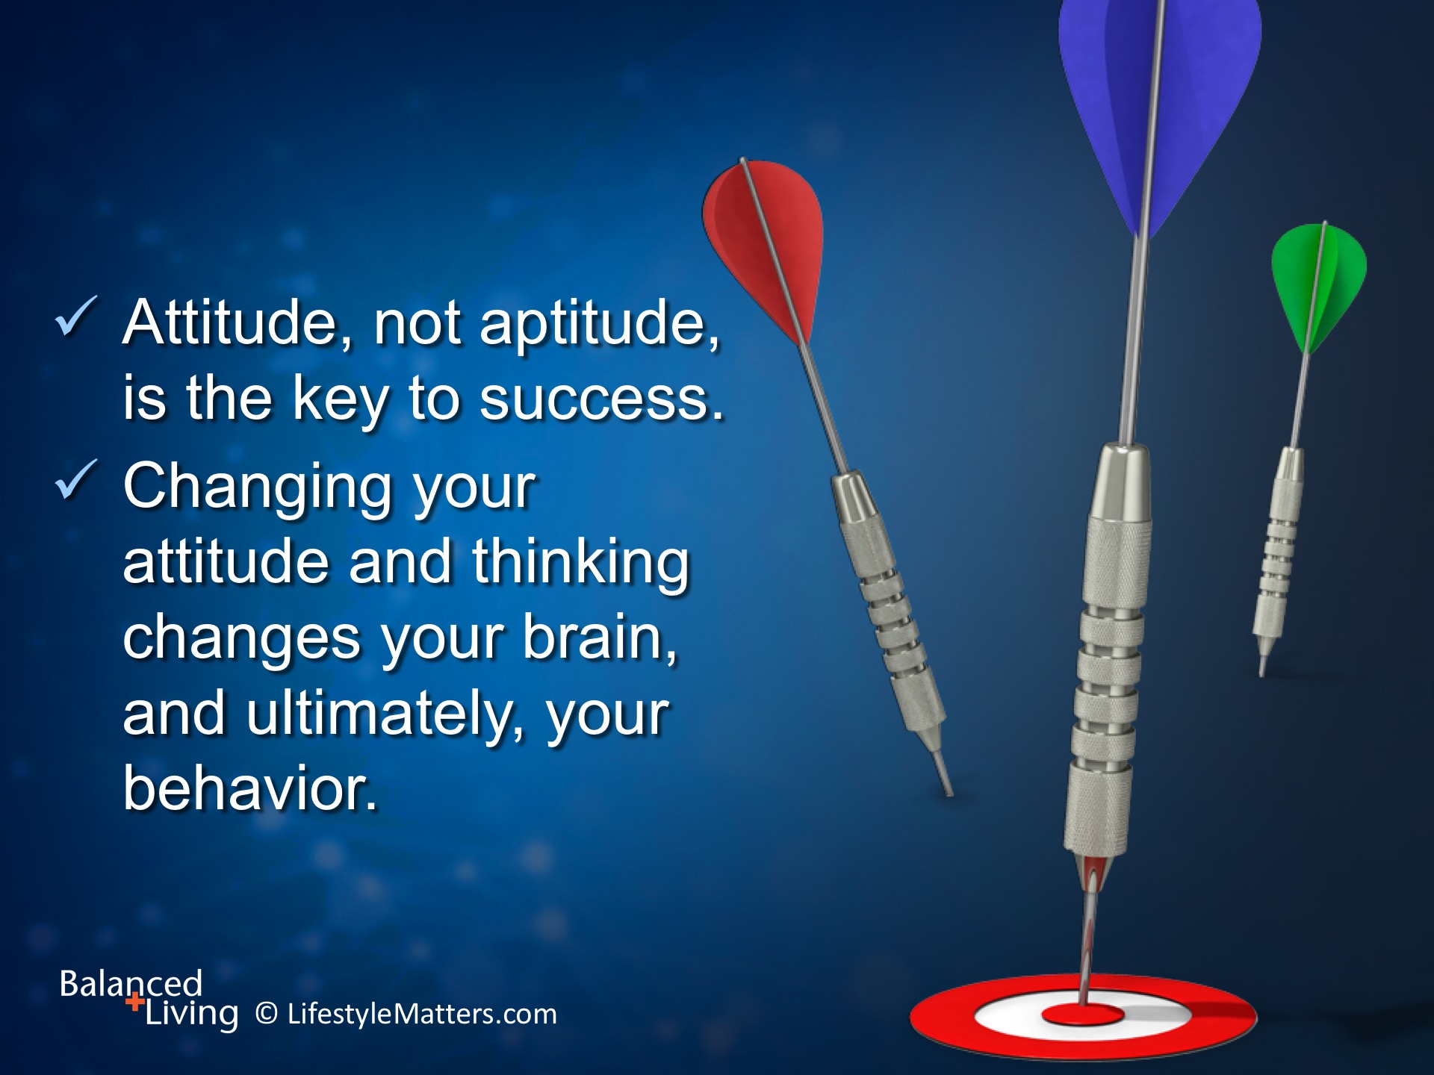
Notes:
Read slide.

Slide 28
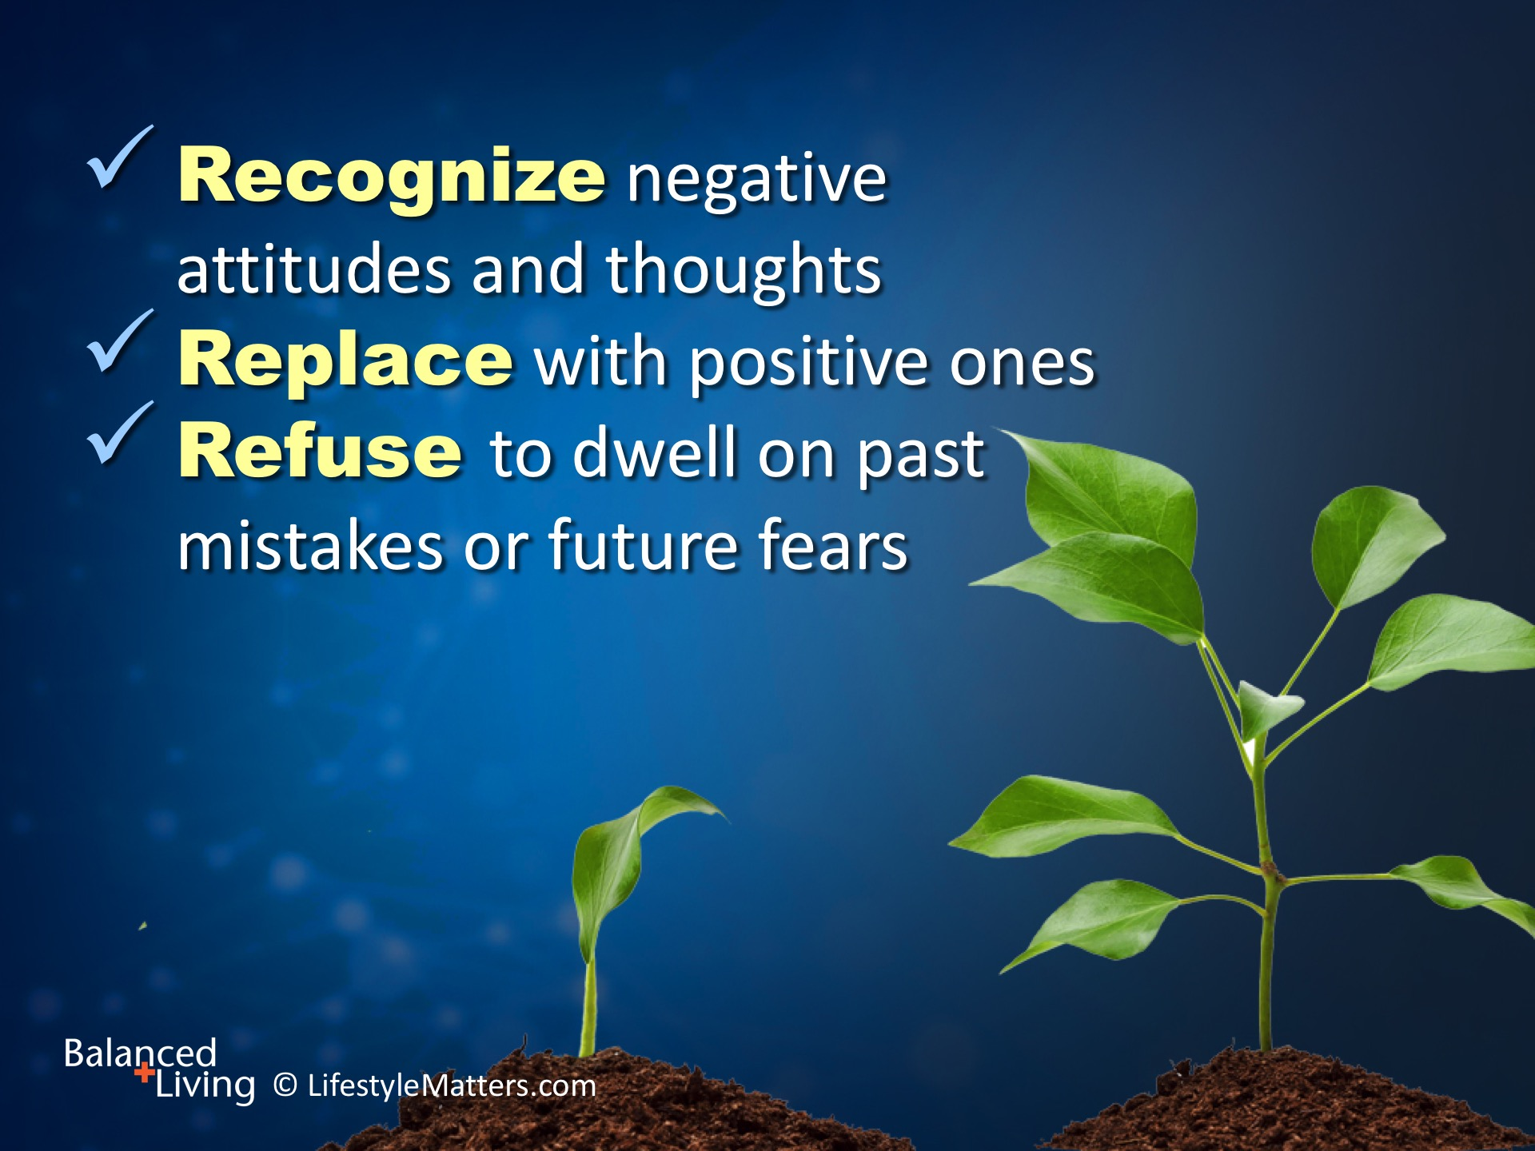
Notes:
The way we think is just as much a discipline as how we choose to live.
I like to think of “attitudinal discipline” when it comes to how I relate to circumstances, challenges, and goals that are part of my life.
Here are three:
Read slide.

Slide 29
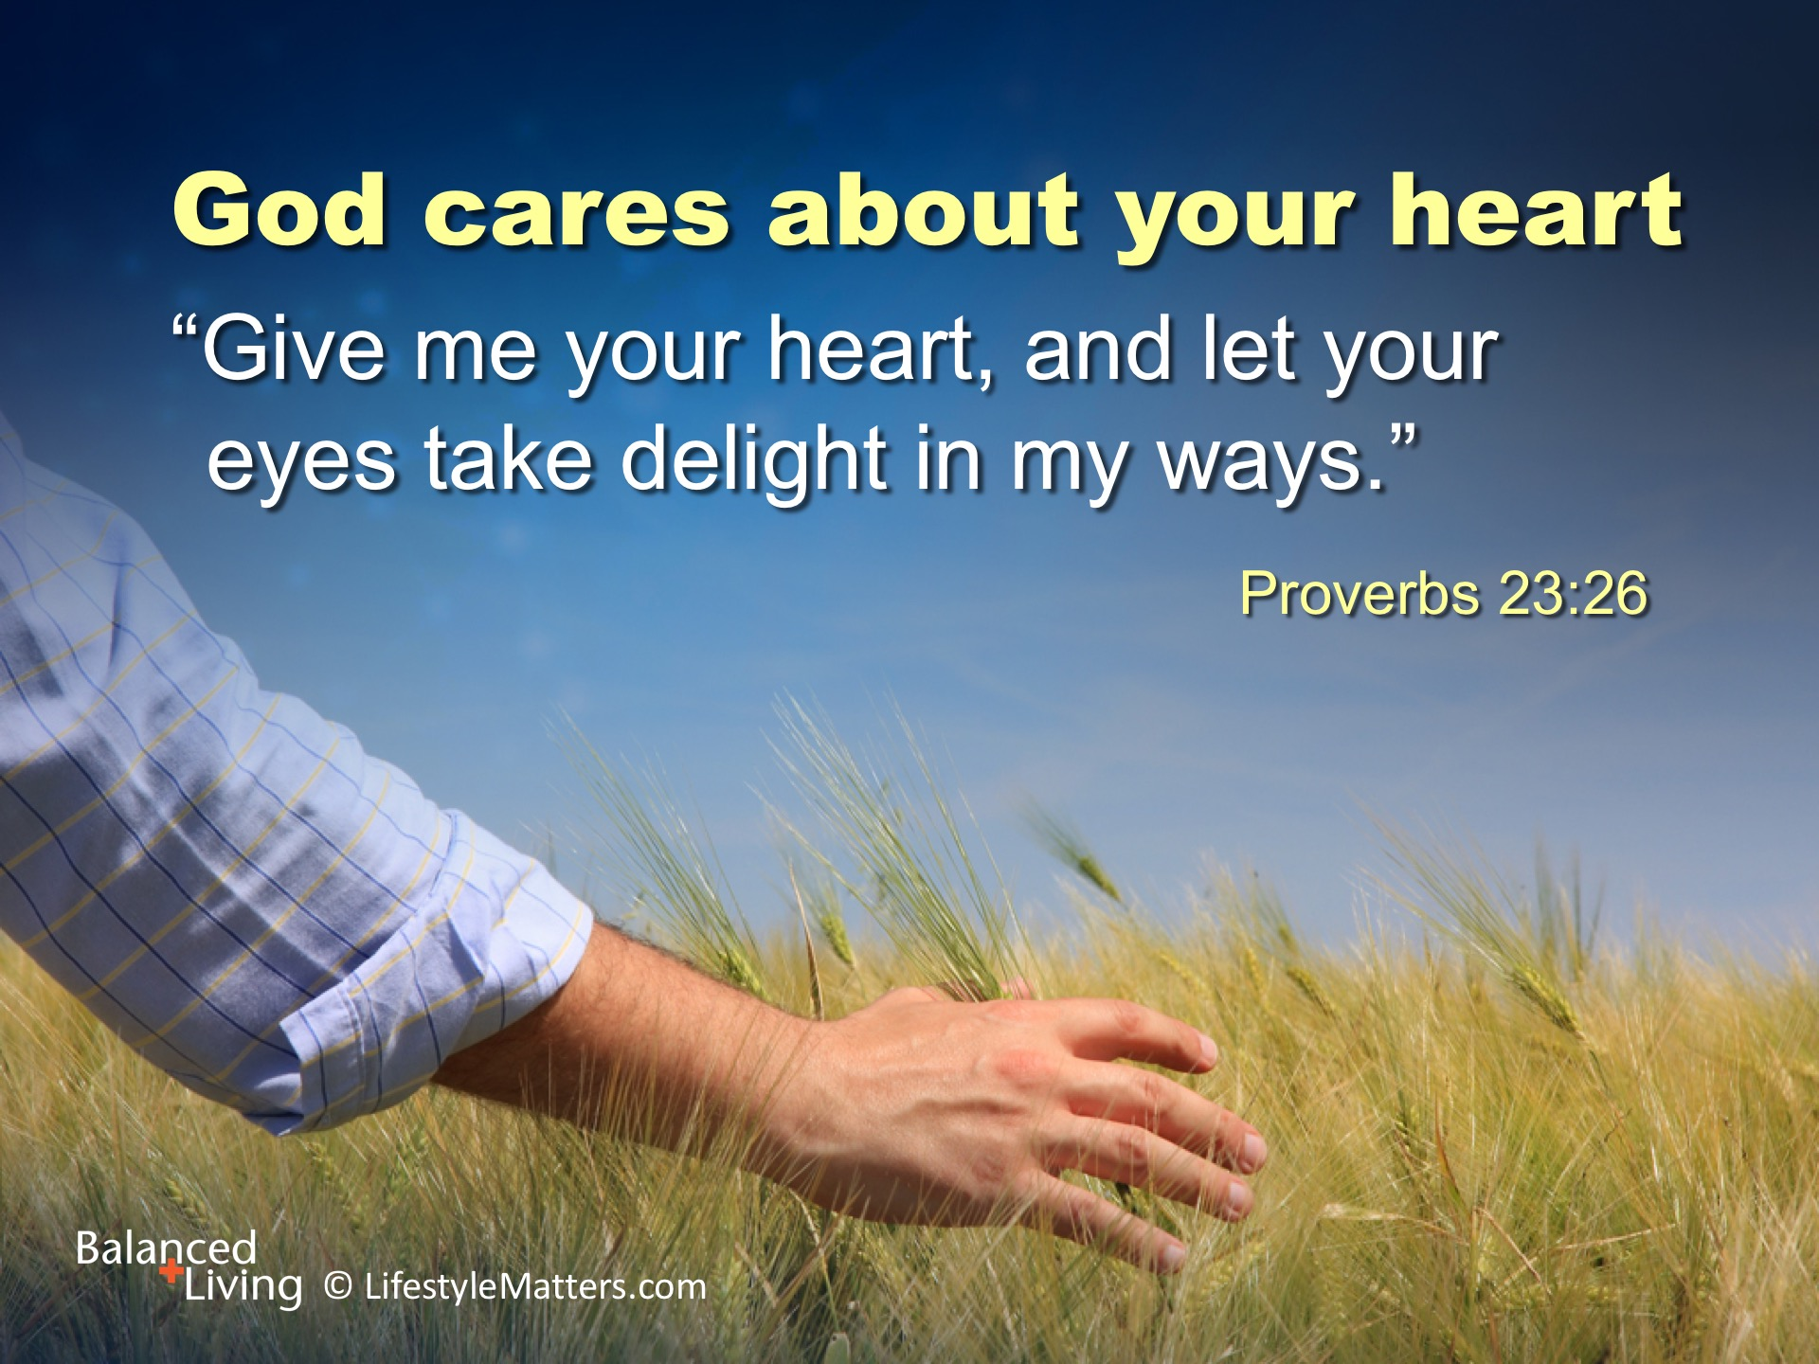
Notes:
God speaks of the heart as more than an organ that pumps blood.
The Bible uses the heart to represent the springboard of our actions and the seat of our emotions.
Read slide.
Why not let Jesus Christ—the God of all healing, comfort, and love—help you form new habits and renew your inner life today? (signify by raised hand)

