Slide 1


Images © Alamy
www.alamy.com
Images used in powerpoint presentation are part of the presentation and not to be used out of context of the presentation, may not be used as stand-alone images unless to promote the presentation/event, and may not be resold in singular form or as part of an image library. Images are © Alamy and presentation templates and content therein are © MISDA, any other usage requires written permission from both parties.

Slide 2
Scripture quotations used in Balanced Living PowerPoints are taken from Bibles in the Public Domain which have no USA copyright restrictions. We have indicated which version each quotation is taken from as follows:
KJV - King James Version
BBE - Bible in Basic English
WEB - World English Bible
DBY - Darby's Translation
Any scriptures not otherwise noted are the author's paraphrase of one of these versions.

Slide 3
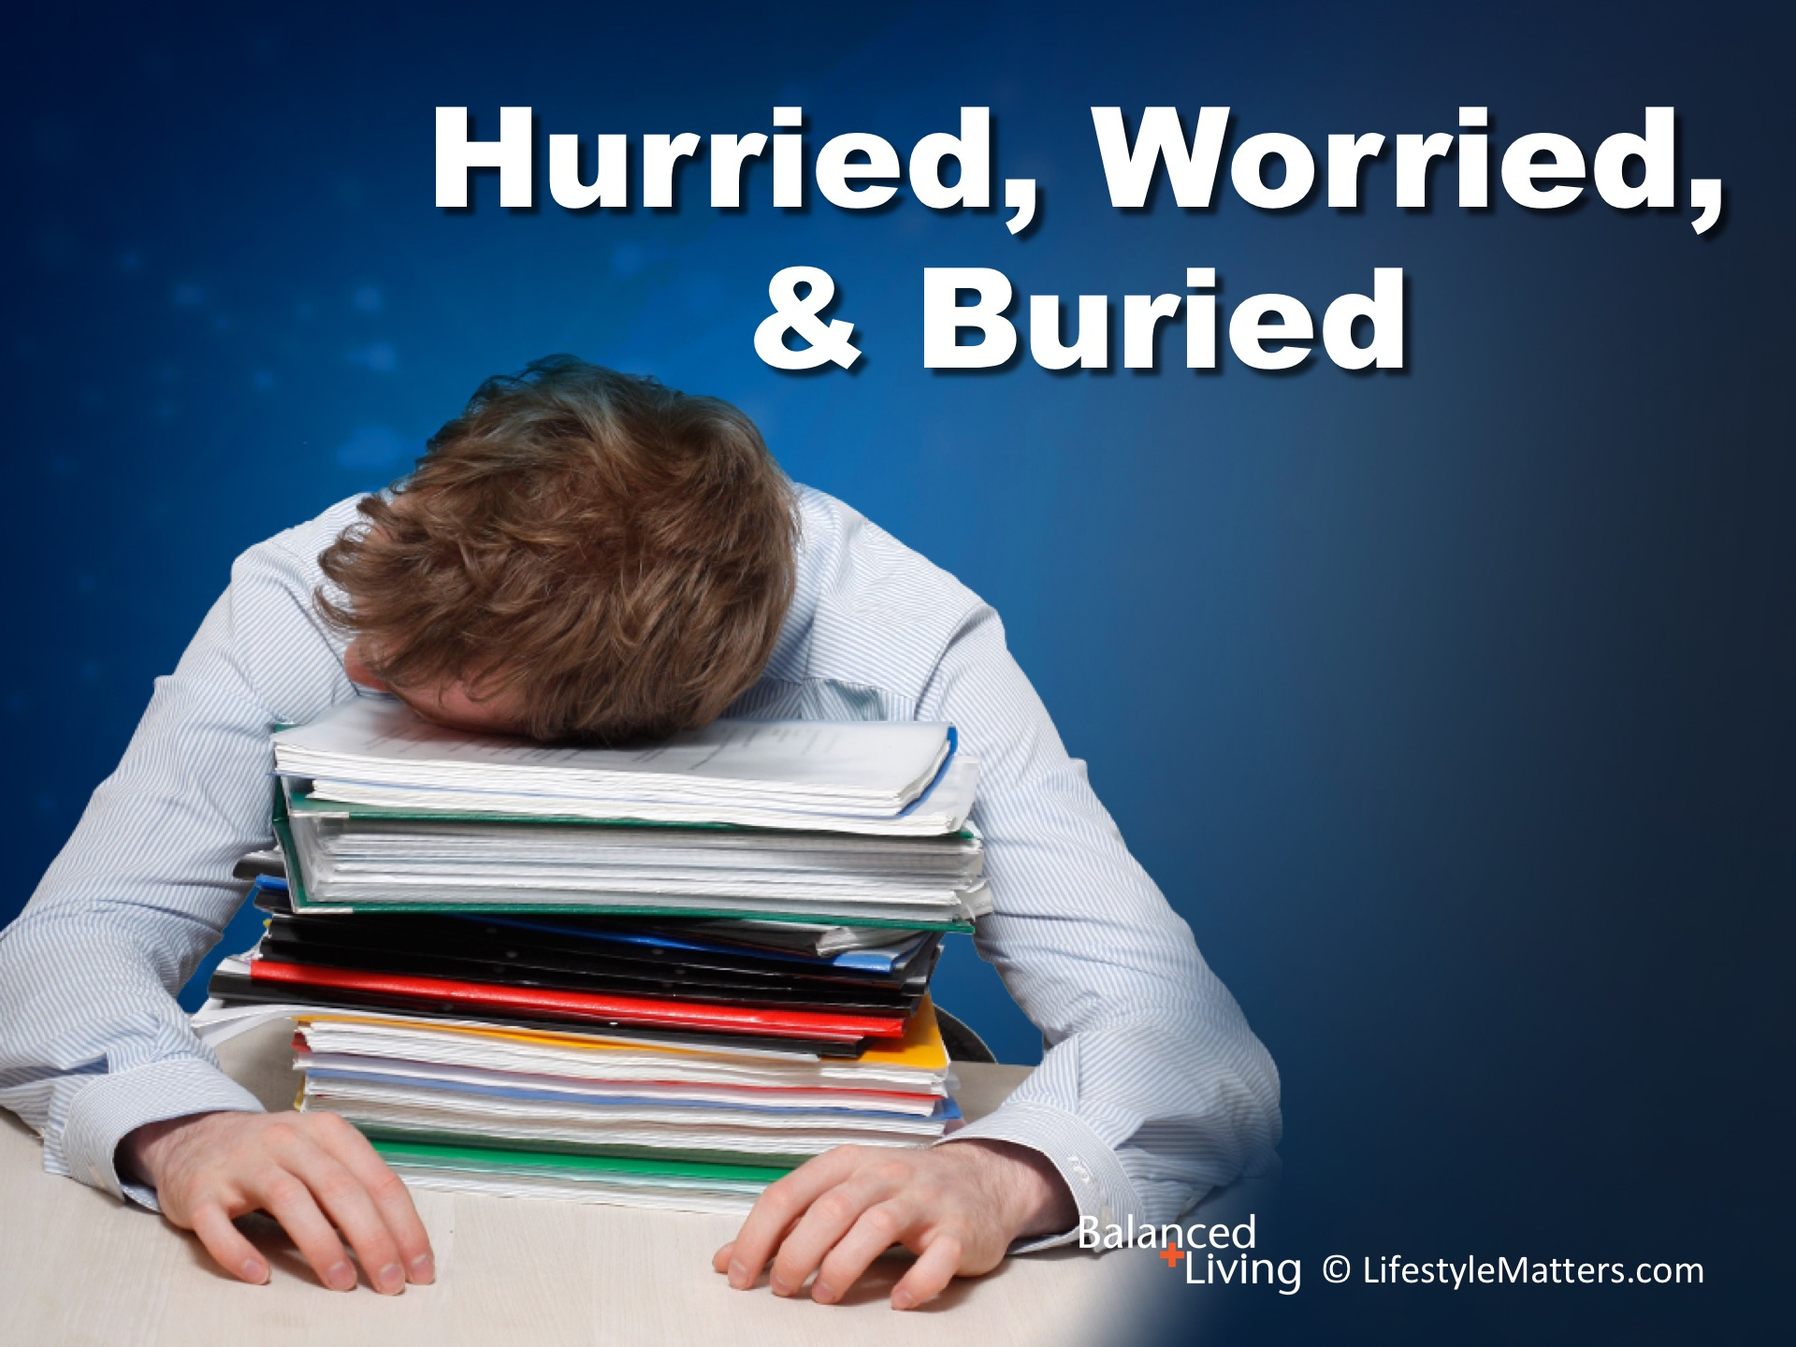
Notes:
In this session we are addressing the growing epidemic of “hurry sickness.” It’s called: Read slide.

Slide 4
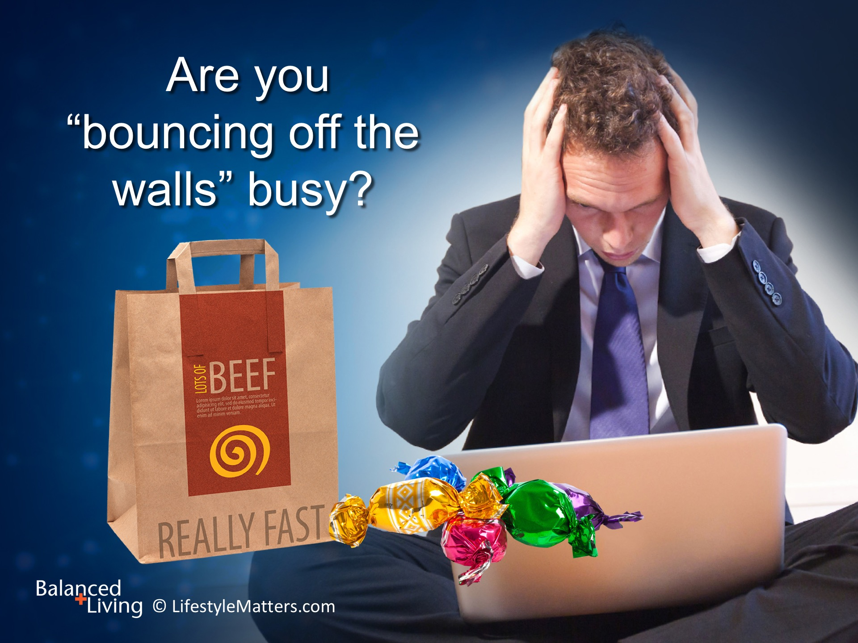
Notes:
Read slide.
So many of us are hooked on busy, but are barren when it comes to true contentment and realizing life’s most important priorities.

Slide 5
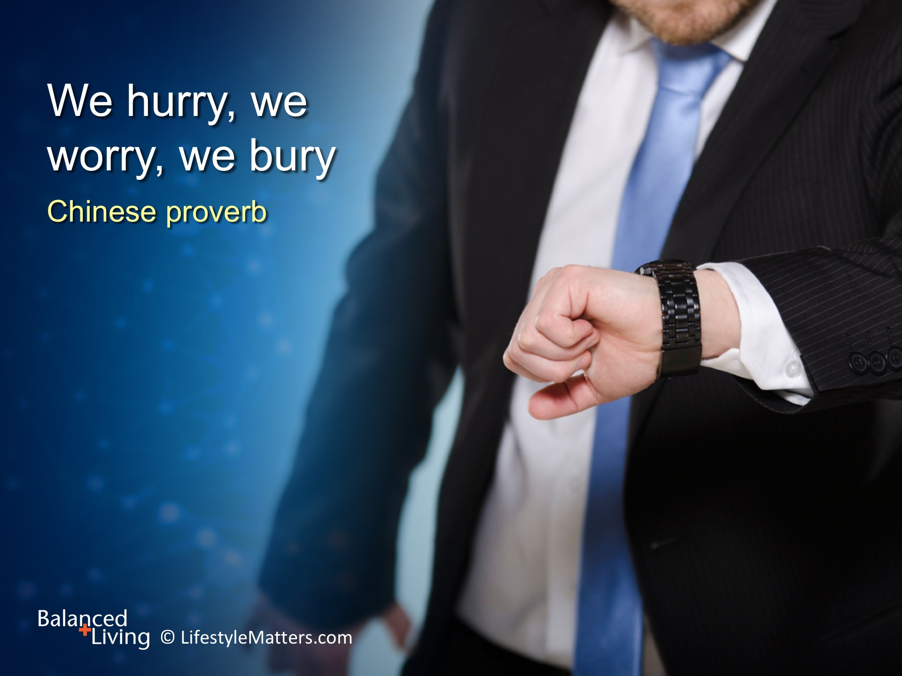
Notes:
Read slide.
We get a lot done, but without balance, we have come down with “hurry sickness” and are suffering physically, emotionally, and spiritually.

Slide 6
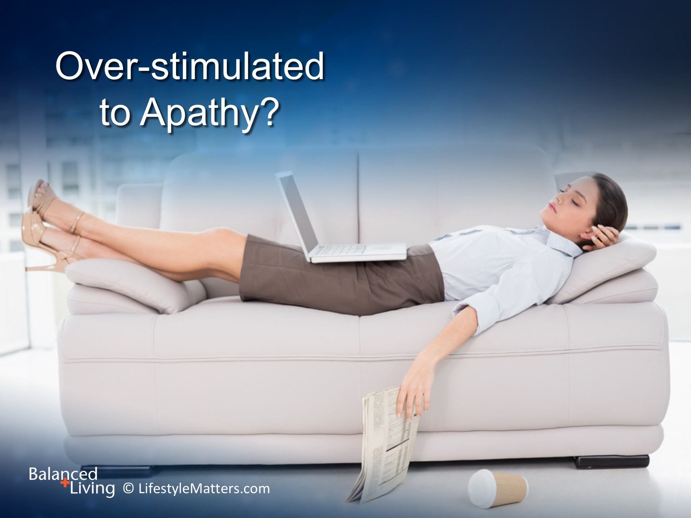
Notes:
Read slide.
How would you describe apathy? (Wait for response)
Apathy is a loss of interest, energy, and motivation—the same symptoms we experience when we come down with the flu!

Slide 7
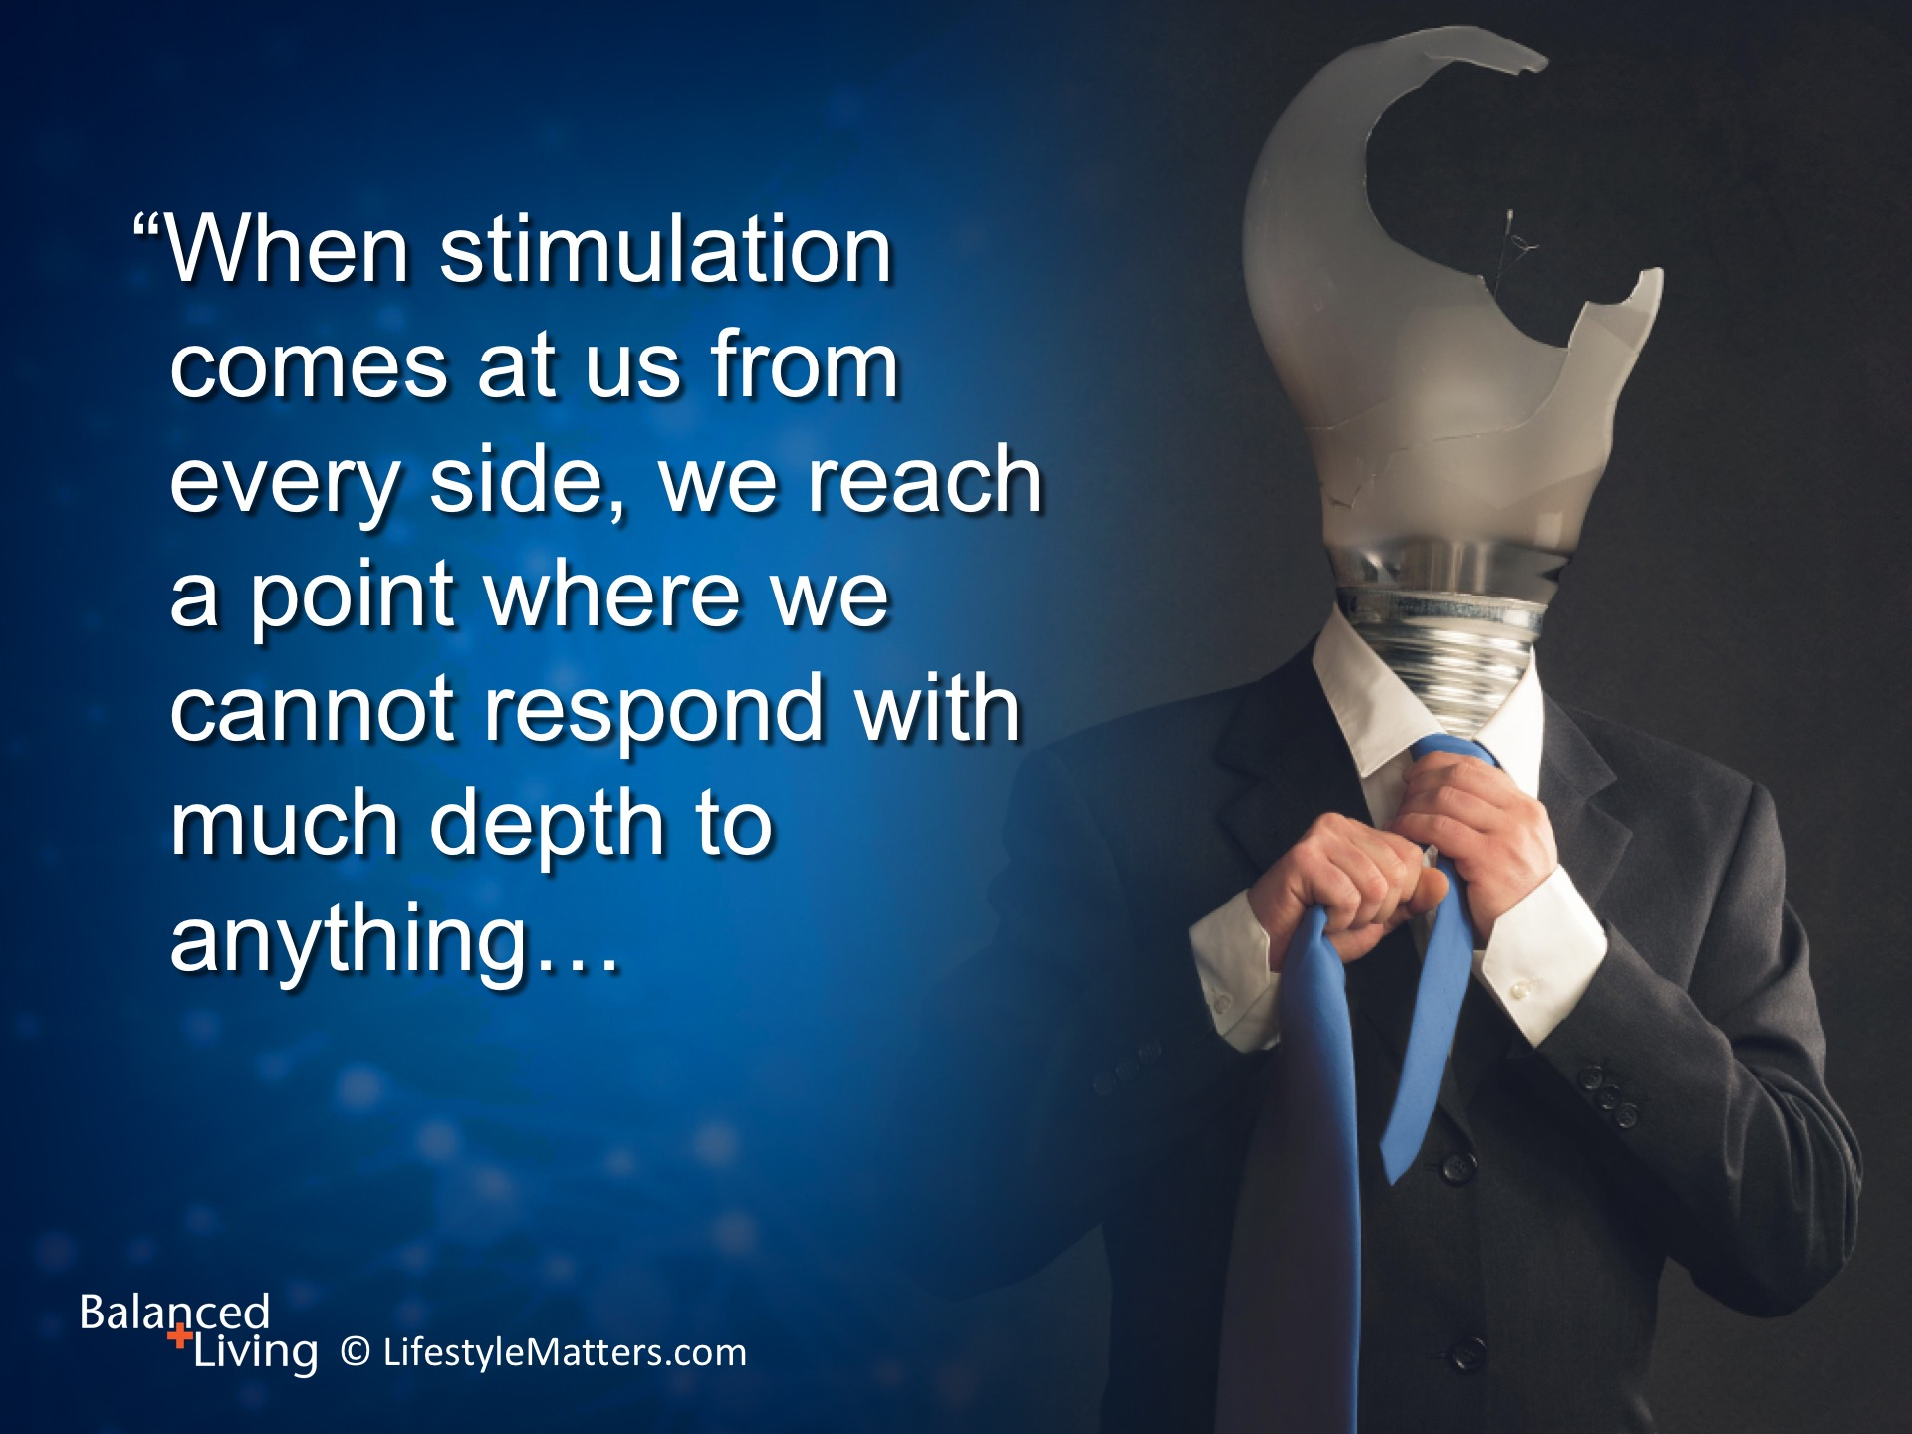
Notes:
Author and Christian psychiatrist Richard Winter states it this way: Read slide.
What is your experience right now? Can you relate? I think most of us can!

Slide 8
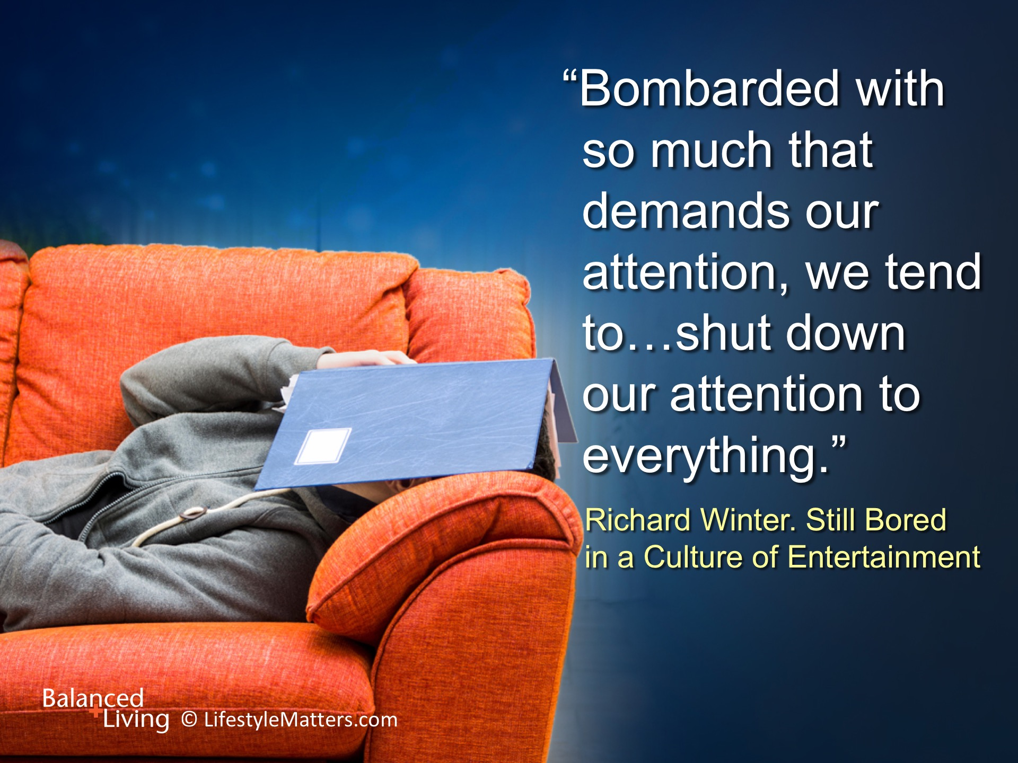
Notes:
Read slide.
We can now carry the “whole world” in our pockets with our smart phones.
We have instant access to news; weather; shopping; friends; work; email; texting; and “alerts” of all kinds in at the touch of a finger.
Are you managing your smart phone or is your smart phone managing you….and stealing away precious time with too much information?

Slide 9
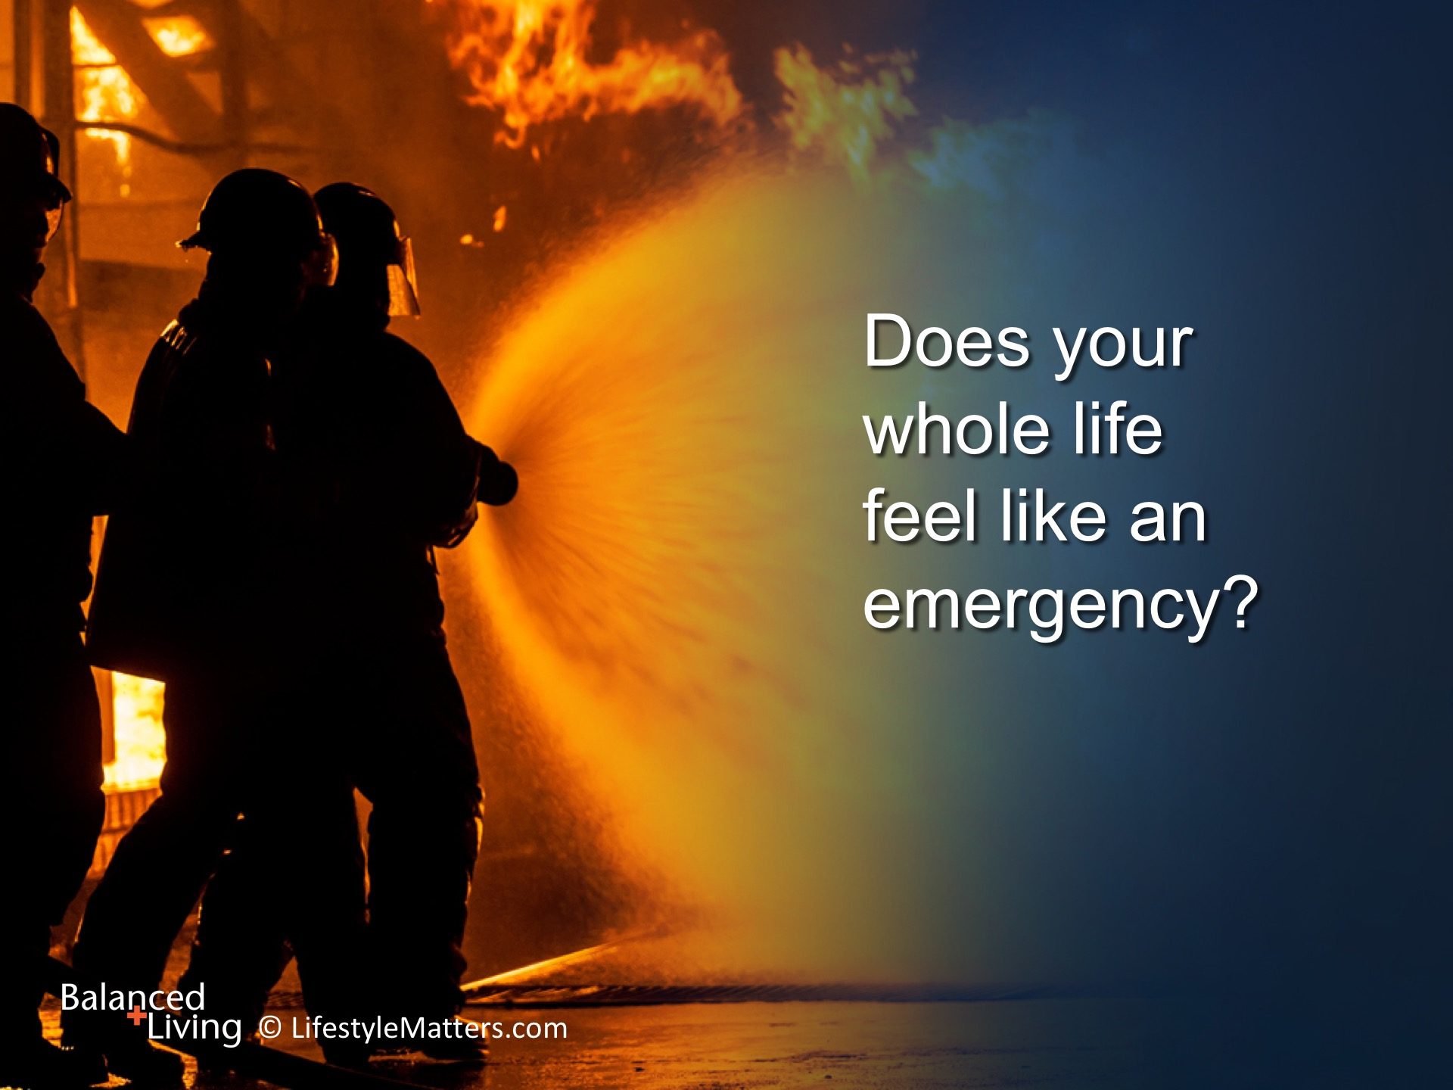
Notes:
Read slide.
Our bodies respond to the panic signals when we are frantic and worried—even over “little” things.
We can be so busy doing things that “feel” like an emergency, but in the big picture they may not be that important at all!
Can you think of some examples? (Wait for response)

Slide 10
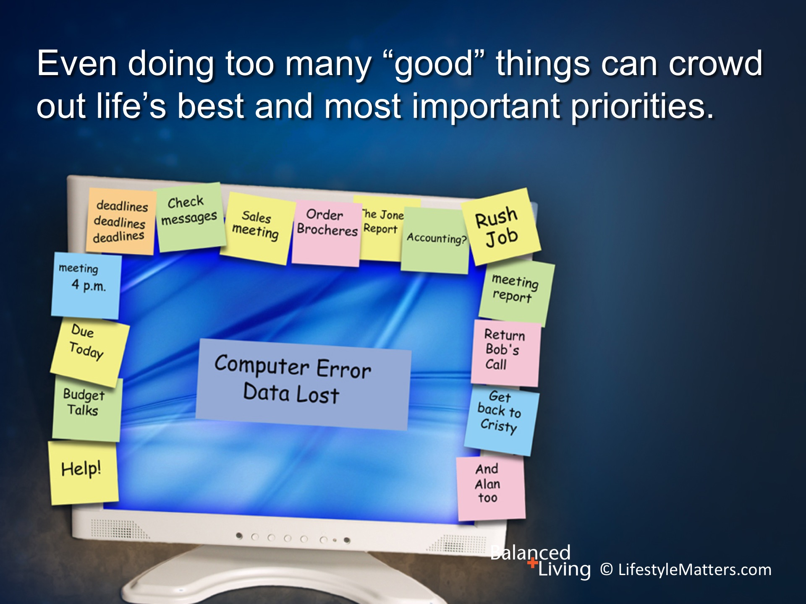
Notes:
Read slide.
Let’s take a breath and look at some important principles for balancing the multiple roles and priorities we all carry.

Slide 11
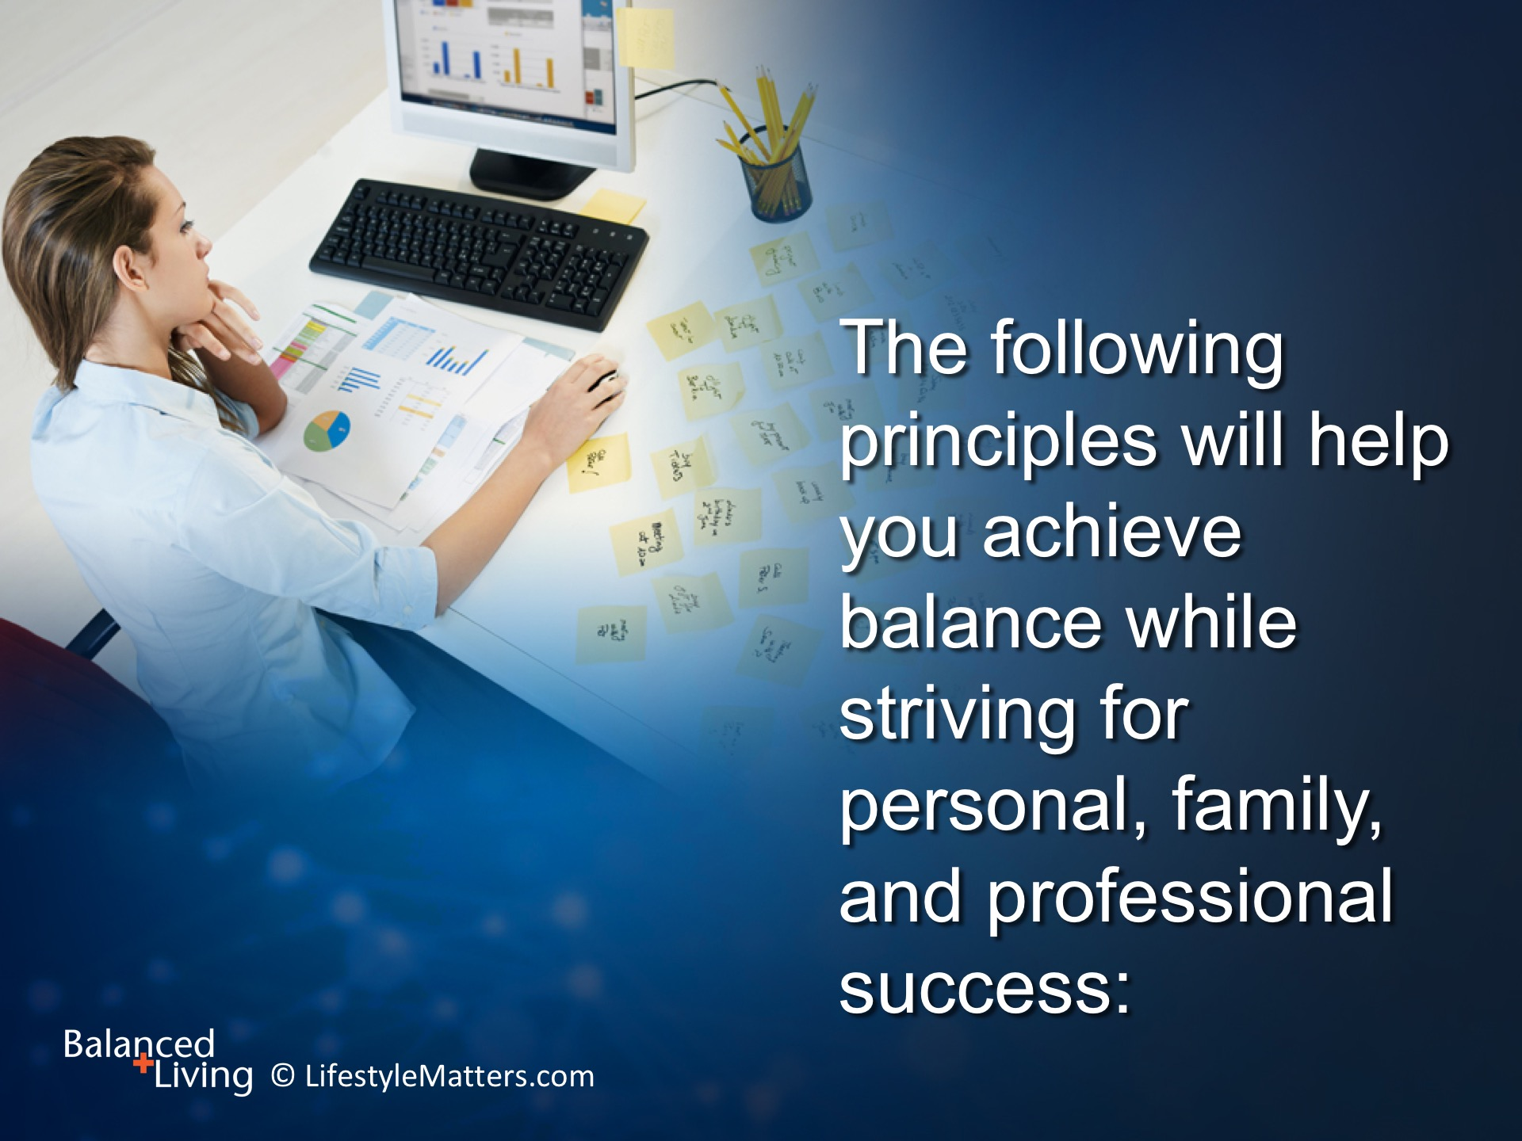
Notes:
Read slide.

Slide 12
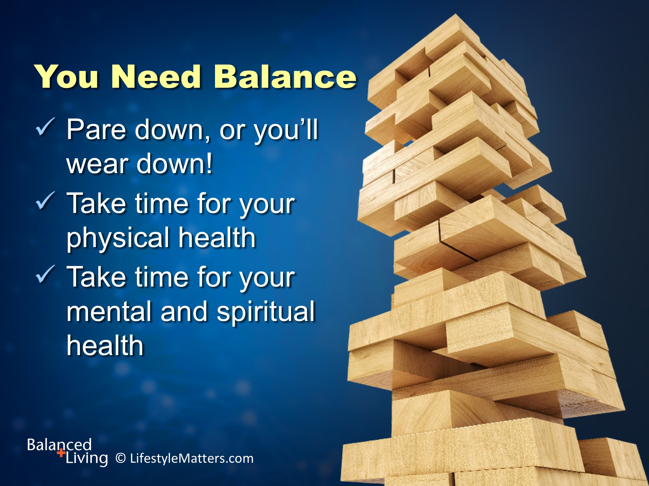
Notes:
Read slide.
Let’s consider each one of these areas.
You may find that you are strong in one area, but need to concentrate more in another.
One thing is certain—they are all essential!

Slide 13
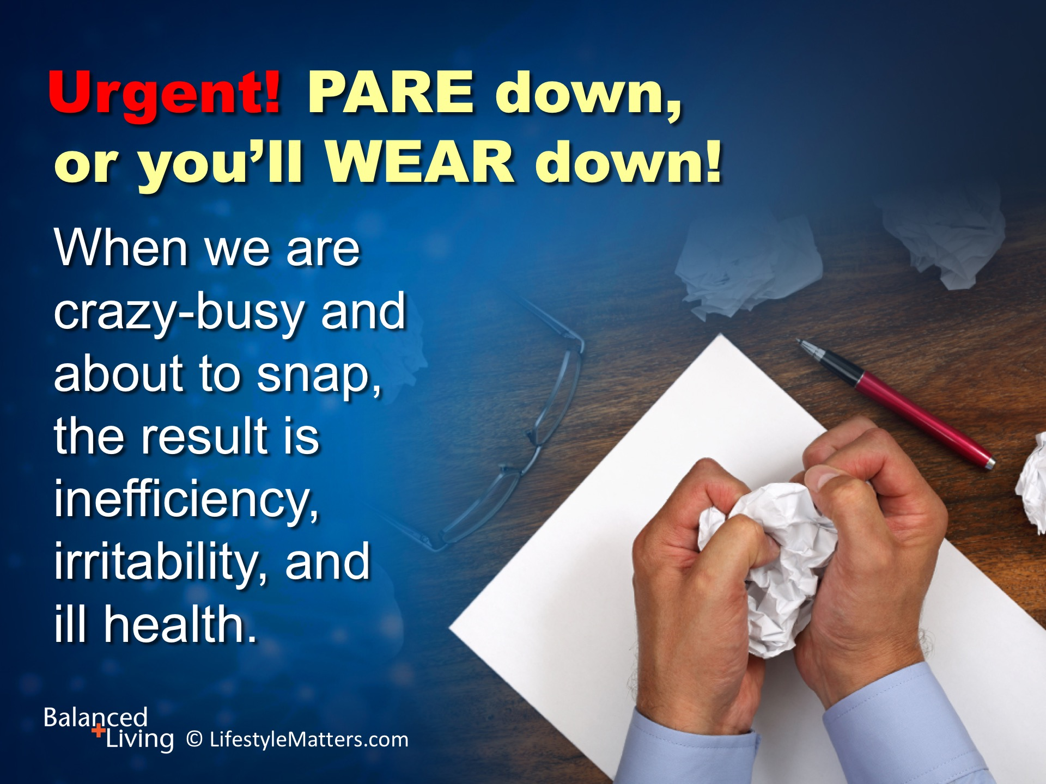
Notes:
Read slide.
Often life’s most important priorities such as sleep, good nutrition, exercise, and time with God and others suffer neglect until a genuine crisis occurs.
The crisis may come in the form of broken mental or physical health, deteriorating relationships, or a broken relationship with God.
What are some ways to simplify life but improve it’s quality? (Wait for response)
Example: We have bigger and costlier houses with more and more stuff.
But we have less time for things that matter the most – relationships and time to relax.

Slide 14
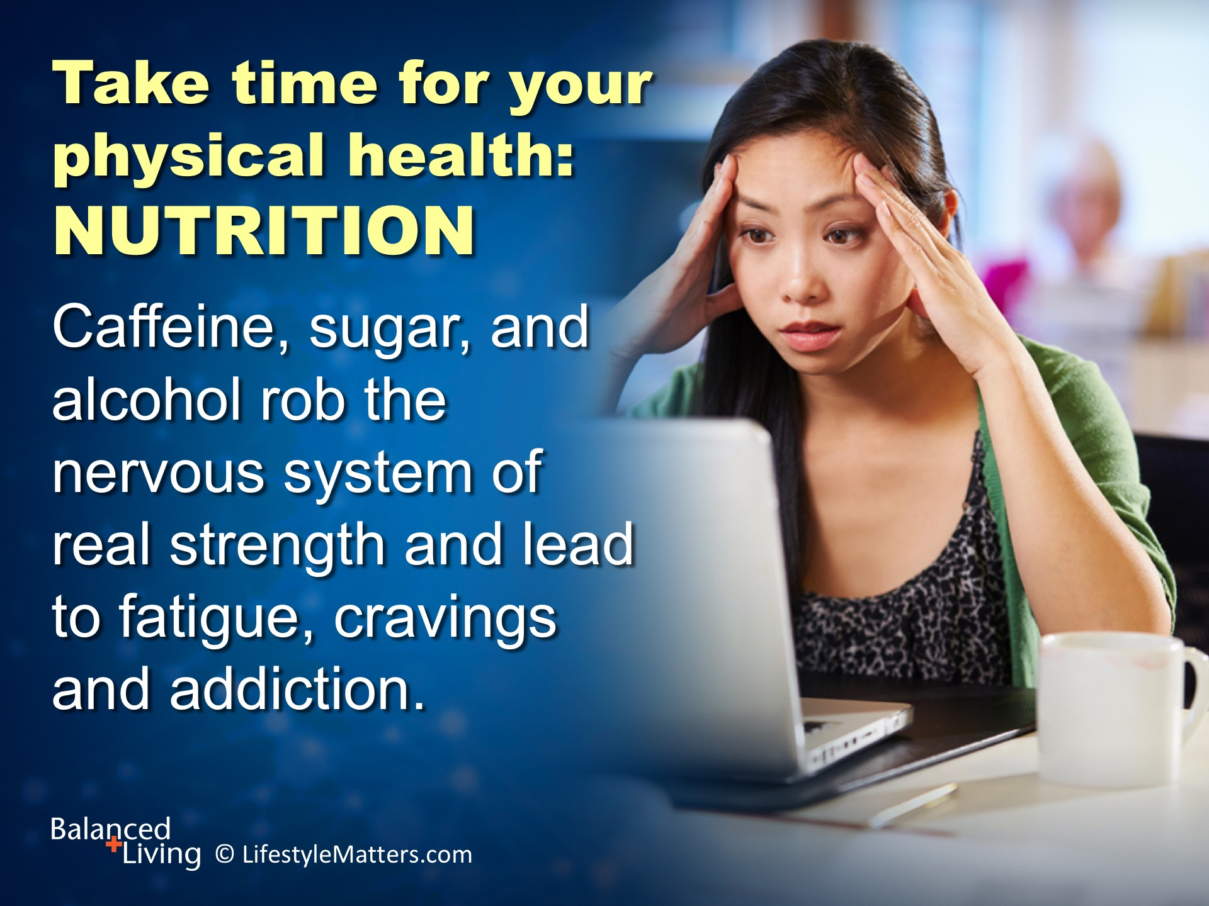
Notes:
Read slide.
What a trap this can be! Worn out, the temptation is to use stimulants to push ourselves to do more.
But it’s a dead-end side road! There are no short-cuts to true mental and physical strength.
The end result is even greater physical, mental, and emotional exhaustion.

Slide 15
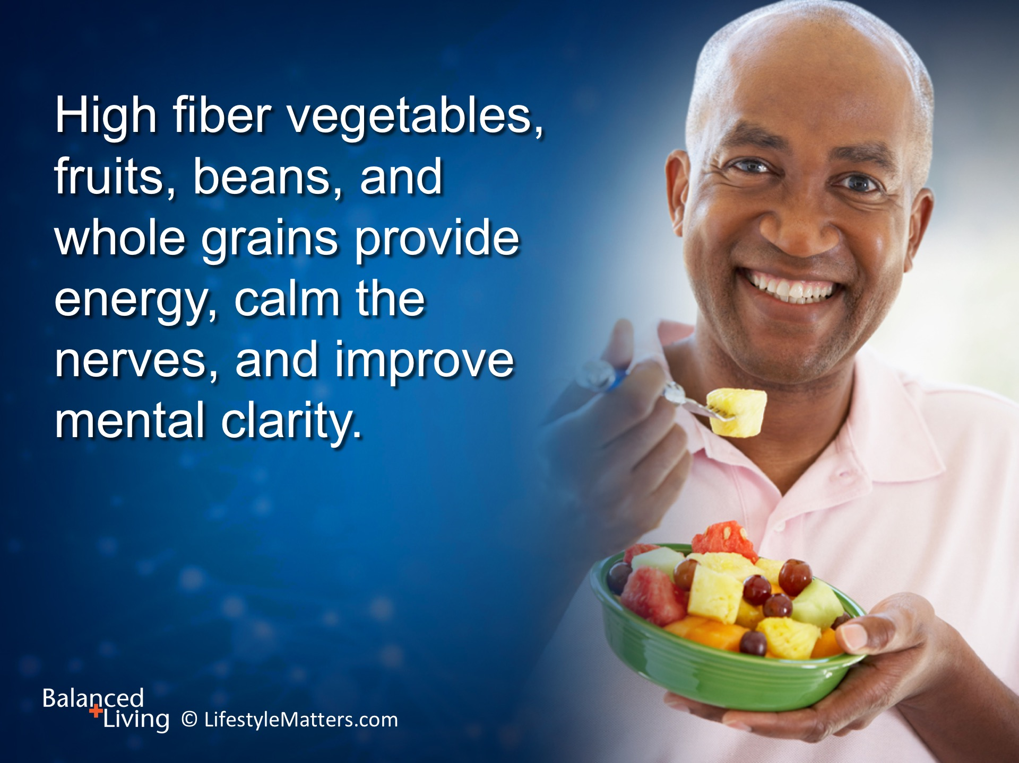
Notes:
Read slide.
What a bounty of benefits, both mental and physical!
Have you experienced the benefit of these choices, especially when stressed? (Wait for response)
How did you make it happen? (Wait for response)
Yes, there are great healthy options available for busy people! (name some, such as pre-packaged cut salads and greens)

Slide 16
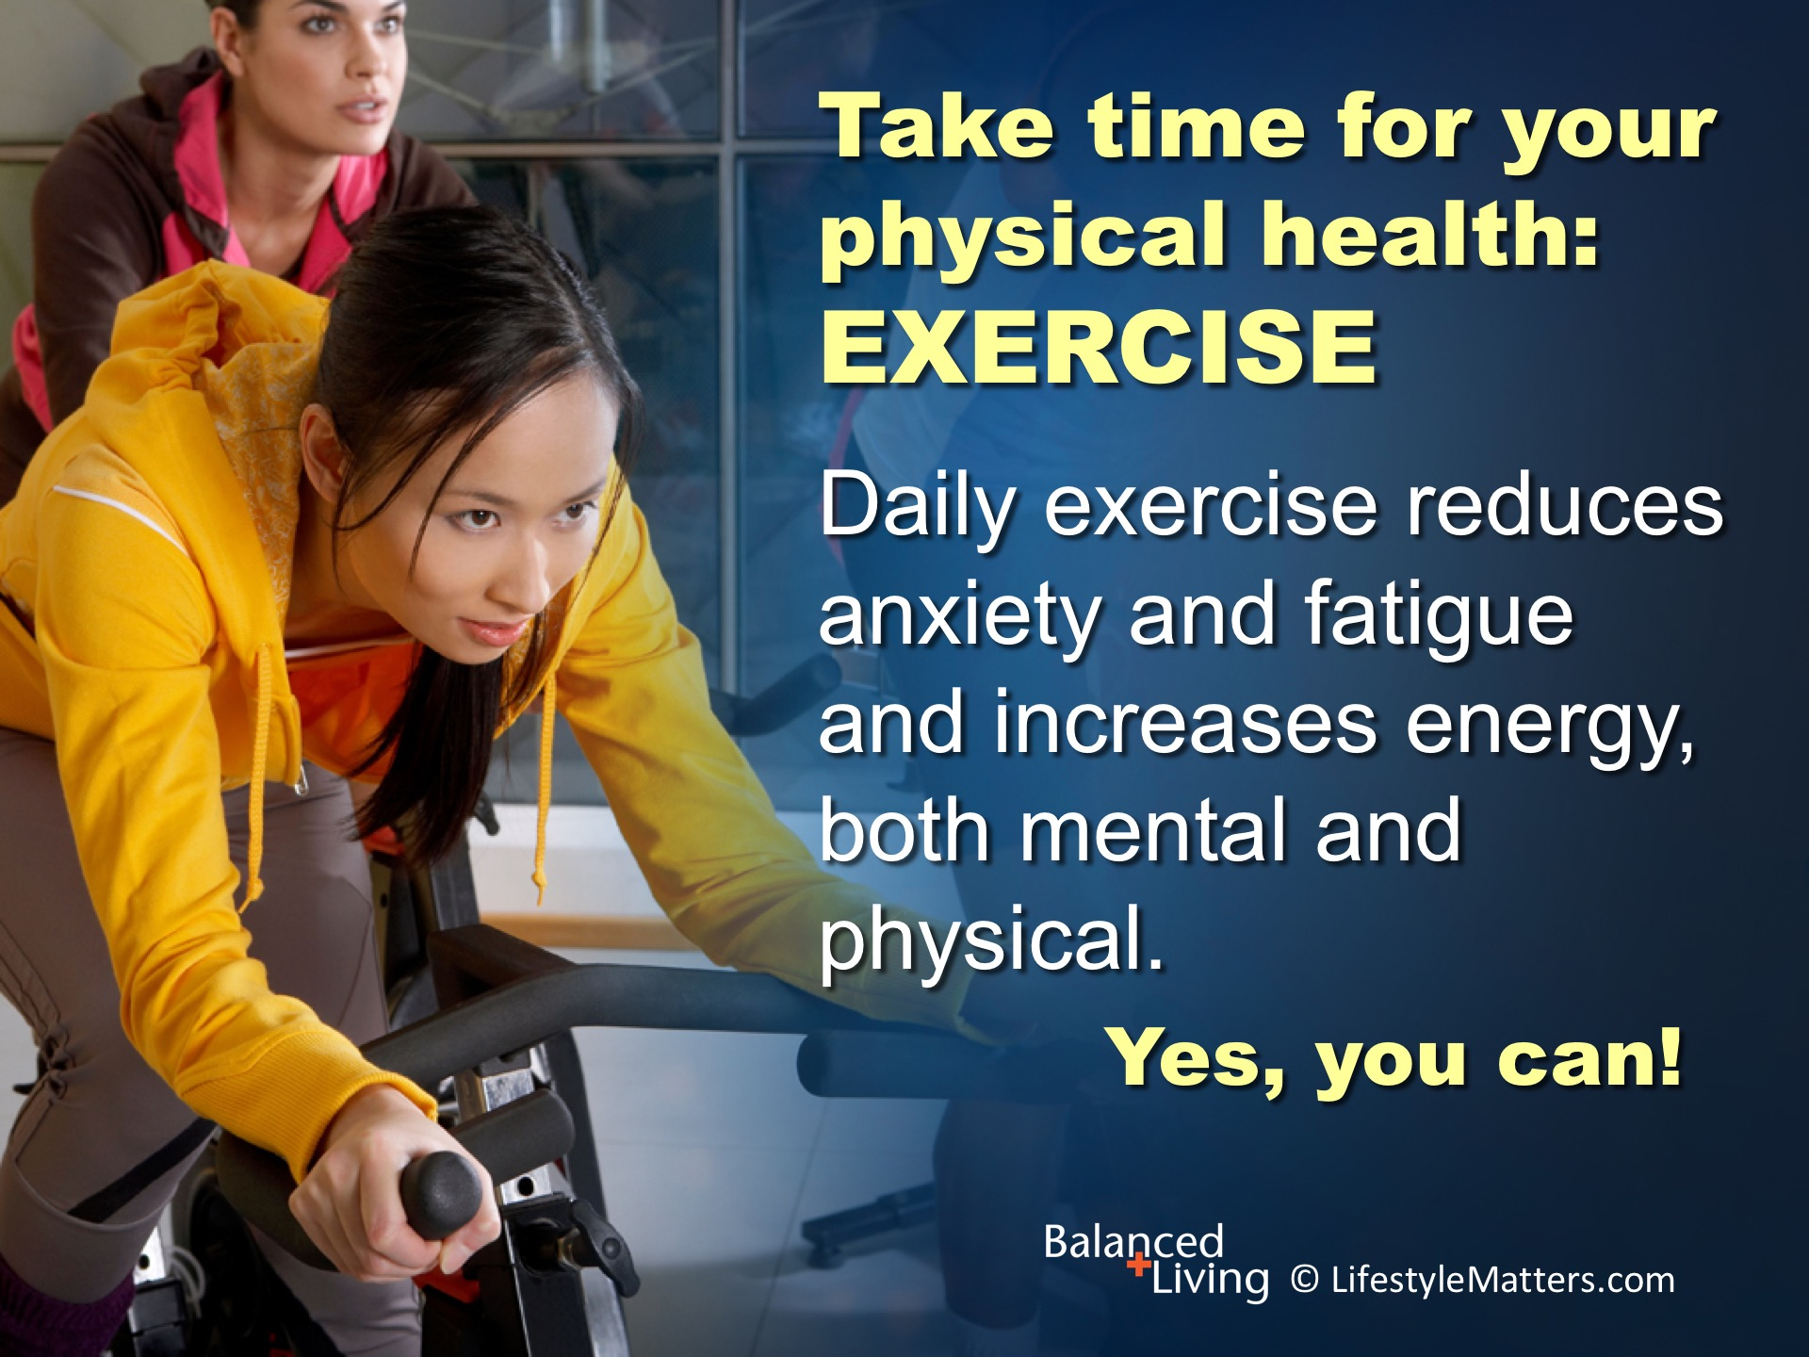
Notes:
Read slide.
Healthy food choices create an “upward spiral” of energy and improved mood; and so does daily exercise!
Mental focus, problem-solving, and creativity are increased with daily exercise, and it reduces stress!
What exercise do you enjoy, or are you willing to do on a daily basis? (Wait for response)
What are some ways to make movement more a part of life during weather? winter? at the office? at home? (Wait for response)
The question is not: WILL I exercise today? It is WHEN and WHERE will I exercise. ☺

Slide 17
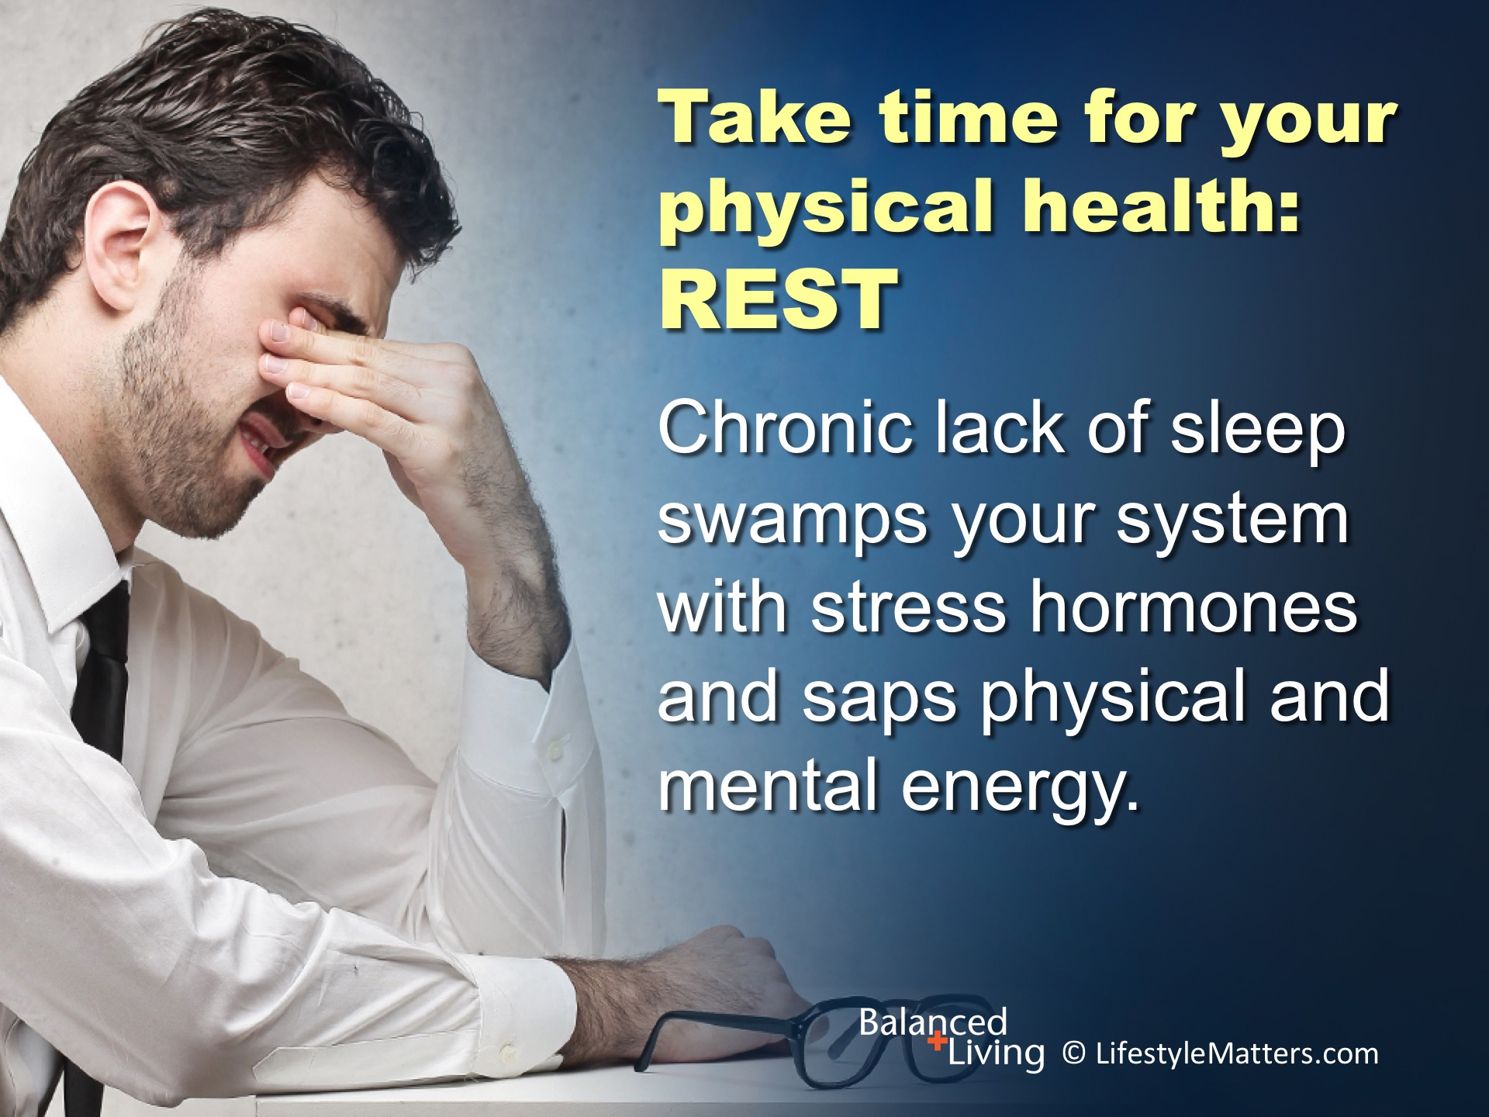
Notes:
Read slide.
As yourself, “When was the last time I really felt rested and at peace?”
The pace, the noise, the expectations, and the interruptions of modern life have not soothed our spirits, satisfied our deepest needs, or ministered to our physical need for rest.
Isn’t it time to consider seasons of rest and healthy sleep habits as a priority in your life?

Slide 18
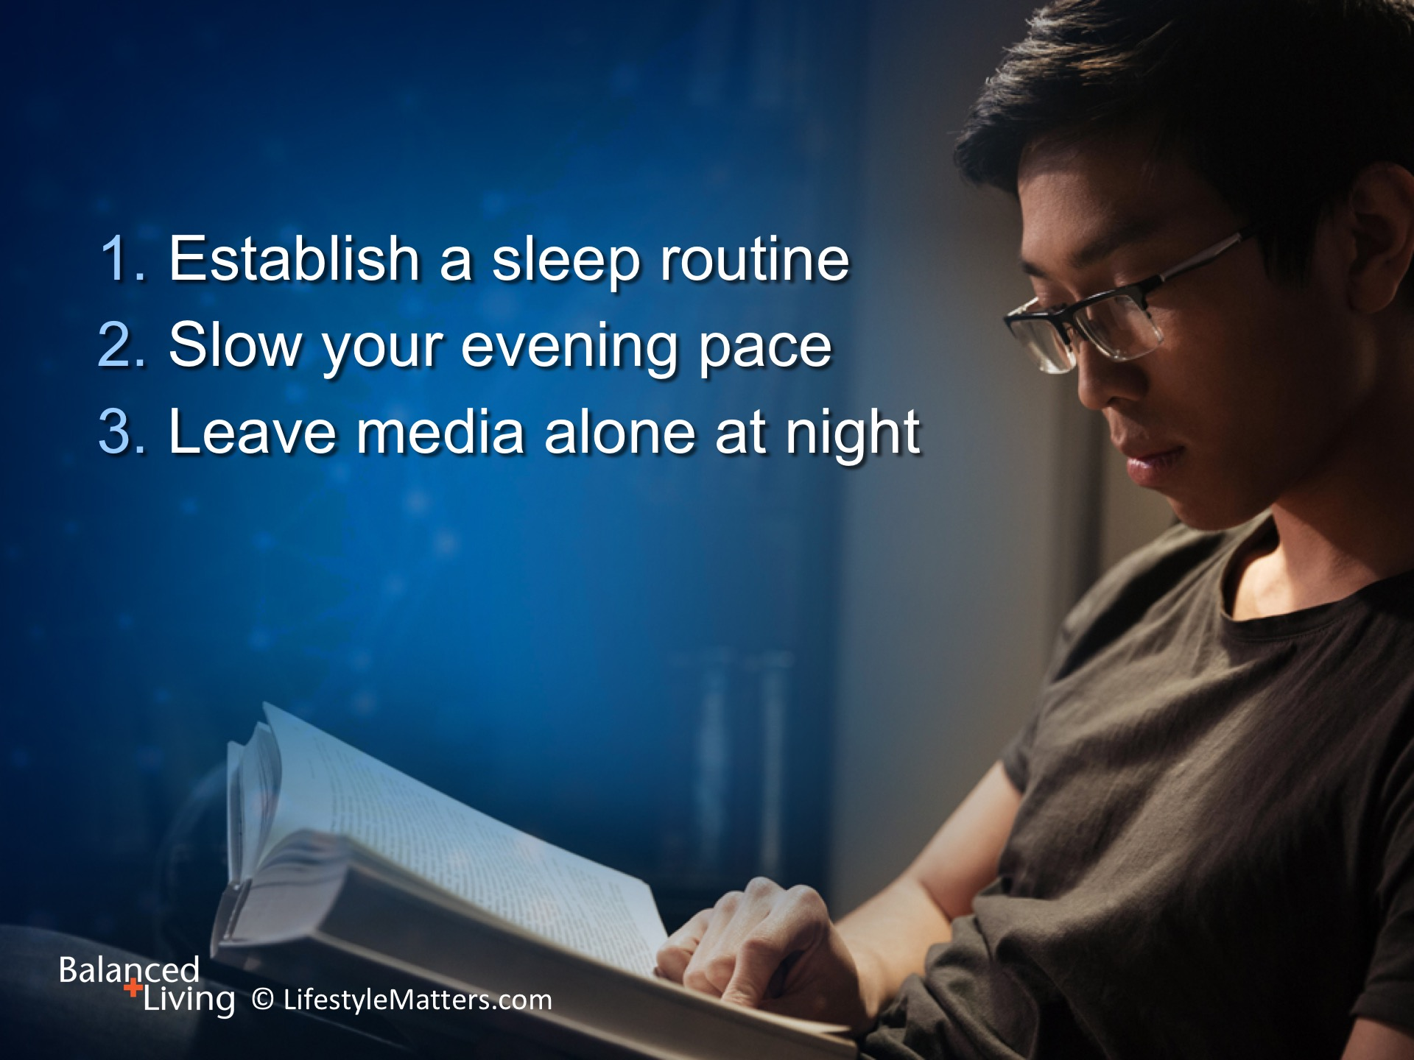
Notes:
Read slide.
What sleep routines do you have that signal your brain and body that it is time to wind down and prepare for sleep? (wait for response)
It could be a warm cup of herbal tea; curling up in your favorite chair with a book; or a relaxing bath or shower.
Probably one of the most challenging disciplines is leaving media alone several hours before bed.
The light emitted wakes the brain and makes it harder to sleep.
Make a new habit to turn off screens before bedtime.
Facetime and emails can wait till tomorrow. You deserve a good nights sleep!

Slide 19
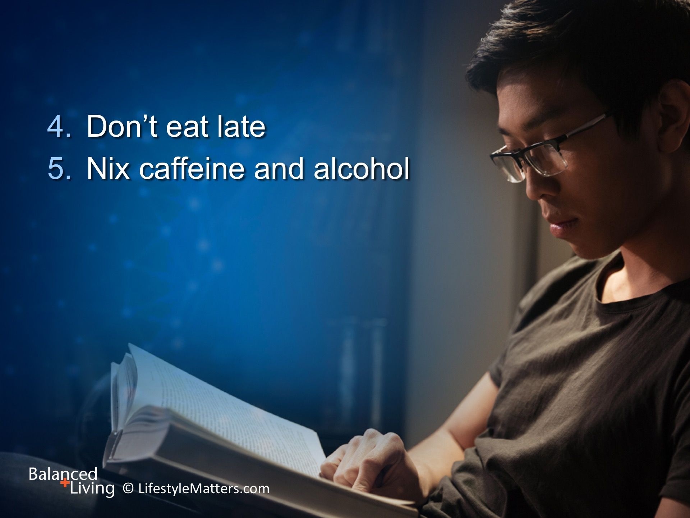
Notes:
Read slide.
Caffeine and eating late at night can stimulate the wake centers of the brain and disrupt deep levels of sleep so important for immune health, memory, and true rest.

Slide 20
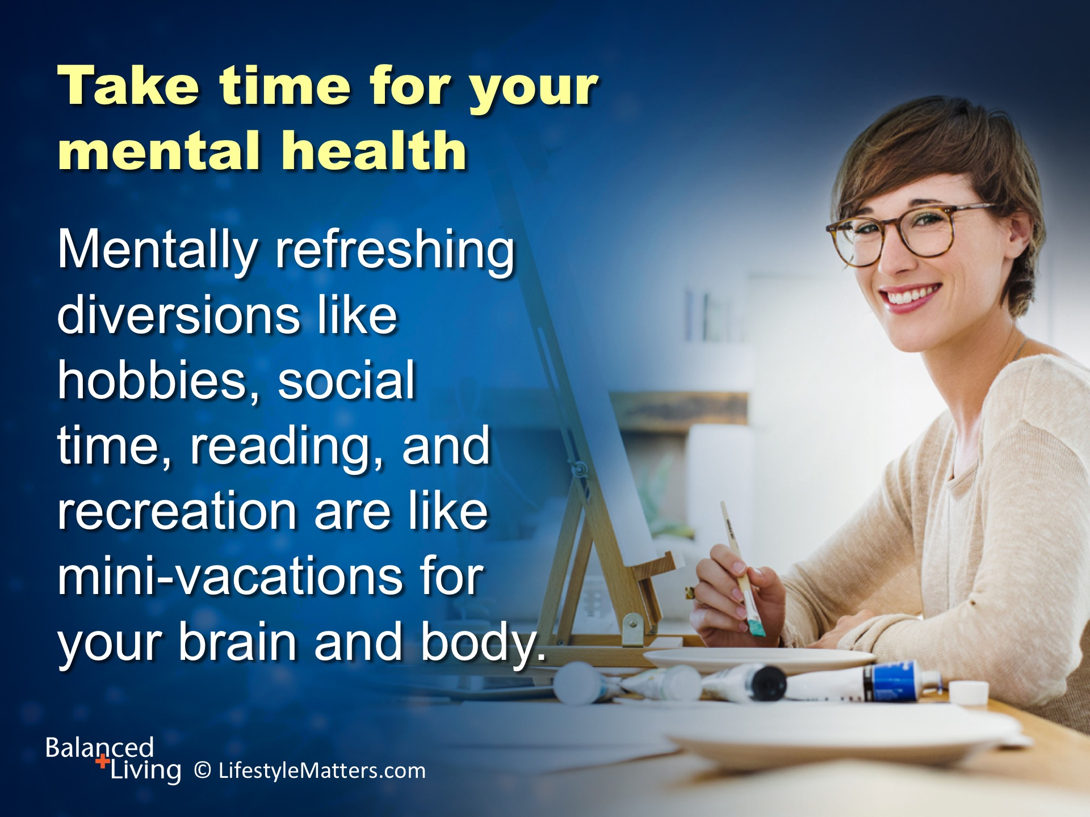
Notes:
Read slide.
Establishing good sleep habits promotes good mental health and so does the refreshing distraction of creative activities.
Switching mental gears to refreshing activities and positive learning experiences even helps reduce chronic pain!
What do you love to do that refreshes your mind and body? (wait for response)
Are you giving yourself permission to have fun with a min-vacation?

Slide 21
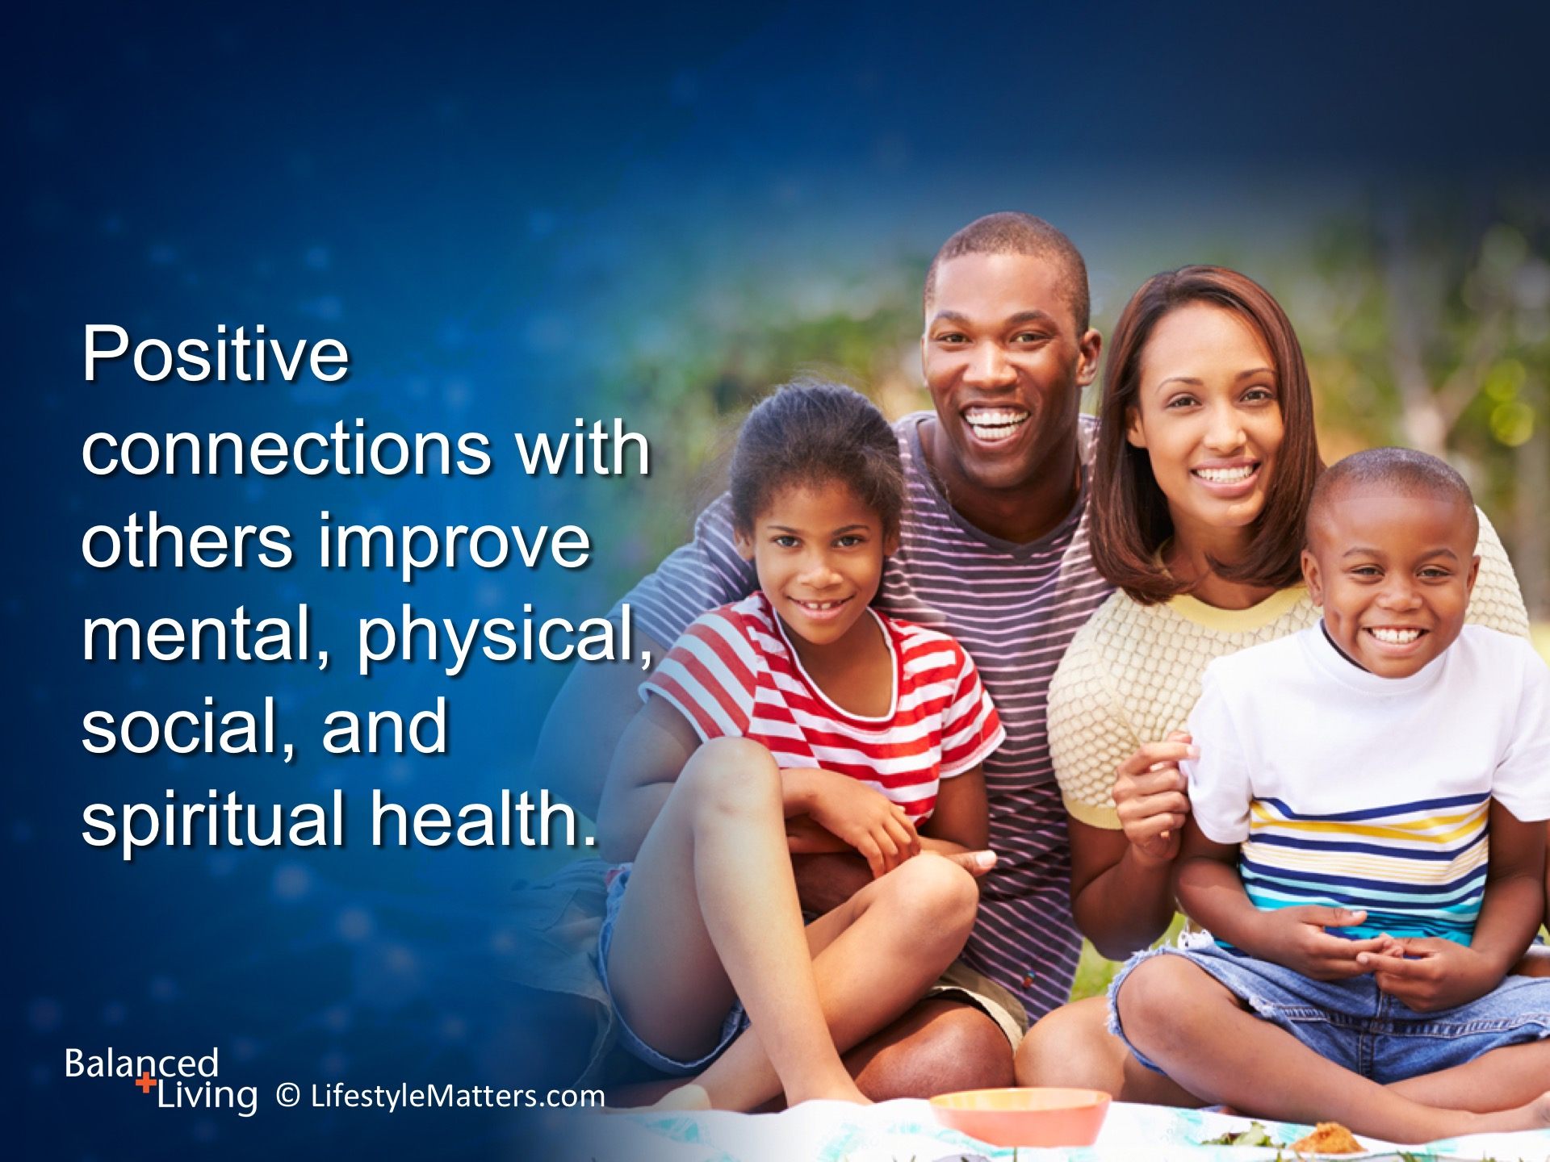
Notes:
Read slide.
Taking time to grow relationships is time well spent.
What do you do to grow positive connections in your life? (wait for response)

Slide 22
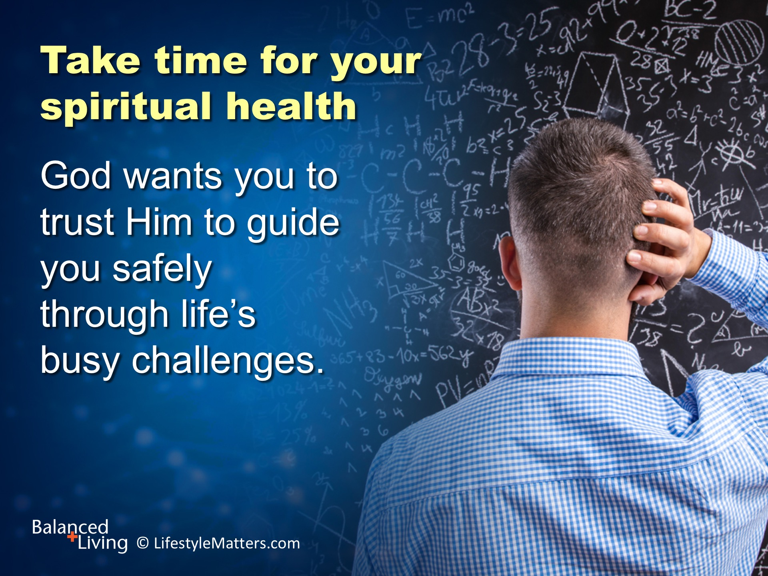
Notes:
Read slide.
He created you and has given principles to help you live the abundant life.
God will give you power to make positive choices in your life.

Slide 23
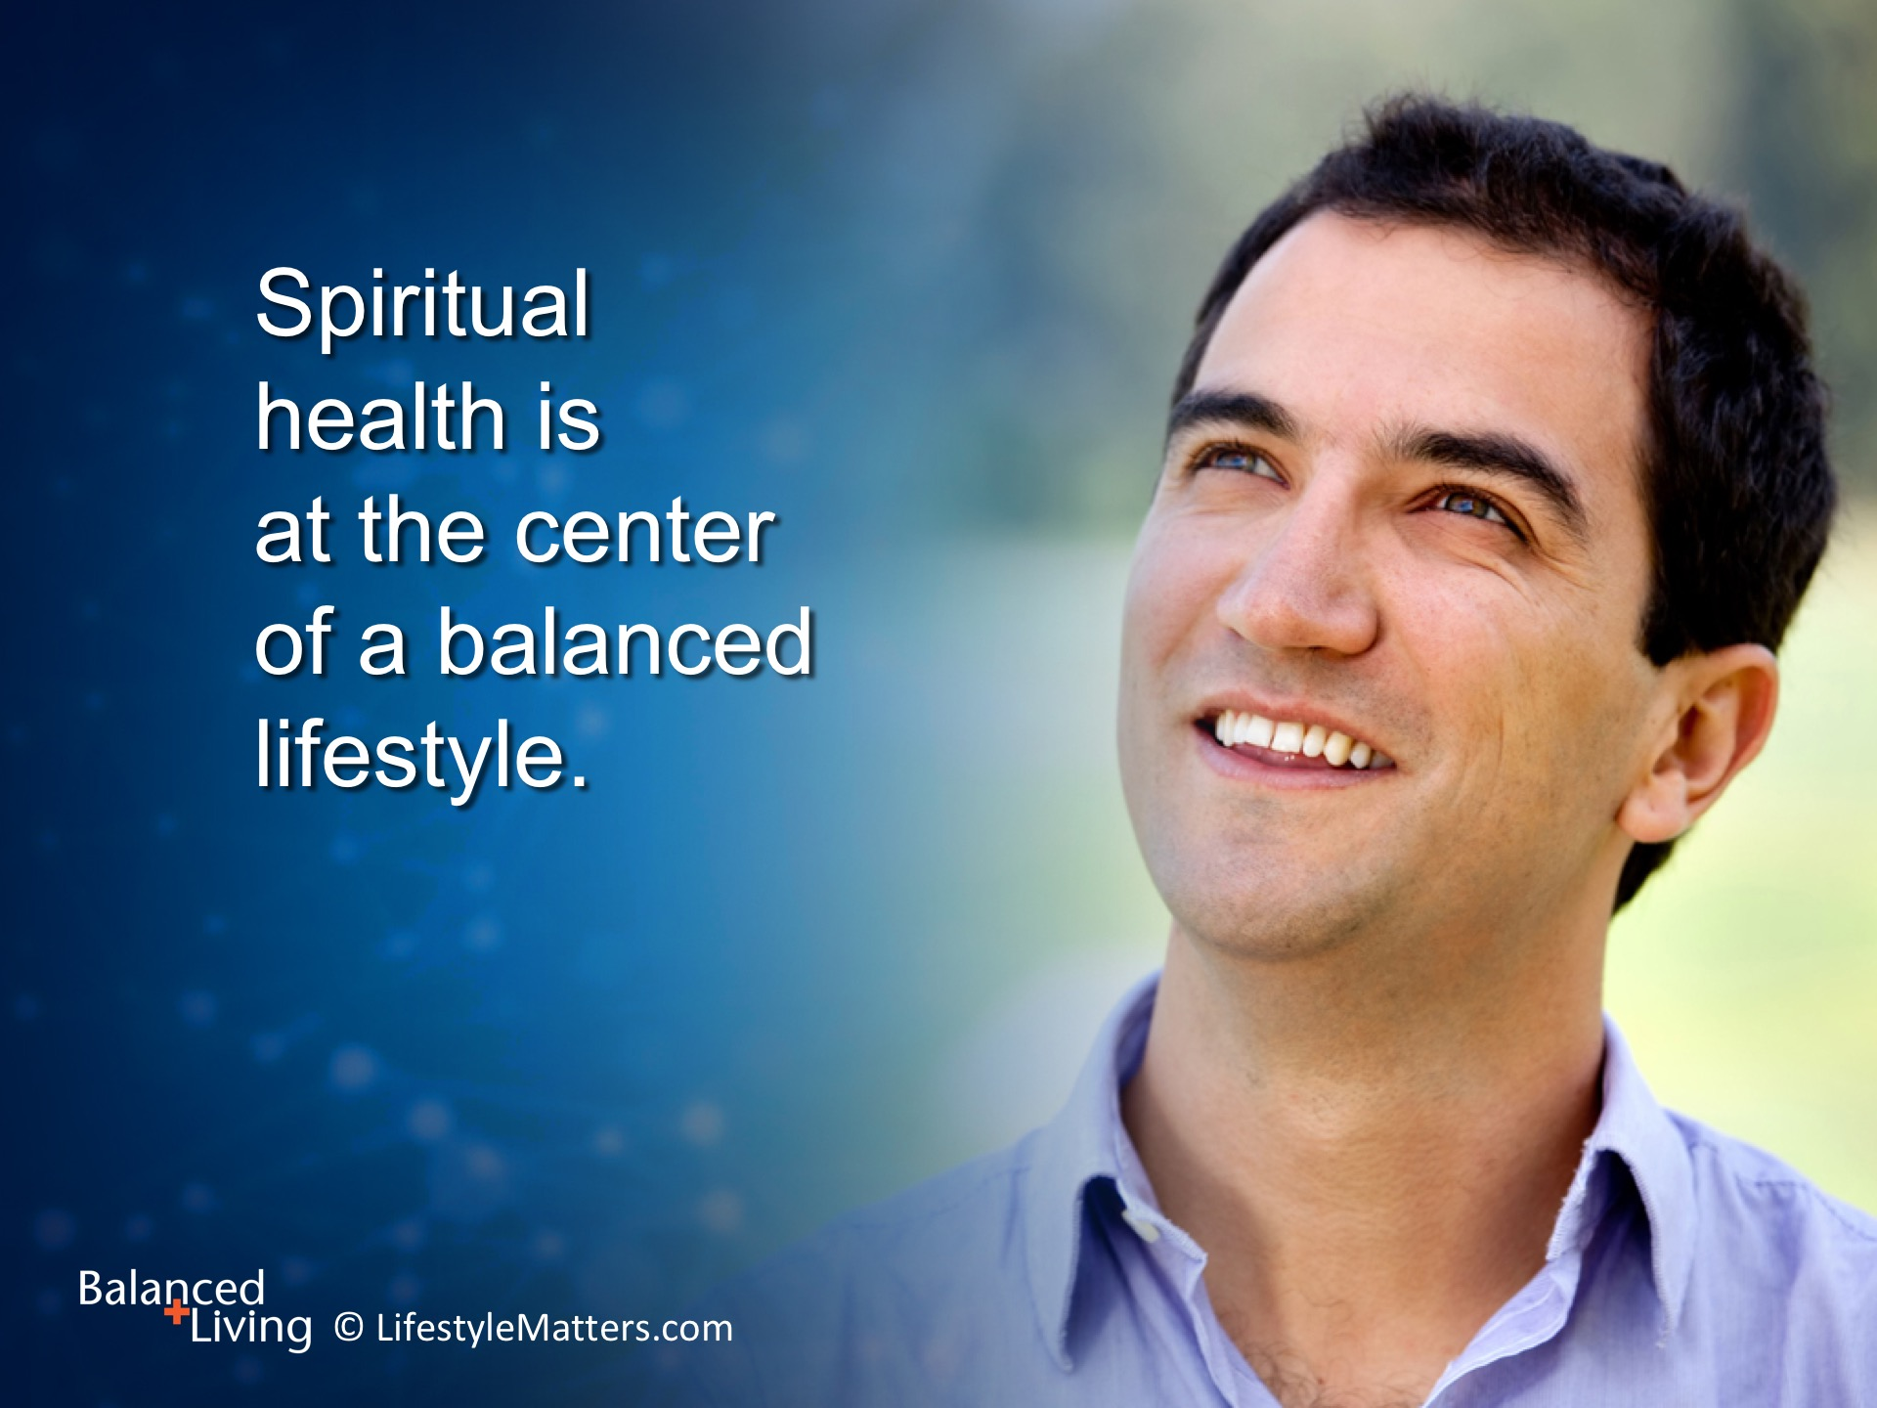
Notes:
Read slide.
Following these health principles can help grow in strength, mental stability, and even joy in the midst of challenges.
God will be your guide to navigate through this life as you commit yourself to Him.
He says: “I will never leave you or forsake you.” Hebrews 13:5

Slide 24
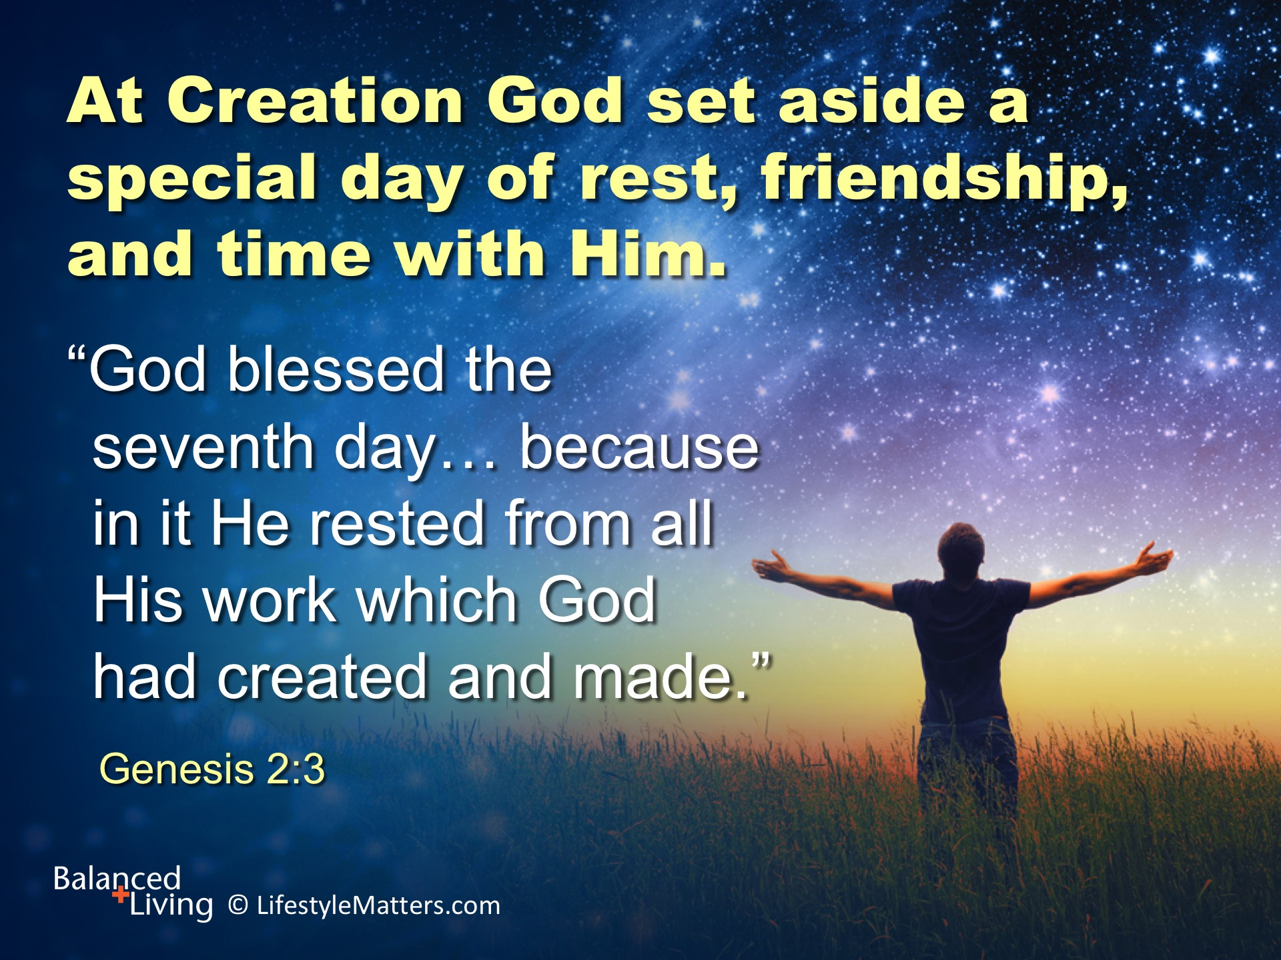
Notes:
Read slide.
God created a special gift for rest and relationships.
On the seventh day of creation God created the Sabbath, a special time set apart for relationships: relationships with others and a relationship with Him.

Slide 25
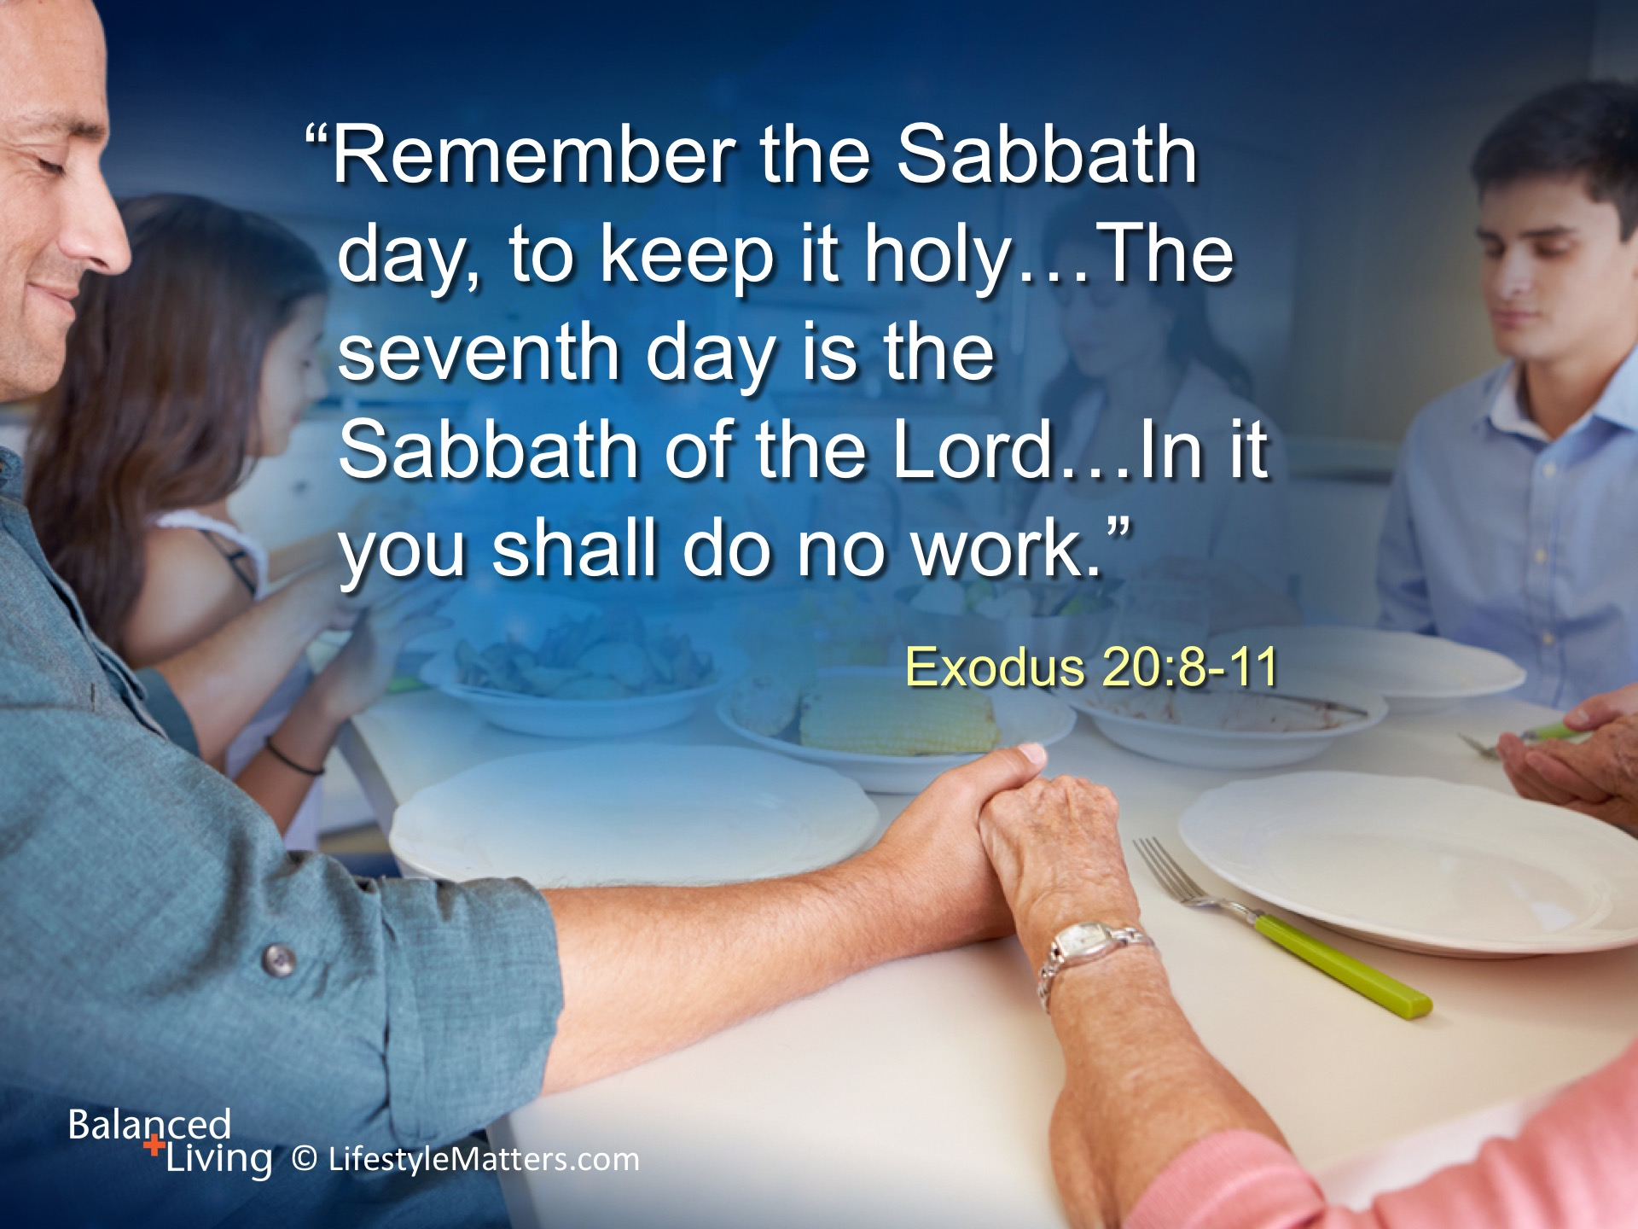
Notes:
Read slide.
What a thought! No intruding thoughts of bills, chores, shopping, working, studying, or worry.
Just rest—and communion with the God who loves you and wants to prepare you for an eternal life of joy that will never end.

Slide 26
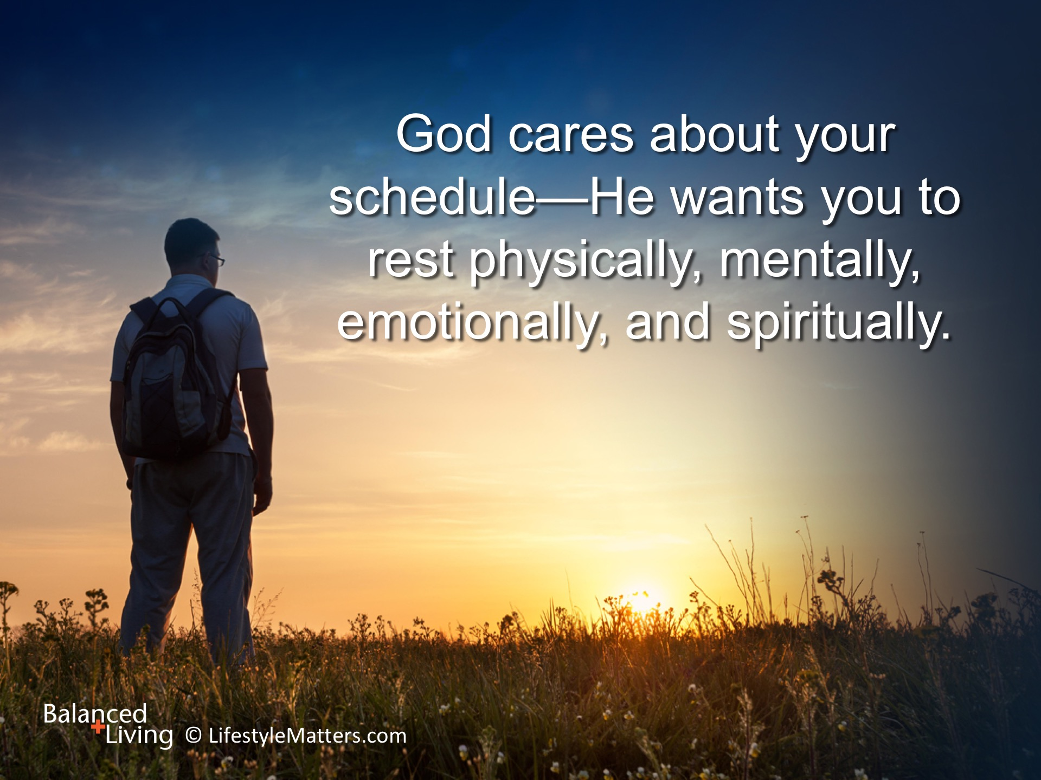
Notes:
Read slide.

Slide 27
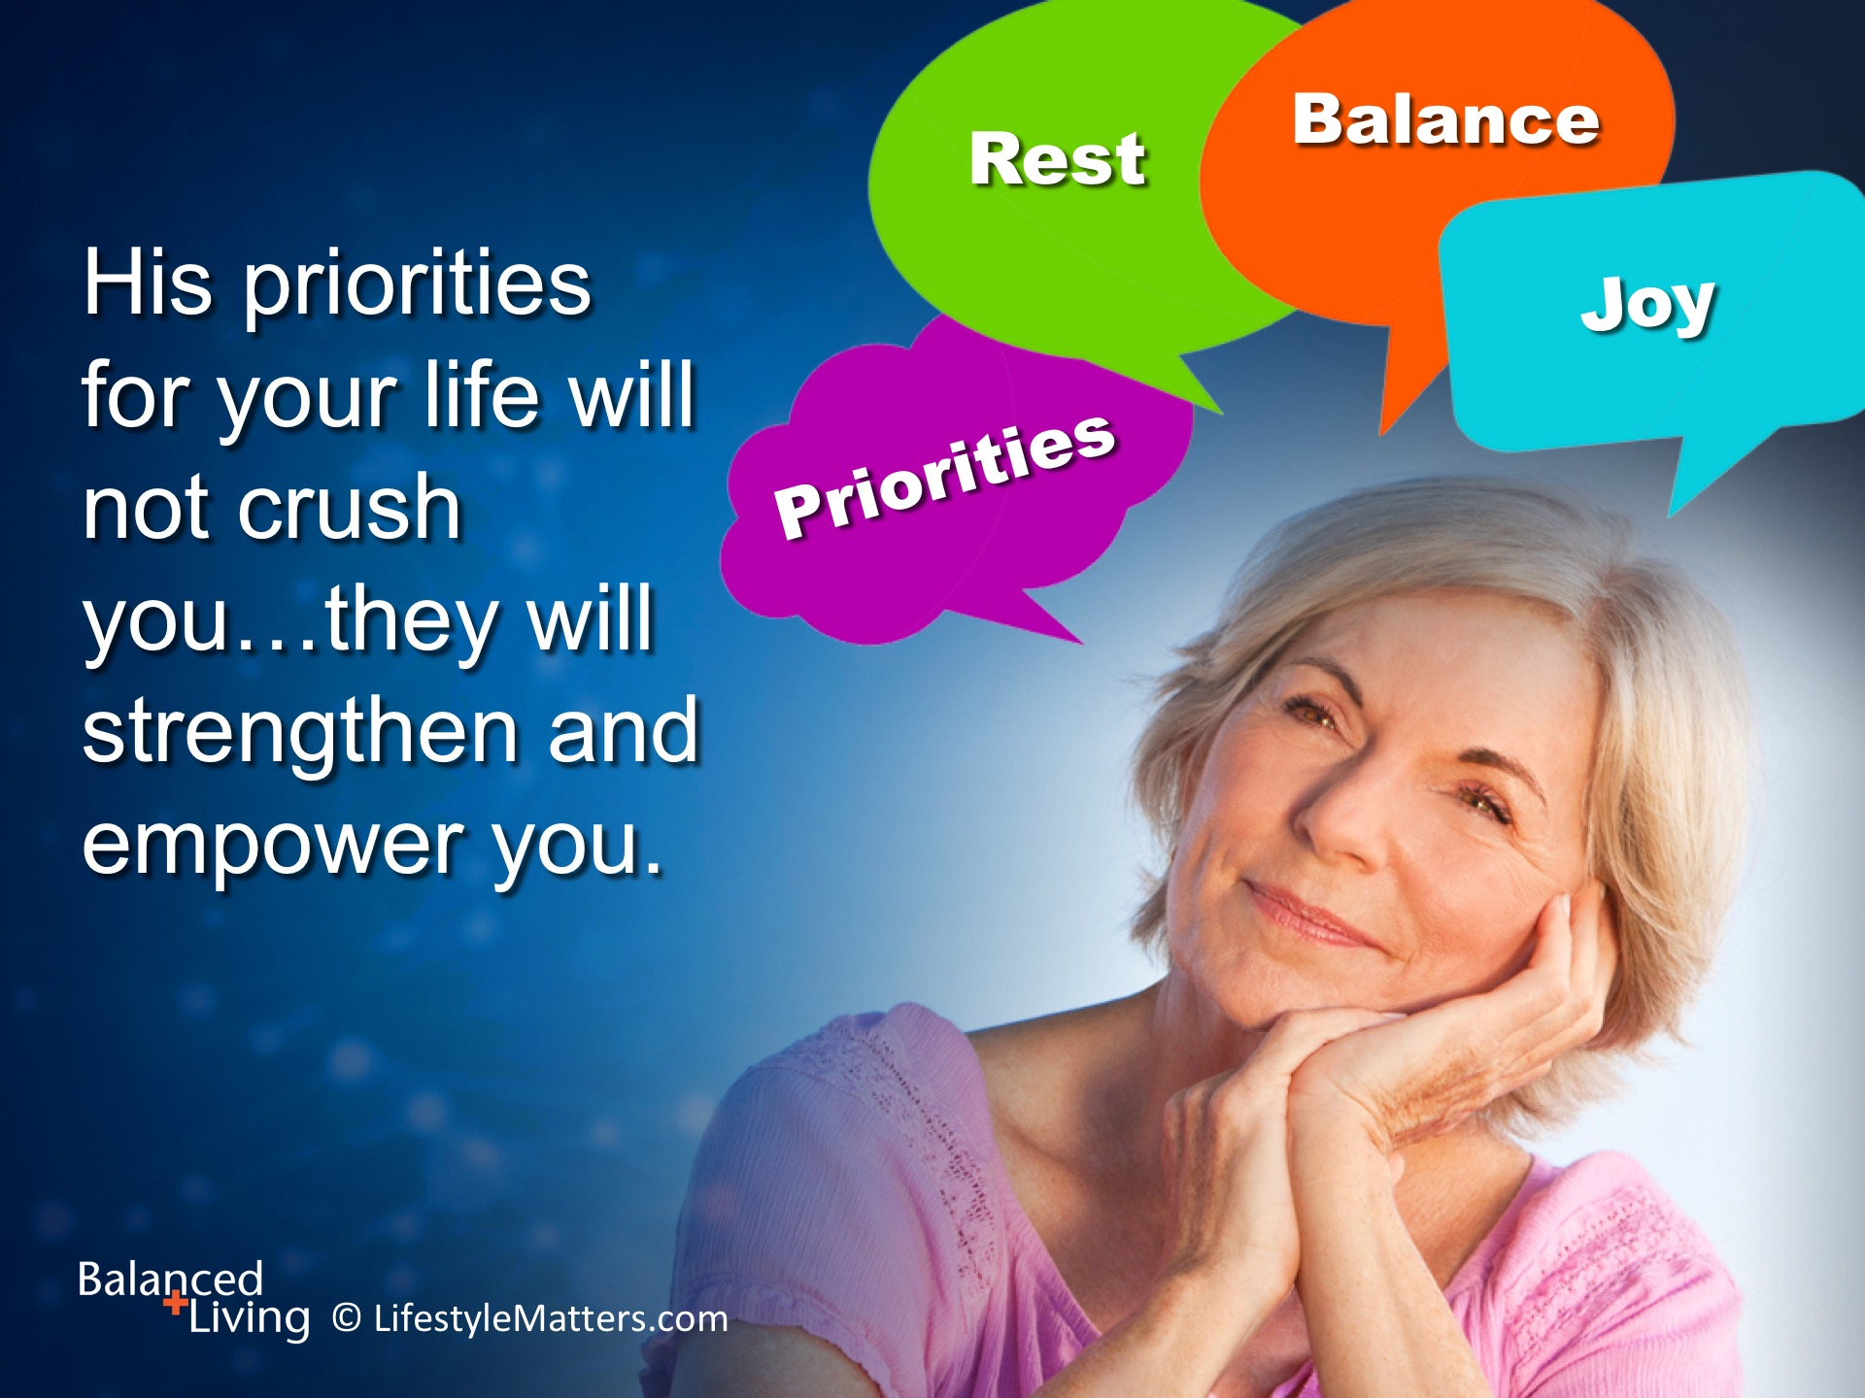
Notes:
Read slide.
You don’t have to be hooked on busy - living the life of hurried, worried, and buried…..
God has power, promises, and a plan.
And you are invited to receive it all!

Slide 28
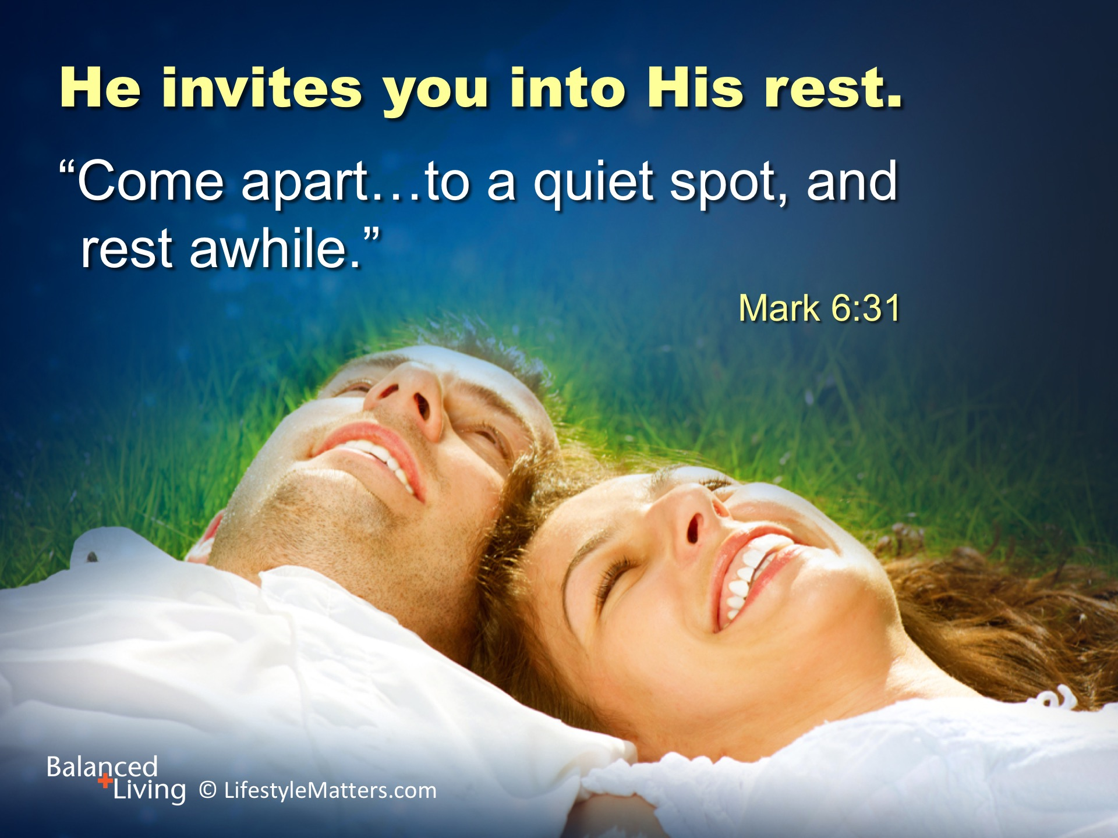
Notes:
Read slide.
Your heart has been stirred by this information and this invitation to rest.
You are invited to give your cares to the One who can help you.
“Casting all your care upon Him; for He cares for you.” 1 Peter 5:7.
Will you accept His invitation just now? (raise hand, wait for response)

